Slide 1



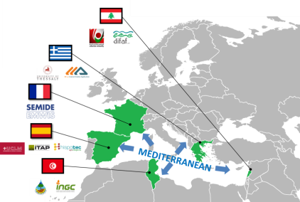






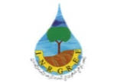




Sustainable Production in water limited environments of Mediterranean agro-ecosystem
SUPROMED
Program: PRIMA Section I
Start date : 01-10-2019
Total budget: 2.030.000 €
Duration: 36 Months
SUPROMED in brief
SUPROMED PARTNERS
SUPROMED provides a holistic crop-livestock water management system resilient to climate change, supported by a web platform specially designed to smartly advise farmers on the efficient water, energy and fertilizer management for Mediterranean systems.
supromed.eu
University of Castille-La Mancha (Spain)
Provincial Agricultural Technical Institute (Spain)
Grupo Hispatec Informatica Empresarial S.A. (Spain)
University of Thessaly (Greece)
3D s.a. General Aviation Application (Greece)
National research Institute of rural engineering, Water and Forests (INRGREF) (Tunisia)
National Institute of Field Crops (Tunisia)
Technical Unit of The Euro-Mediterranean Information System on Know-how in the Water sector (France)
Difaf (Lebanon)
Lebanese University, Faculty of Agronomy (Lebanon)

Slide 2

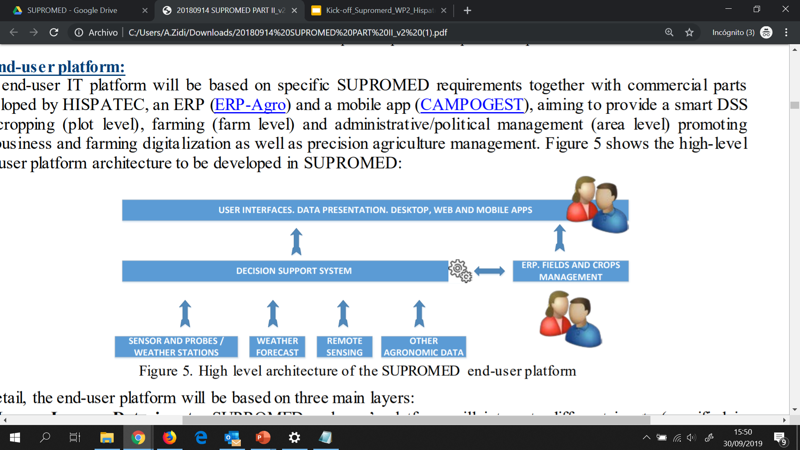
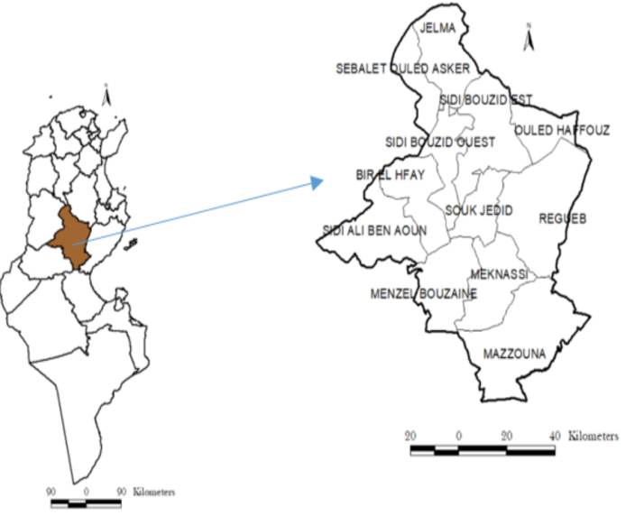
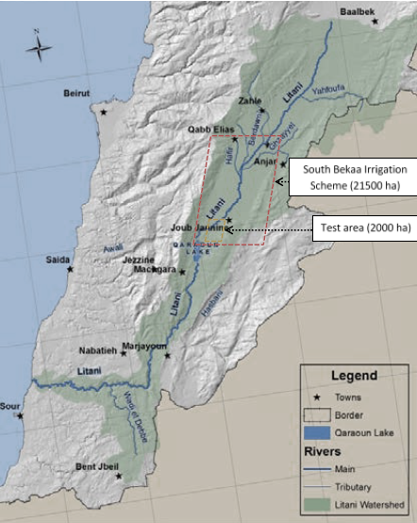
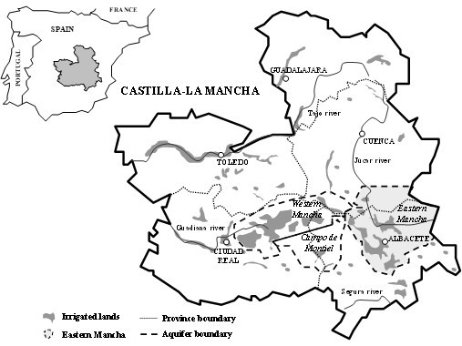
SUPROMED Project objectives
Improve food security by increasing irrigation water productivity
Increase the agricultural income and decrease the impact on the environment by optimizing and reducing the use of inputs
Increase the resilience of agricultural systems to climate change through the development of tools for forecasting and advising against extreme climatic events
Implement advanced methodologies for farm management, promoting the creation of qualified and specialized jobs
Models and tools
SUPROMED integrates a validated set of models and tools in an online platform to increase the production and incomes of farms thanks to a more efficient and reduced use of water, energy and fertilizers, while decreasing the impact on the environment.
Architecture of the SUPROMED end-user platform
Demosites
Tunisia
Sidi-bouzid
Liban
South Bekaa
Spain
Eastern Mancha
Lack of technical assistance
Water stress
Need for an Early Warning System (EWS) for irrigation
Lack of water resources
Groundwater shortage and increasing pumping cost
Low integration of ICT in the agricultural sector
Imbalance between water supply and demand
Poor animal production system
Decrease of agricultural profitability

