Slide 1
Progress midterm report
Francesca Sanna
Project manager
Webinar on progress midterm report with pre-financing
15 December 2021
UNITO

Slide 2
Overview
The main actors in project implementation
Type of reports
Scoring report
Unit cost system
Eligible activities
Budget structure
Eligible staff days
How to report the costs
Supporting documentation to be kept
Reductions
Checks and Audits
What time sheets should contain
Time sheets, practical example

Slide 3
The main actors in project implementation and their roles
Coordinator
✓ Monitors implementation
✓ Intermediary between the Agency and the other beneficiaries, informs about changes
✓ Sole recipient of payments –transfers to other beneficiaries
✓ Always accountable for administrative and financial management (cannot be subcontracted)
Beneficiaries
✓ Co-responsible for project implementation
✓ Inform coordinator of any changes
✓ Internal co-operation agreements with coordinator
✓ Responsible for the financial contribution received
✓ Submit to co-ordinator all necessary reports, information, documents
European Commission – DG EAC/DG EMPL
✓ Policy and programme definition
✓ Dissemination and exploitation of results +impact analysis
The Agency - EACEA
✓ Delegated by the European Commission to manage specific Erasmus+ actions
✓ Responsible for the legal and financial compliance
✓ Monitoring and support
✓ Evaluation of results
✓ Dissemination of results

Slide 4
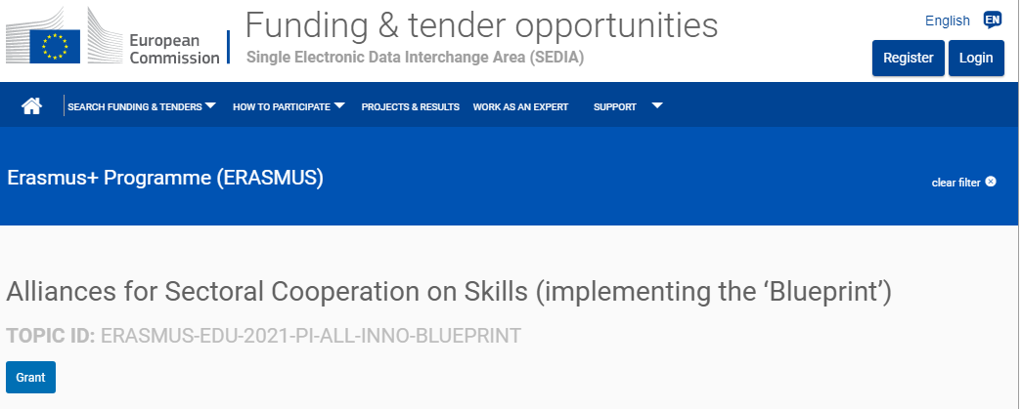
What are the types of reports?
Flash reports (word document)– no pre-financing
Technical progress report (word document) – no pre-financing
Progress midterm report (e-report + annexes) – with pre-financing (40%)
Final report (e-report +annexes) – with balance payment (remaining 20%)
General aspects
Describe project activities, achievements (finished, unfinished)
Declare costs
Provide deliverables and content supporting documents (e.g. minutes, internal assessment, testing)
Provide financial supporting documents only upon request
e-REPORT

Slide 5
What is the purpose of reports and when to submit them
Specificity –Flash report (without pre-financing)
✓Sent to the Agency via e-mail only (3 -4 pages)
✓Covers 3 months period
✓Reviewed by the Agency and relevant DG
✓Structure: Work progress and results, next steps, dissemination and exploitation, challenges
Specificity–Technical progress report (without pre-financing)
✓Covers first year and three years period
✓Deadline: end of first year + 1 month AND end of third year + 1 month
✓Sent to the Agency via e-mail only
✓Declare costs
✓Descriptive part (word) + financial part (excel) + Declaration of honour (word)
✓Provide financial supporting documents only upon request
✓Feedback (within 60 days) → sent to coordinator
✓Discuss feedback and implement with partners

Slide 6
What is the purpose of reports and when to submit them
Specificity – progress report (with pre-financing)
✓ Covers first half of eligibility period
✓ Deadline: end of first half of eligibility period + 2 month
✓ Descriptive part (word) + financial part (excel) + Declaration of honour (word)
✓ Erasmus+ Project Results Platform (update project summary)
✓ Discuss feedback and implement with partners
Specificity –final report (with balance payment)
✓ Covers full eligibility period
✓ Deadline: end of eligibility period + 2 months
✓ Descriptive part (word) + financial part (excel) + Declaration of honour (word)
✓ Erasmus+ Project Results Platform (update project summary, upload results)

Slide 7
What is the structure and scoring of reports?
Feedback (within 60 days) → sent to coordinator
Technical-progress report M13 submitted the 05/02/21
Relevance of the project results 22/25
Quality of the project design and implementation 24/30
Project consortium and cooperation arrangements 21/25
Impact and dissemination 16/20
Global score | 83/100

Slide 8
How does the unit costs system work?
The EU contribution is calculated through:
"𝒅𝒂𝒚𝒔 𝒐𝒇 𝒔𝒕𝒂𝒇𝒇 𝒓𝒆𝒍𝒂𝒕𝒆𝒅 𝒕𝒐 𝒑𝒓𝒐𝒋𝒆𝒄𝒕 𝒊𝒎𝒑𝒍𝒆𝒎𝒆𝒏𝒕𝒂𝒕𝒊𝒐𝒏" 𝑿 "𝒑𝒓𝒆−𝒆𝒔𝒕𝒂𝒃𝒍𝒊𝒔𝒉𝒆𝒅 𝒂𝒎𝒐𝒖𝒏𝒕𝒔"
The resulting EU grant is the EU contribution to cover all activities/costs of the project, whatever their nature:
Activity directly linked: project management, project meetings, intellectual outputs , IT tools, analyses, studies, dissemination, participation in events, conferences, travel, etc.)
Nature: staff; travel and subsistence; subcontracting; equipment; direct and indirect costs
N.B. The unit rate (𝒑𝒓𝒆−𝒆𝒔𝒕𝒂𝒃𝒍𝒊𝒔𝒉𝒆𝒅 𝒂𝒎𝒐𝒖𝒏𝒕𝒔) is a fix contribution related to the working days of the staff and will remain fix for the entire project duration

Slide 9
Eligible activities
Directly connected with the project;
Necessary for the execution of the project;
Reasonable and justified (maximisation of the impact);
Identifiable and verifiable;
Realised/produced during the contractual lifetime of the project;
Described in the work plan (as applied for in the grant application and as approved by the Agency);
NB: Activities not compliant with the rules shall be evaluated as ineligible activities.

Slide 10
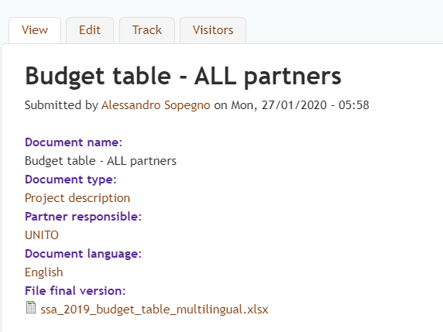
Budget structure
"𝒅𝒂𝒚𝒔 𝒐𝒇 𝒔𝒕𝒂𝒇𝒇 𝒓𝒆𝒍𝒂𝒕𝒆𝒅 𝒕𝒐 𝒑𝒓𝒐𝒋𝒆𝒄𝒕 𝒊𝒎𝒑𝒍𝒆𝒎𝒆𝒏𝒕𝒂𝒕𝒊𝒐𝒏" 𝑿 "𝒑𝒓𝒆−𝒆𝒔𝒕𝒂𝒃𝒍𝒊𝒔𝒉𝒆𝒅 𝒂𝒎𝒐𝒖𝒏𝒕𝒔"
Staff days = lump sum.
Manager
Teacher/Trainer/Researcher
Technician
Administrative
Staff days
http://www.erasmus-fields.eu/management/?q=staff-days
The number of staff days were estimate at the application stage, at the reporting stage you refer to the incurred (real) staff days
Budget table all partners – pre-established amounts
http://www.erasmus-fields.eu/management/?q=node/80
1st_reporting_partner-budget_all
http://www.erasmus-fields.eu/management/?q=node/1668

Slide 11
Eligible staff days for project implementation support
✓ The days of staff incurred (based on timesheets):
This is related to the staff employed (related to permanent, temporary, and interim staff) with an employment contract by the beneficiaries' organisations
Actually realised.
✓ The category of staff involved in the implementation:
The staff category applicable to each person has to be one of the four categories listed in the application form and related to the professional profile and job description of the person implementing the project
NB (non Eligible staff days):
Working staff days of Learners/Trainees, volunteers and persons working through subcontracting cannot be considered as eligible staff days and are not accepted as number of units for the calculation of the grant based on unit costs. Except if these workers are considered as assimilated to staff by national legislation.

Slide 12
How to report the costs
How to report the costs for travel, organization of events, communication etc.?
Only report/claim incurred days of staff incurred
(days of subcontractors are not days of staff)
The EU makes national hourly costs grouped by country and gives a lump sum in terms of staff costs.
Into this lump sum there are all the real costs that the partner made.
For example, the travel expenses are included in the amount of the hourly cost per category of staff employed in the project.

Slide 13
Supporting documentation to be kept
Occurrence of the activities (non-exhaustive list):
Proof of outputs produced: leaflets, brochures, reports, analytical papers, press releases, websites, social media outputs, etc. They should remain available for checks and audits at the premises of the coordinator. (invoices, service contracts can serve as further proof for the activities).
Proof of partnership meetings: agenda indicating time and place, attendance lists signed by the individual participants, individual travel tickets, minutes, reports, etc.
Proof of events/conferences: final programme, invitations, list of invitees/mailing list, list of attendance signed by each participant, material for the conference, outputs of the conference.
project implementation support (non-exhaustive list): employments contracts, salary payslips, timesheets (per person) showing the effective working time spent on the project, extract of official accounting books with reference to staff, presence list to meeting and events where applicable, bank transfers.
NB: Those documents should mention a clear reference to the project or directly ascribable/attributable to the project.

Slide 14
Reductions
Reduction of the final grant in the event of weak implementation or non-compliance with publicity obligations
Article I.10.5 of the Special Conditions of the Grant Agreement:
Reduction of 20% of the amount of the Grant for in case of non-compliance with publicity obligations
Reduction from 25 to 75% of the amount of the Grant in case of poor, late or partial implementation depending on the scoring of the final report
Article 8.3 of the Consortium Agreement:
The Coordinator reserves the right to request, evaluate and validate the documentation (timesheets, employment contracts, eligible costs, etc.) to the Parties, relating to the reference period before proceeding with the transfer of the second pre-financing or final payment and to retain part of the payment in case of non-compliance of the documentation provided.

Slide 15
Checks and Audits
Keep all supporting documents relating to the project no matter which partner incurred the costs. Unjustified activities will not be considered as eligible by the Agency nor by the auditors.
The supporting documents are NOT requested for demonstrating the underlying costs actually incurred.
The Commission and the Agency have the right to ask additional documents and information for the purpose of:
  the periodical re-assessment of data used in the method of determination of the unit cost,
  to exercise its powers of controls, notably for fraud prevention or detection.
Up to 5 years after the final payment.

Slide 16
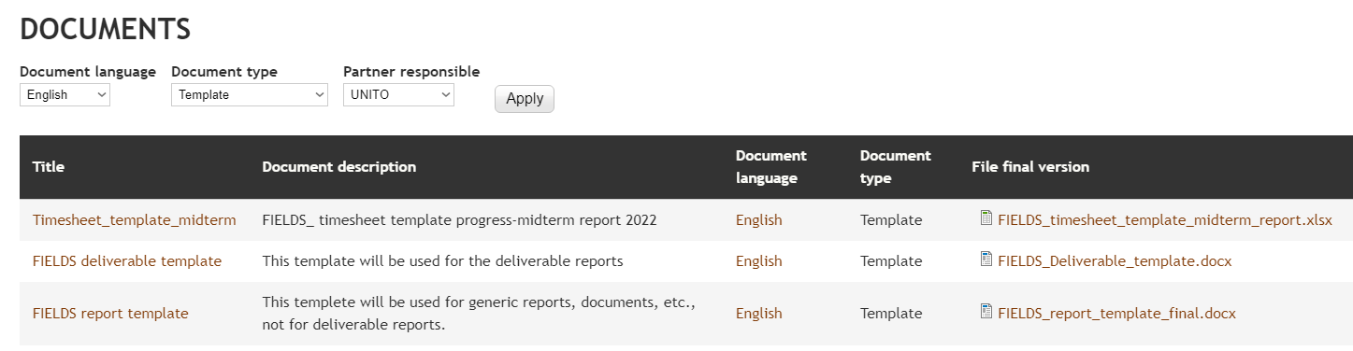
Timesheet
http://www.erasmus-fields.eu/management/?q=node/1667

Slide 17
What time sheets should contain
What to be in
Reference to the project reference number (grant agreement number);
Name of the employee;
The time sheet should allow the Agency to identify precisely the hours worked per day (+ the days worked on the project) and to verify that the actual rate per time unit is applied. Global sheets showing for example "x" hours spent per month are not accepted as supporting documentation;
The number of time units (days or hours but possibly the time unit used in the budget attached to the grant agreement) worked on the project during the period of the time sheet;
Number of time units (days or hours) worked on other grants/activities;
Total number of time units (days or hours) worked;
Details of the tasks performed for the project;
Date and signature of the employee (within 10 days of the following month);
Date and signature of the project manager (within 15 days of the following month, after the employee’s signature).
What should not be
Not retroactively
Not signed
On a year basis

Slide 18
Q&A ?

Slide 19































Thank you for your attention!
Francesca Sanna, UNITO
francesca.sanna@unito.it

