Slide 1

WP1 – Skill needs identification
Luis Mayor, Ana Ramalho, Francesca Sanna, Erika M.R. Somlay, Valentina Chanina, Billy Goodburn, Jacques Trienekens
luis.mayor@iseki-food.net
Project Partner Meeting
30th May 2022

Slide 2
WP1 Skill needs identification (M1-M15)
Objective: establish a general overview of the labor market in the agri-food , forestry and related sectors in order to define present and future skills needs
Task 1.1: State of the art (UNITO) (M1-M6)
Task 1.2: Stakeholders strategic mapping and mobilization (LLL-P) (M1-M6)
Task 1.3: Country and EU focus groups (ISEKI) (M2-M9)
Task 1.4: Bottom-up surveys (ICOS) (M9-M13)
Task 1.5: Future trends analysis (WUR) (M8-M15)
COLLECT INFORMATION TO SUPPORT ACTIVITIES IN WP2
ALL partners contributed to WP1 activities
WP timeline: (January 2020-March 2021)

Slide 3


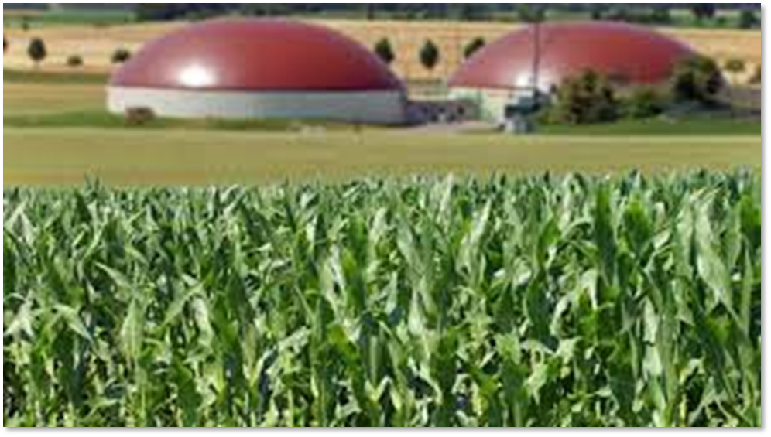
WP1 - Task 1.1 State of the art &
Task 1.2 Stakeholders strategic mapping (M1-M6)
Aims of the tasks: state of the art for the agri-food and forestry sectors
Education/training (curricula and institutions)
EU instruments for skills transferability
Best practices
Projects
Policies and initiatives
Stakeholders mapping
Growth strategy of the sector
SUSTAINABILITY
DIGITALLIZATION
BIOECONOMY

Slide 4
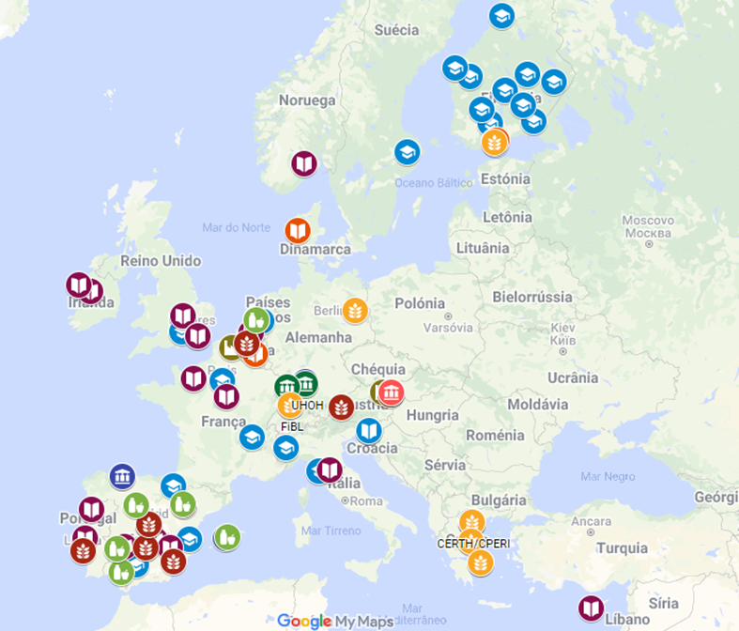

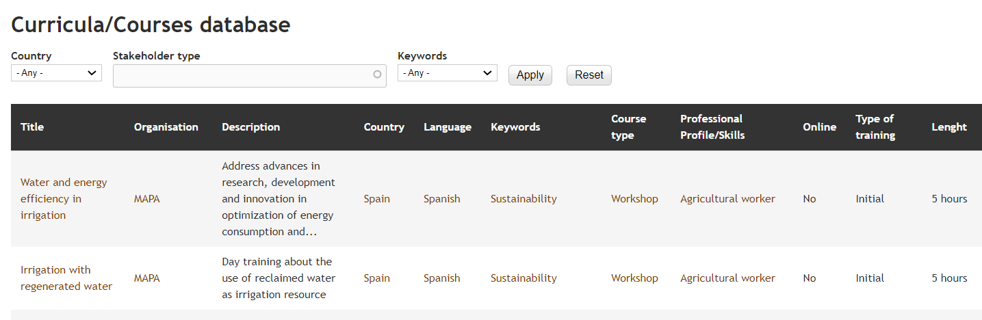
WP1 - Task 1.1 State of the art &
Task 1.2 Stakeholders strategic mapping (M1-M6)
Outcomes: DATABASES
Organisation DB map
Database | Entries
Organisations/stakeholders (Universities, VET providers, Research Institutes, Cooperatives, Other) | 210
Curricula/courses | 156
Best practices | 16
Projects | 35
Policy and advocacy | 24
Regulatory frameworks (Task 5.1) | 152
Funding oportunities (Task 5.2) | 122
http://www.erasmus-fields.eu/management/?q=node/871
D 1.2

Slide 5
WP1 - Task 1.1 State of the art &
Task 1.2 Stakeholders strategic mapping (M1-M6)
Outcomes: REPORTS
Stakeholders strategic plans and analysis report (D1.1)
Trends and policies on sustainability, digitalization anb bioeconomy
European frameworks in Vocational Education and training (EQF, EQAVET, ECVET, ESCO): key aspects for developing FIELDS occupational profiles and training
VET list and classification (D1.3)
Classification of project target groups and how to reach them

Slide 6
WP1 Skill needs identification (M1-M15)
Task 1.1: State of the art (UNITO) (M1-M6)
Task 1.2: Stakeholders strategic mapping and mobilization (LLL-P) (M1-M6)
Task 1.3: Country and EU focus groups (ISEKI) (M2-M9)
Task 1.4: Bottom-up surveys (ICOS) (M9-M13)
Task 1.5: Future trends analysis (WUR) (M8-M15)

Slide 7

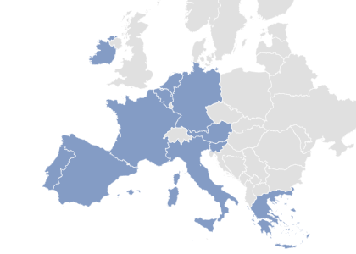
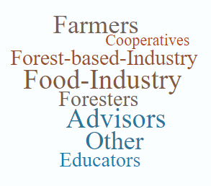

WP1 - Task 1.3 Country and EU focus groups (M2-M9)
Gather information about:
Skill needs in the agri-food and forestry sectors
Sustainability, digitalization, bio-economy and soft skills.
Existing and missing training
Target groups
Training methods
FG guidelines (D 1.4)
May-July 2020
9 national FG (86)
1 EU-FG forestry sector (14)
1 EU-FG policy (13)
TOT 113 participants
→ ONLINE

Slide 8
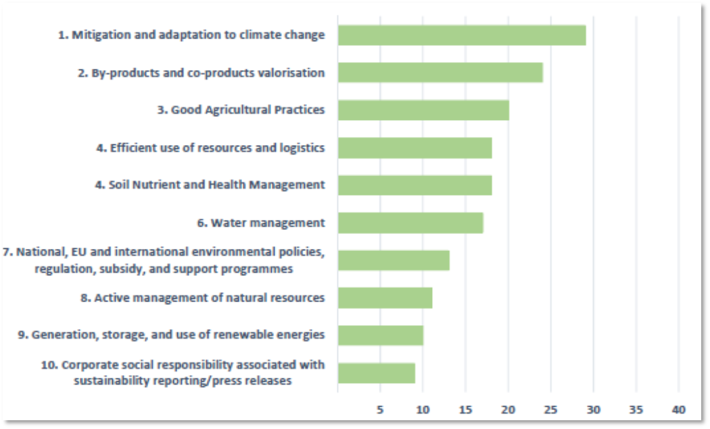
Tasks 1.3 Country and EU Focus Groups
Example of results: most important skills (10-ranking exercise)
Most important skills (farmers)
Nº times the skill was selected in the 10-ranking exercise
Most important skills (sustainability)
Nº times the skill was selected in the 10-ranking exercise

Slide 9

Tasks 1.3 Country and EU Focus Groups
Example of results: final recommendations of the policy FG
Actions to carry out with the support of European and National policies
Homologation and recognition of skills and experience
Holistic approach for coherence of the skills and training provided at EU level
Bigger alliances to support the agri-food and forestry sectors
Evidence-based approach to provide guidelines to policy makers
Social Dialogue in order to set the basis for the needed training and skills
Increase the attractiveness of the sector for the younger generation

Slide 10
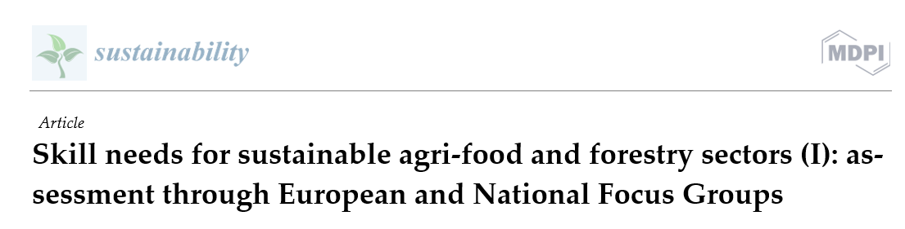
Tasks 1.3 Country and EU Focus Groups
Where to find the results of the task?
Deliverable 1.5
Core document: analysis at European level
Anexes: analysis at country level
How results were used?
Support task 1.4 in the preparation of the survey
Refine scenarios in task 1.5
Support tasks 2.1 (Skill gaps and new profiles) and task 2.2. (profiles prioritization)
Outcomes disseminated in events
In preparation!!!

Slide 11
WP1 Skill needs identification (M1-M15)
Task 1.1: State of the art (UNITO) (M1-M6)
Task 1.2: Stakeholders strategic mapping and mobilization (LLL-P) (M1-M6)
Task 1.3: Country and EU focus groups (ISEKI) (M2-M9)
Task 1.4: Bottom-up surveys (ICOS) (M9-M13)
Task 1.5: Future trends analysis (WUR) (M8-M15)

Slide 12

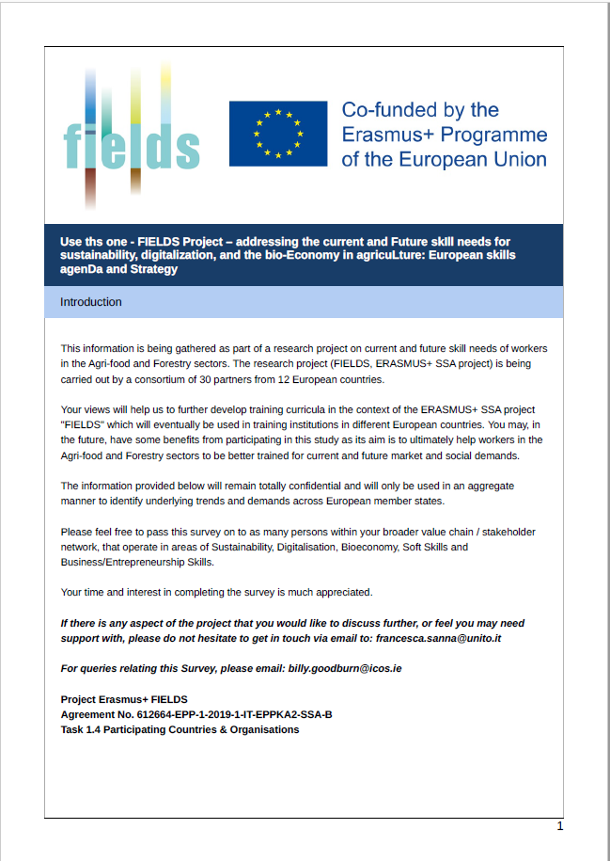
T1.4 Bottom-up Survey (M9-M13)
  Focus Groups outcomes (T1.3)
AIM:
  To assess SKILLS NEEDS and SKILLS GAPS,
  To assess TRAINING NEEDS and TRAINING RECOGNITION
  BUSINESS INSIGHTS
Areas of interest
Sustainability | Digitalisation | Bioeconomy | Soft skills | Business-entrepreneurship
Analysis:
517 respondents from across
23 countries within the European Union
EU level
By Country
By Sector

Slide 13

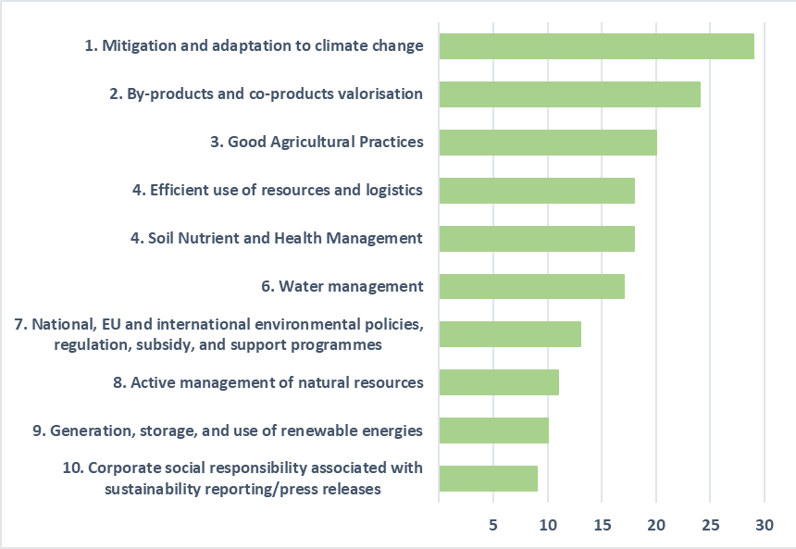
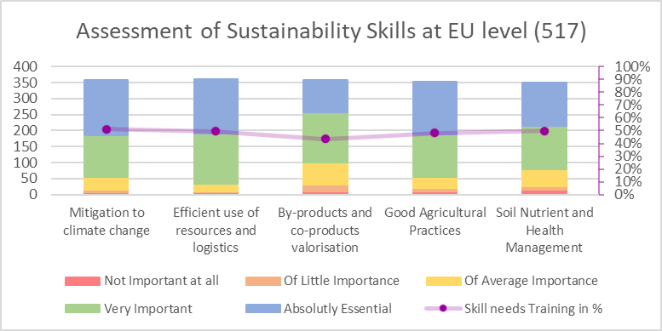
T1.4 Bottom-up Survey examples of outcomes SKILL NEEDS
Sustainability
  FG outcomes (T1.3)
  TOP 5 skills
  Survey (T1.4)
Skills important for FG participants were also important for survey respondents
On average 50% of respondents found these skills needed training

Slide 14
T1.4 Bottom-up Survey – examples of outcomes TRAINING
than to have TRAINING RECOGNITION
More importante to have THE SKILLS TO PERFORM
Employee
Employer
Employee
Employer
FORMAL TRAINING
YES
Formal training more suitable to cover training needs than Non-formal training
Significant differences among countries
NO
DON’T KNOW
NON-FORMAL TRAINING
YES
NO
DON’T KNOW

Slide 15
T1.4 Bottom-up Survey – examples of outcomes : business insights
Business Operating Models
Strategic Business Model Focus Areas
B2B
B2C
Other
n respondents
n respondents
Business Strategy Skills
Business Analytical Tools
%

Slide 16
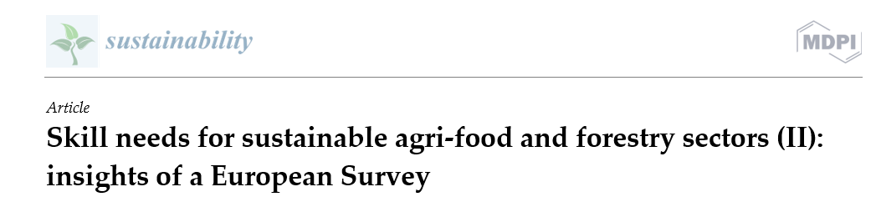
T1.4 Bottom-up Survey
Where to find the results of the task?
Core document: analysis at European level
Anexes: analysis at country level and sector
D 1.7
How results were used?
Refine scenarios in task 1.5
Support tasks 2.1 (Skill gaps and new profiles) and task 2.2. (profiles prioritization)
Outcomes disseminated in events
In preparation!

Slide 17
WP1 Skill needs identification (M1-M15)
Task 1.1: State of the art (UNITO) (M1-M6)
Task 1.2: Stakeholders strategic mapping and mobilization (LLL-P) (M1-M6)
Task 1.3: Country and EU focus groups (ISEKI) (M2-M9)
Task 1.4: Bottom-up surveys (ICOS) (M9-M13)
Task 1.5: Future trends analysis (WUR) (M8-M15)

Slide 18
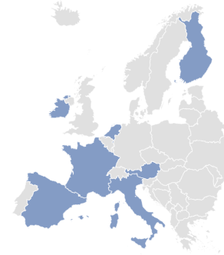
Tasks 1.5 Future trends analysis (M8-M15)
Aim:
To develop scenarios for agriculture, food industry and forestry sectors, to help guiding Vocational Education and Training development
Specified for sustainable production, bio-economy, digitalisation, business models
Steps:
Identification of trends in agriculture, food industry and forestry*
Scenario development (3 scenarios)*
*European and Country level (7)

Slide 19
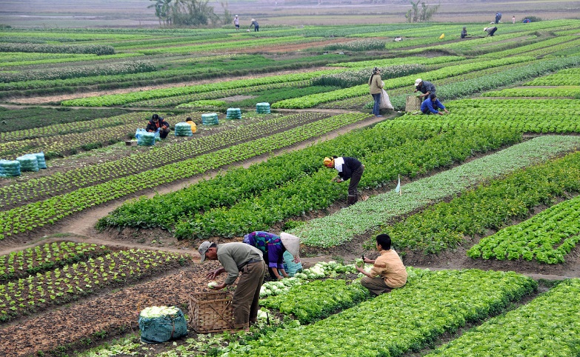
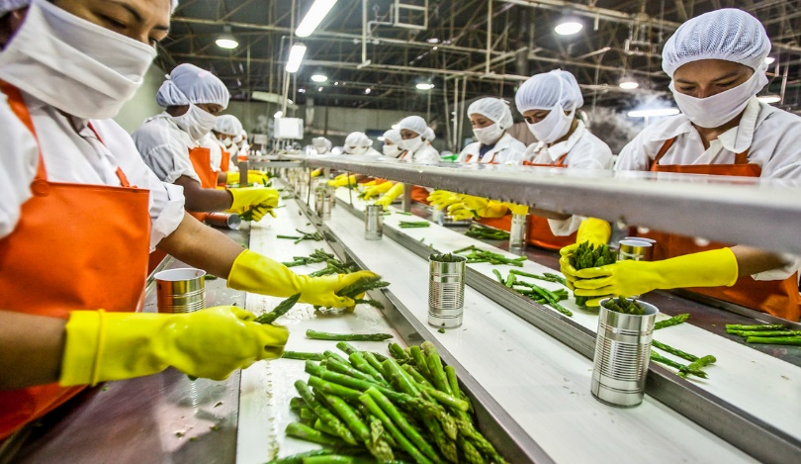
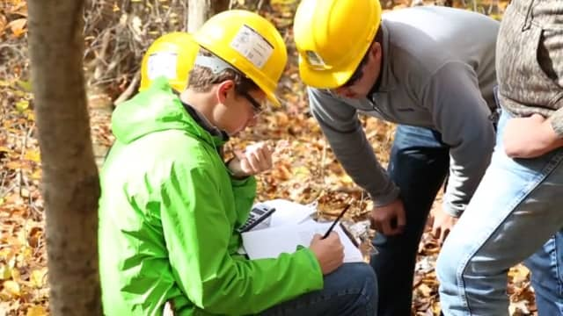
Tasks 1.5 Future trends analysis
Trends in agriculture, the food industry and Forestry
Agriculture
(S) ecological production
(S) GHG emissions
(BM) changes in farm structure
(BM) short food supply chains
(D) precision farming
(D) SC information systems
(BE) food waste-loss, biomass production
(BE) biodiversity and eco-system conservation
Food industry
(S) energy efficiency, env. footprint
(S) food waste and loss
(BM) new proteins, dietary shifts
(BM) packaging and ‘’green’’ labels
(D) food supply chain monitoring
(D) industry 4.0 (robotics, 3D printing, etc.)
(BE) co- and by products and circular production
(BE) biomass transformation
Forestry
(S) biodiversity and conservation of eco-systems
(S)scarcity of natural resources
(BM) short supply chains
(BM) value chain integration
(D) digitalisation forestry (IoT etc.)
(D) forest management information systems
(BE) biomass production and transformation
(BE) forest eco-system services

Slide 20

Tasks 1.5 Future trends analysis
Scenarios
Three scenarios were defined:
  “Established Paths” scenario: represents furthering on historical socio-economic patterns
  “Sustainable Paths” scenario: reflects environmental awareness, an active public sector, inclusiveness (Globally)
  “High-Tech” scenario: reflects faith in technology, strong role private sector, globalisation and free-trade
The description of each scenario was done by using the trends as elements of the narratives.

Slide 21


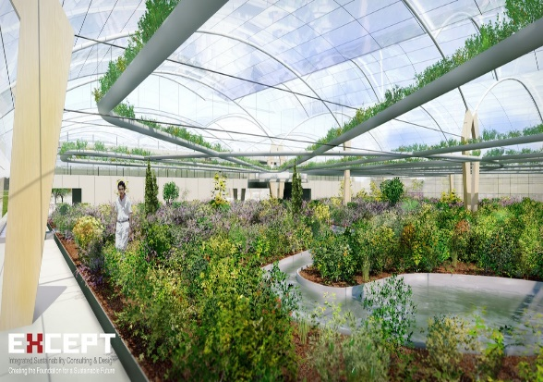
Tasks 1.5 Future trends analysis
Scenarios for sustainability and bioeconomy: key trends
Scenario Sustainable Paths
Scenario EstablishedPaths
Scenario High Tech Paths
Sustainability
>consumer focus on cost, taste, convenience
>Intensive agricultural production
>focus on resource efficiency
Sustainability
>healthy personalised diets
>technology intensive large scale production (agriculture, food industry and forestry)
Sustainability
>focus plant-based consumption
>diversified cropping systems (sme)
>agroforestry and ecosystem services
Bioeconomy
>fossil fuel based energy markets
>biomass supply by forests
Bioeconomy
>high tech circular production systems
>technology driven biobased industries
Bioeconomy
>decarbonised energy markets
>increasing wood consumption

Slide 22
Tasks 1.5 Future trends analysis
Scenario Sustainable Paths
Scenario Sustainable paths: skill needs on sustainability
Netherlands | Ireland | Finland | Austria | France | Spain | Italy
-Minerals and emissions accounting - Improved agrifood system productivity -Renewable energy -Multifunctional forests/eco-system services -Sustainable packaging | -Mitigation/ adaptation to climate change -By/co products valorisation -Good Agricultural Practices. -Soil Nutrient and Health Management | -Soil nutrient and health management -By/co products valorisation -Organic production -Mitigation/ adaption climate change -Multifunct. Forests /eco-system serv. | -Biodiversity -By/co-products valorisation -Generation renewable energy -Soil nutrient and health management -Protective role of forests | -By/co products valorisation (circularity) - Sustainable packaging -Organic farming - Agricultural biodiversity -Animal care and welfare | -Water management -Organic farming -Agricultural biodiversity -Animal care and welfare -Biofertilizers, compost, bio digestates | -Mitigation/ adap-tation to climate change -Improved agrifood system productivity -Identification of renewable energy systems -Water managem. -Soil Nutrient and Health Management

Slide 23
Tasks 1.5 Future trends analysis (M8-M15)
Where to find the results of the task?
Deliverable 1.8
Trends and scenarios at EU level
Trends and scenarios at national level
Skill needs (related to the scenarios) at national level

Slide 24
WP1 final remarks
Objectives achieved:
- State of the art established
- Skill needs identified (Focus Groups, Survey, Trend- Scenario Analysis)
Potential use of WP1 databases: training design, dissemination contacts…
Results from focus groups, survey and scenarios at EU level have been used in WP2
Results of these activities at national level can also be used (e.g. national roadmaps, training)
WP1 outcomes at EU level have been used for project dissemination (events, scientific articles)
WP1 outcomes at national level have a great potential for project dissemination in the respective countries.

Slide 25






























Thank you for your attention!
Luis Mayor, ISEKI-Food Association
luis.mayor@iseki-food.net

