Slide 1


FIELDS
WP1 - Task 1.1 State of the Art
Francesca Sanna, Project Manager
Francesca.sanna@unito.it
4th Virtual Project Monitoring Meeting
17 March 2021

Slide 2
WP1 – State of the art (ISEKI)
Task 1.1: State of the Art (UNITO), M1-M6
Francesca Sanna (UNITO)
D1.1 Stakeholders strategic plans and analysis report, M1 – M6
D1.2 Repository of previous projects, results and best practices, M1 – M6

Slide 3
Task 1.1 State of the Art (UNITO), M1 – M6
D1.1 Stakeholders strategic plans and analysis report, M1 – M6
The growth strategy of the sector has been summarized through the available material and directives from the EU, producers associations and industries, in a comprehensive report by UNITO, UHOH, CONFAGRI and WUR
Literature research
15 contribution received from the partners
Meetings to define the firsts steps on the growth strategy of the sector and revised to discuss on the contribution received
D1.1 finalized, sent to the HSC and submitted

Slide 4
Task 1.1 State of the Art (UNITO), M1 – M6
D1.1 Stakeholders strategic plans and analysis report (UNITO)
The report is divided in three main sectors (sustainability, digitalisation and bioeconomy) plus a paragraph dedicated to the European Frameworks in Vocational Education and Training (VET)
Each sector has three main sub-chapters:
Description
Trends (with a focus on the European projects)
EU policies
Annex I: European and national projects (33)

Slide 5

Task 1.1 State of the Art (UNITO), M1 – M6
D1.2 Repository of previous projects, results and best practices, M1 – M6
UNITO created online databases, by means of the open source platform Drupal, storing all relevant researches. The database was created in the FIELDS project management platform and it is also available through the project’s public website.
It will be kept updated during the project lifetime
and maintained afterwards.
The databases will be further used in Task 4.3 and Task 5.2 and integrated with a geographical map as an additional layer on the website.
UNITO lead the set-up of the database, in conjunction with EfVET and LLL-P.
All partners participated and provided information related to their domain, included EU funded projects, regional pilot projects and best practices carried in the sector.
Notes:
UNITO lead the set-up of the database, in conjunction with EfVET and LLL-P.
All partners participated and provided information related to their domain, in a form of curricula available, best practices and projects, included EU funded projects, regional pilot projects and best practices carried in the sector as well as concrete examples of policies and initiatives at the national levels.

Slide 6
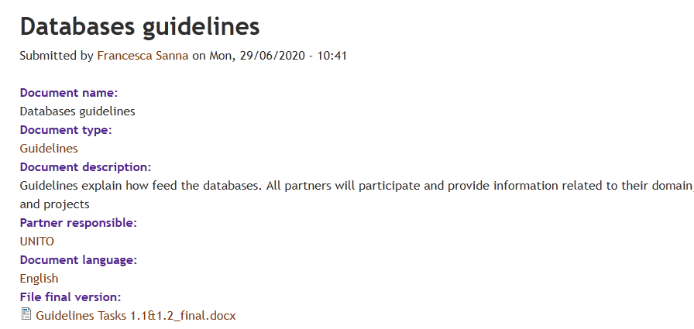
Task 1.1 State of the Art (UNITO), M1 – M6
D1.2 Repository of previous projects, results and best practices, M1 – M6
Database feature: avoid duplication, system does not save the same records previously inserted
More info in the guidelines available in the management portal
http://www.erasmus-fields.eu/management/?q=node/1191
A target of 30 institutes to populate the platform is set for year one and a target of minimum 120 is set until the end of the project.
  Type of Deliverable: Technological/Service outputs.
D1.2 finalized and submitted the 30/06/2020
Notes:
Type of Deliverable: Technological/Service outputs: refer to virtual platform/services developed and provided to target beneficiaries in the context of the Fields project. It will be validated based on the document drafted to describe the features of the technological output.

Slide 7
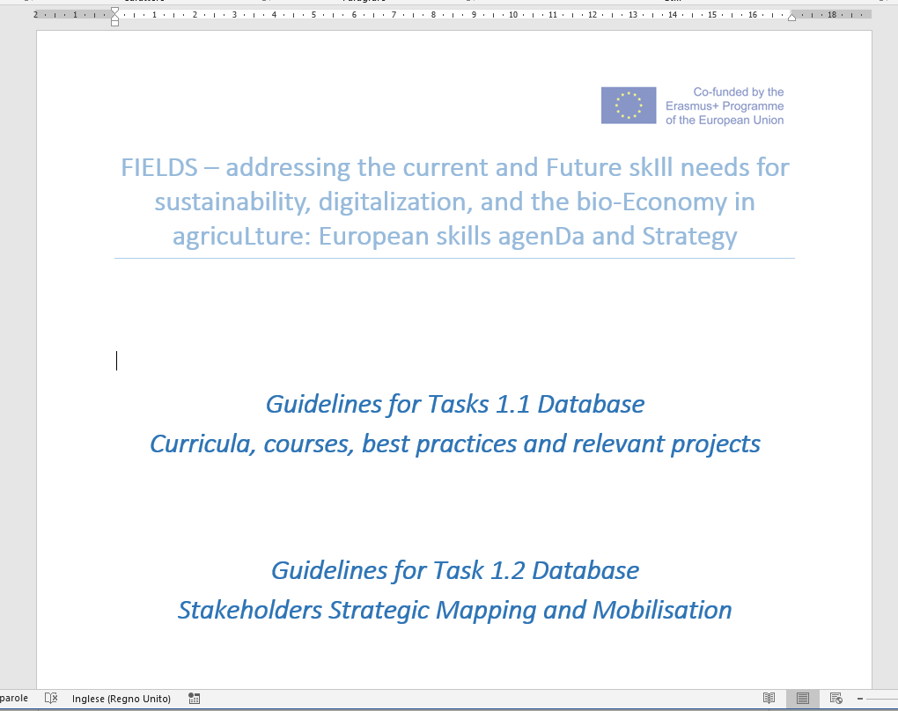
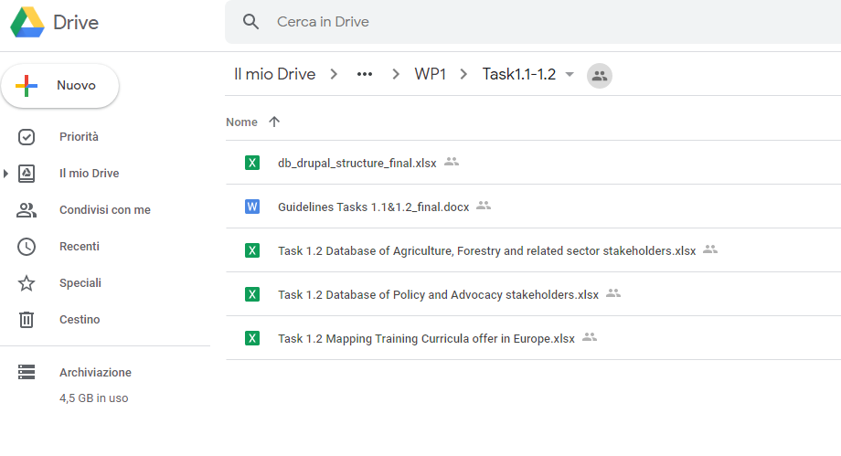
Guidelines for task 1.1 and 1.2 databases
Data uploading and main recommendations for data collection
https://drive.google.com/open?id=12iH9Fe7mf_ZaDFEQbAiTBtMtFoSGShB9

Slide 8

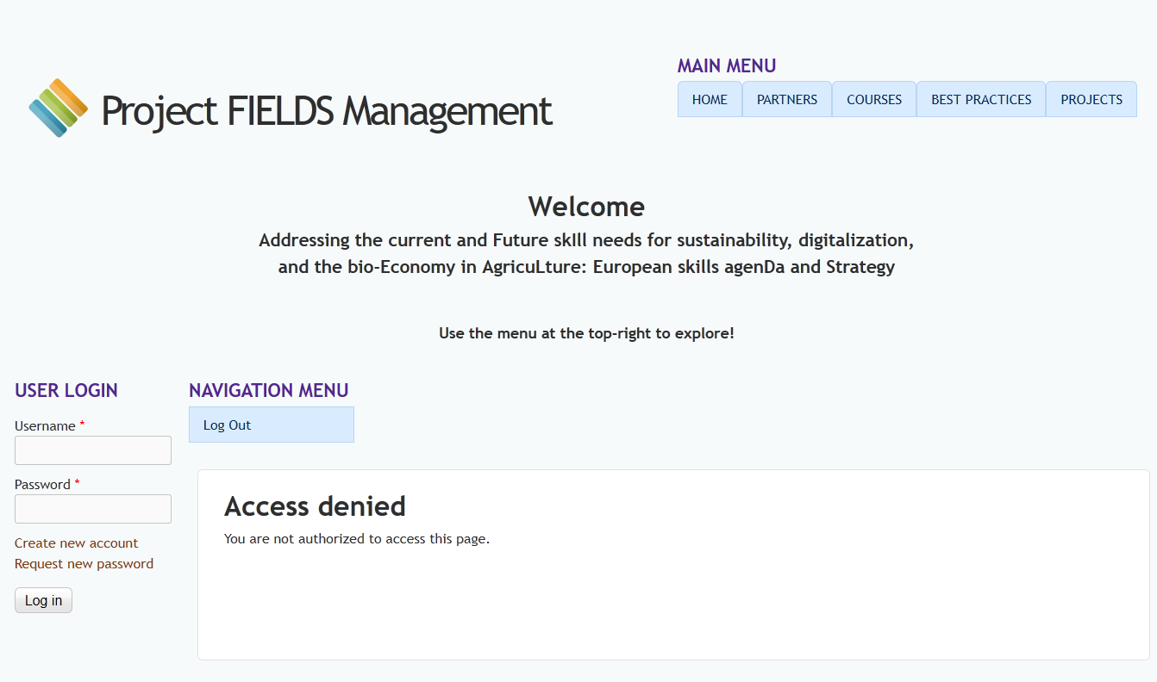
FIELDS Management portal info
http://www.erasmus-fields.eu/management/
Notes:
this link will not appear in the menu of the public page, it is only for internal use.

Slide 9
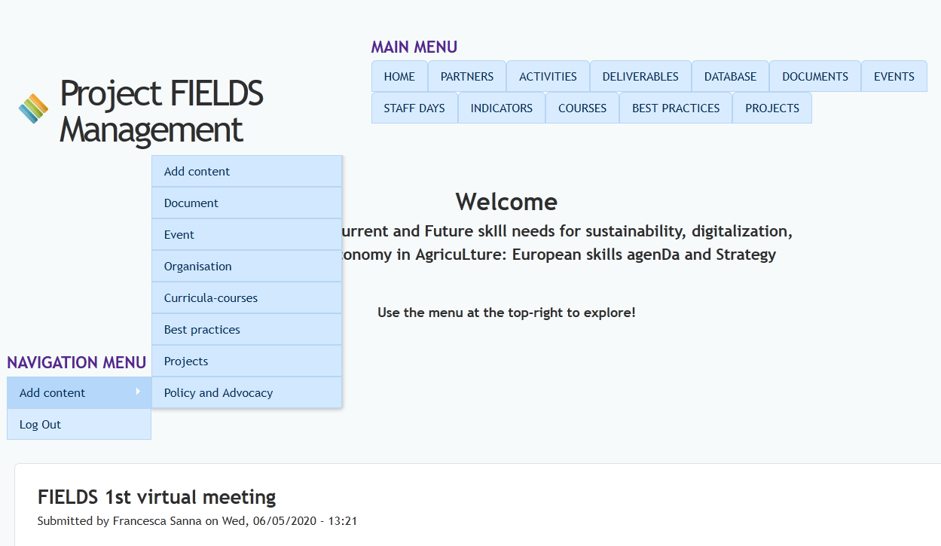
Add content

Slide 10
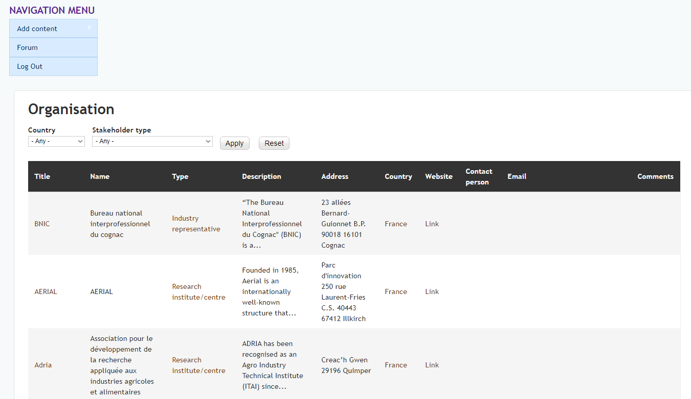

Organisations/stakeholder database
180 Organisations inserted so far!
34 Universities; 32 VET Providers; 23 Research Institutes; Others
http://www.erasmus-fields.eu/management/?q=organisation

Slide 11
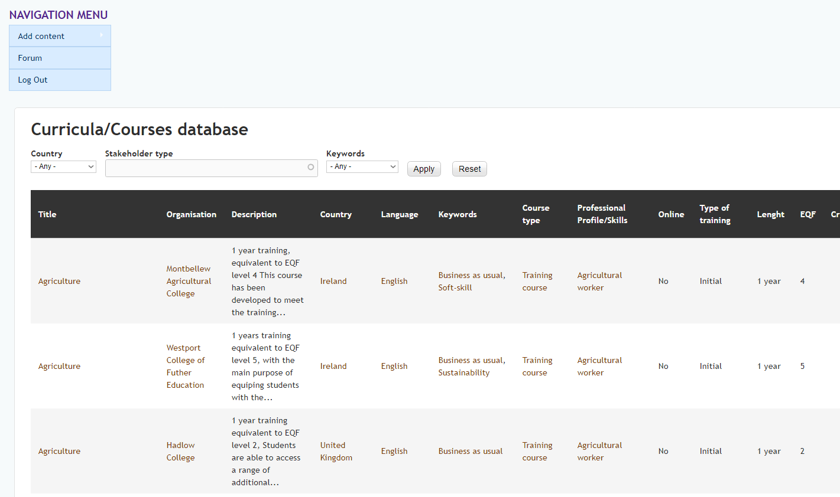
Curricula/Courses database
109 Curricula/Courses inserted so far!
64 Sustainability; 33 Bio-economy; 12 Digitalization; 15 Soft-skill;
20 Entrepreneurship; 45 Business as usual
http://www.erasmus-fields.eu/management/?q=curricula-courses-database

Slide 12
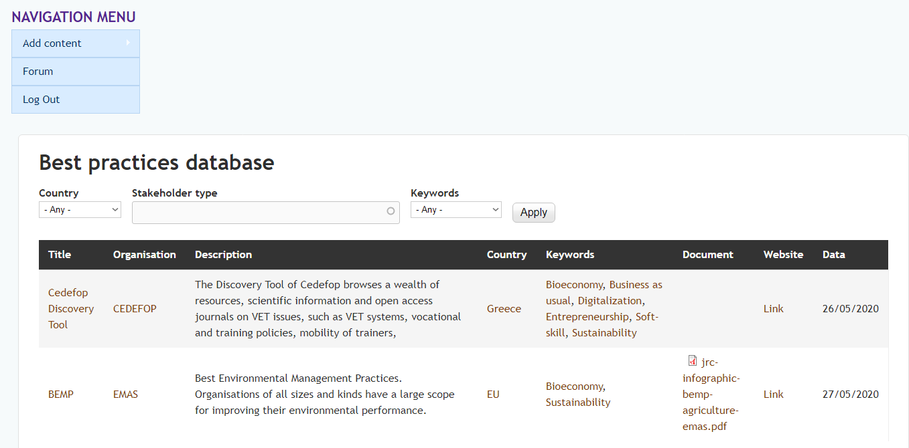
Best practices database
13 Best practices inserted so far!
12 Sustainability; 10 Bio-economy; 4 Digitalization; 3 Soft-skill;
9 Entrepreneurship; 3 Business as usual
http://www.erasmus-fields.eu/management/?q=best-practices-database

Slide 13
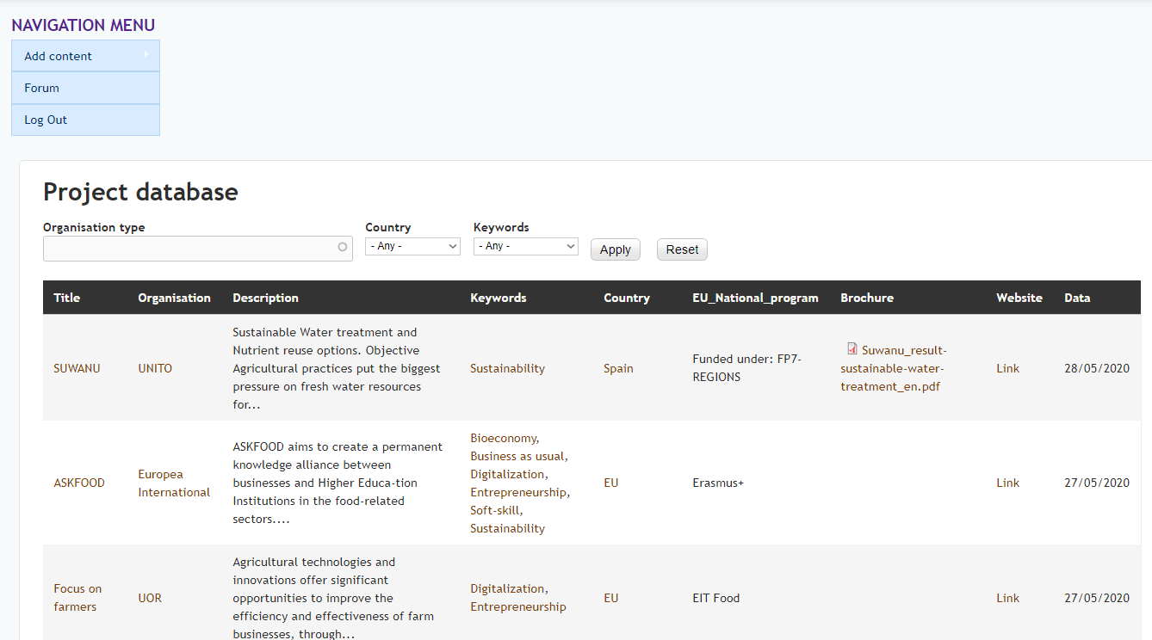
Projects database
26 Project inserted so far!
18 Sustainability; 5 Bio-economy; 11 Digitalization; 4 Soft-skill;
7 Entrepreneurship; 4 Business as usual
http://www.erasmus-fields.eu/management/?q=projects-database

Slide 14
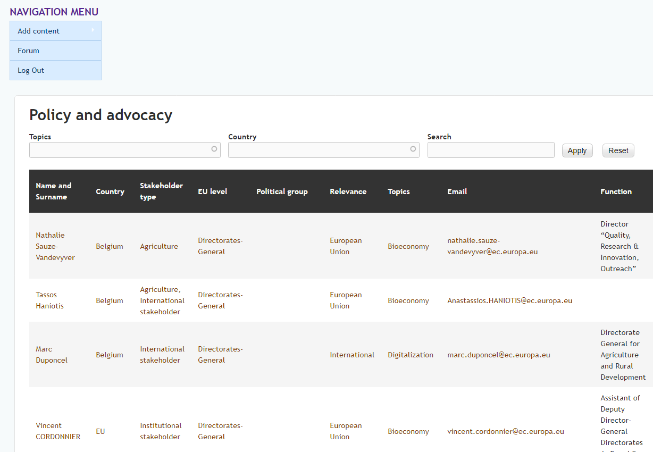
Policy and advocacy
22 Policy and advocacy inserted so far!
Institutional stakeholders, Farmers’ representatives, Food Industry
http://www.erasmus-fields.eu/management/?q=policy-and-advocacy

Slide 15

Questions and comments
At the end of the WP session

Slide 16




























Thank you for your attention!
Francesca Sanna, FIELDS project manager
francesca.sanna@unito.it

