Slide 1
WP1 – Skill needs indentification
Luis Mayor
ISEKI-Food Association, luis.mayor@iseki-food.net
Project Partner Meeting
17th March 2021
Online

Slide 2
WP1 Skill needs identification
Main objective: establish a general overview of the labor market in agriculture, forestry and related sectors in order to define present and future skills needs
Task 1.1: State of the art (UNITO)
Task 1.2: Stakeholders strategic mapping and mobilization (LLL-P)
Task 1.3: Country and EU focus groups (ISEKI)
Task 1.4: Bottom-up surveys (ICOS)
Task 1.5: Future trends analysis (WUR)

Slide 3
WP1 Skill needs identification
WP timeline: (January 2020-March 2021)
Task | Deliverable | State
1.1 | D1.1: Stakeholders strategic plans and analysis report | Submitted
1.1 | D1.2: Repository of previous projects, results and best practices | Submitted
1.2 | D1.3: VET list and classification | Sumbitted
1.3 | D1.4: Focus Group guidelines | Submitted
1.3 | D1.5: Focus group analysis | Submitted
1.4 | D1.6: Web-based questionnaire | Submitted
1.4 | D1.7: Survey analysis | In progress
1.5 | D1.8: Scenarios analysis | In progress

Slide 4
Task 1.3 – FIELDS Focus Groups
Luis Mayor
ISEKI-Food Association, luis.mayor@iseki-food.net
Line Friis Lindner, Christoph Köbl, Jonas Lázaro-Mojica
Project Partner Meeting
17th March 2021
Online

Slide 5

T1.3 Country and EU focus groups
Duration: M2-M9
Leader: ISEKI-Food Association
Other Partners Involved: All

Slide 6
Tasks 1.3 Country and EU Focus Groups
Summary of the task
Gather information about:
Skill needs in agriculture, forestry, food industry and forest-based industry.
Sustainability, digitalization, bio-economy and soft skills.
Existing and missing training
Target groups
Training methods
Deliverables
D1.4. Focus Group guideline (ISEKI)
D1.5. Focus Groups analysis (ISEKI)

Slide 7
Tasks 1.3 Country and EU Focus Groups
Methodology
Focus Group guidelines (D1.4)
Stakeholders
Farmers
Cooperatives
Foresters
Food industry
Forest-based industry
Education providers
Advisors
Other
Composition of the focus groups (at least 5 profiles)
Skill lists (partners input, ESCO and other sources)
Focus group guiding questions and conduction (change to online format!)
Transcription, processing and reporting to task leader
BOTTOM-UP APPROACH
Skill lists (c.a. 25 skills per category)
Sustainability | Digitalisation | Bioeconomy | Soft skills | Business-entrepreneurship

Slide 8
Tasks 1.3 Country and EU Focus Groups
FG Organisation
Country | Date (2020) | Number of participants
Austria | 18 May | 12
Ireland | 27 May | 13
Italy | 8 June | 13
Germany | 10 June | 7
France | 15 June | 9
The Netherlands | 23 June | 8
Greece | 25 June | 6
Spain | 26 June | 10
Slovenia | 1 July | 8
EU-Policy | 9 June | 13
EU-Forestry | 2 July | 14
9 focus groups at national level (86 participants)
1 EU-FG forestry sector
1 EU-FG policy

Slide 9
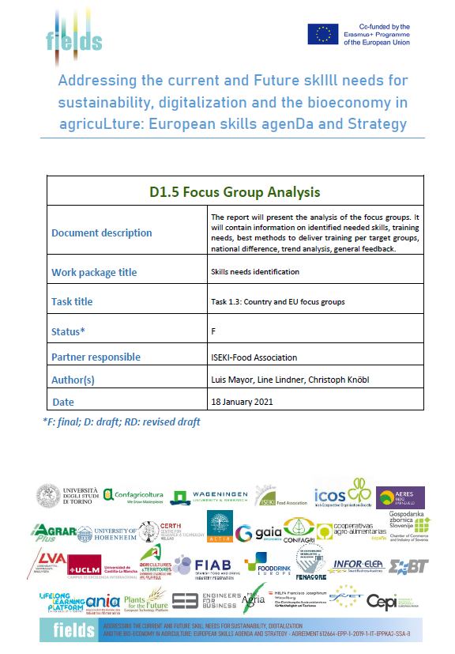
Tasks 1.3 Country and EU Focus Groups
Focus Group analysis (D1.5)
Analysis at European level (considering national focus groups data as a whole)
Skills:
Most important skills of the sector you represent (based on skill lists)
Missing skills in the lists
Change of skill needs in the next 5-10 years
Skill needs and job responsibility level
Training:
Training needs based on the selected skills
Needs of the training systems at national and European level
Preferred training methods
Training methods and target groups
Training recognition through certification
Annexes:
Analysis of FGs at national level (9 annexes)
EU-Policy and EU-Forestry FGs

Slide 10
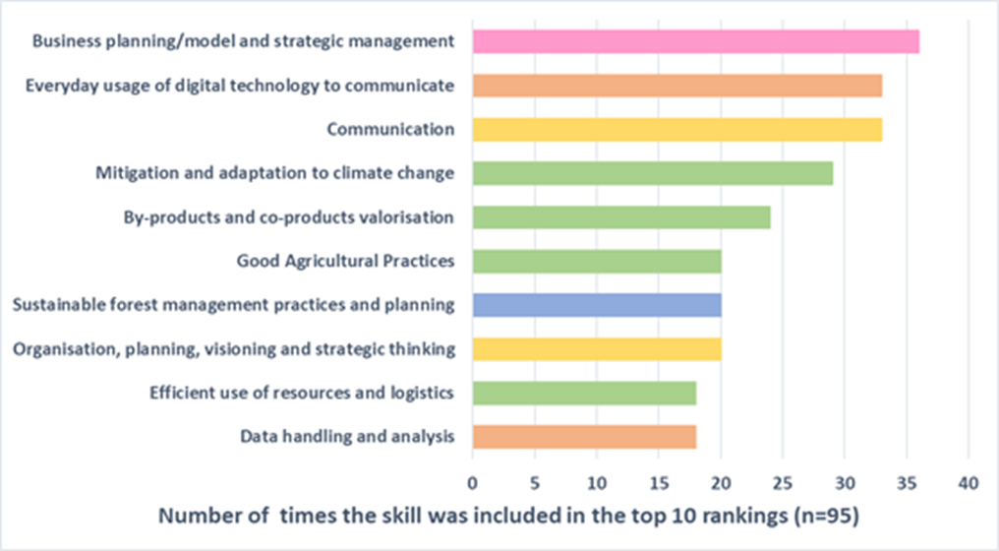
Tasks 1.3 Country and EU Focus Groups
Most important skills
EU-analysis: all categories and sectors

Slide 11
Tasks 1.3 Country and EU Focus Groups
Most important skills (sector-farmers)
Most important skills ( sector- food industry)

Slide 12
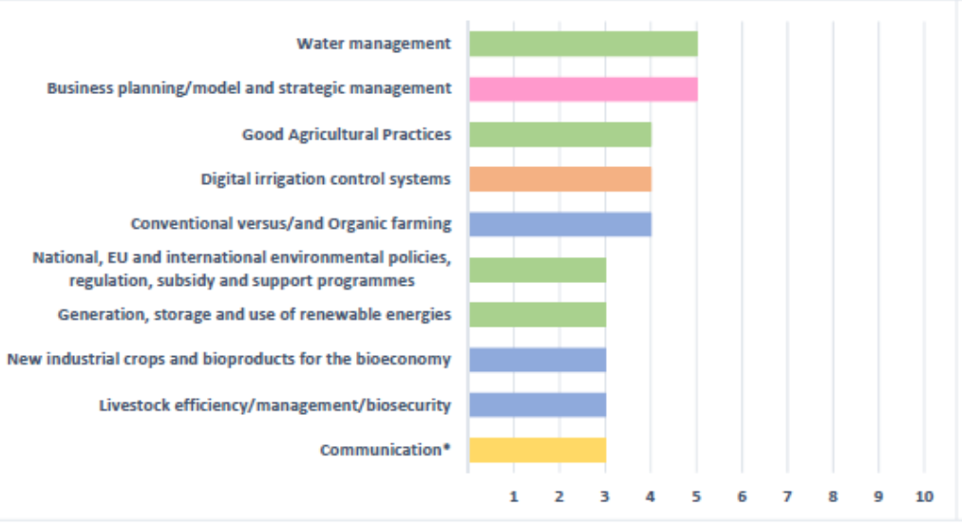
Tasks 1.3 Country and EU Focus Groups
Most important skills (category- sustainability )
Most important skills (national level-Spain/Portugal)

Slide 13


Tasks 1.3 Country and EU Focus Groups
Missing skills in the lists
Common findings:
Communication and engagement with consumers, market and society
Languages: English, neighbor countries languages, Chinese for the forestry global market
Improvement of stakeholders’ interaction
Knowledge/ability to understand the whole value chain
Education providers: ability to connect or to integrate skills and competences

Slide 14



Tasks 1.3 Country and EU Focus Groups
Skills change
Digital and sustainability skills!
Forestry focus group, three sets of skills for the future: technical, sustainability and social (soft) skills.
Skills and job responsibility level
Different skills needs across jobs/positions
Need to share knowledge and skills across different responsibility levels
A wide set of soft skills (external communication) more important at high responsibility levels.
“All rounders” for small companies

Slide 15

Tasks 1.3 Country and EU Focus Groups
Training needs
Most important skills are also those with more training needs!
Needs of the national education/training systems
Remarkable differences amoung countries: Greece vs. Germany
Common needs:
More practical training, more realistic approach (university students)
Universities get closer to farms and companies
Virtual training vs. experience on the ground

Slide 16


Tasks 1.3 Country and EU Focus Groups
Training and target groups
Students or early careers: formal learning approach
Adult learners: short trainings, different methodologies provide more flexibility
Certification
Participants were positive towards certification
Need of official certification for recognition and validation of prior learning (informal and non-formal, EU-Policy FG)

Slide 17
Tasks 1.3 Country and EU Focus Groups
EU-Policy Focus Group – selected recommendations
Balanced approach to the needed skills: basic-specialized-soft
Homologation and recognition of skills and experience
Holistic approach for coherence of the skills and training provided at EU level
Bigger alliances to support farmers and the food industry
Evidence-based approach to provide guidelines to policy makers
Social Dialogue in order to set the basis for the needed training and skills
Increase the attractiveness of the sector for the younger generation

Slide 18
Tasks 1.3 Country and EU Focus Groups
Related activities after task 1.3 completion
Support task 1.4 in the preparation of the survey on skill needs
Provide input to refine scenarios in task 1.5
Information for the identification of skill gaps in task 2.1
Support task 2.2 in the prioritization of the job profiles

Slide 19






























Thank you for your attention!
Luis Mayor, ISEKI-Food Association
luis.mayor@iseki-food.net

