Slide 1
WP1 – Skills Needs Identification
Billy Goodburn
Head of Learning & Development
Project Partner Meeting
17th March 2021
ICOS

Slide 2
T1.4 Bottom-up Surveys
Duration: M9-M12
Leader: ICOS
Other Partners Involved: All (UNITO, CONFAGRI, WUR, ISEKI, ICOS, AERES, AP, UHOH, CERTH, ACTIA, GAIA, CONFAGRI PT, SCOOP, GZS, LVA, UCLM, AC3A, FIAB, FDE, FENACORE, INFOR, SEVT, LLL-P, , Plant ETP, EFB, PA, FJ-BLT, EFVET, CEPI, EFFAT, BIC)

Slide 3
T1.4 Bottom-up Surveys
In Summary
Creation of a survey to assess skills needs, skills gaps, training needs and training gaps, in agriculture, forestry and the bio-economy, including green and digital skills needs, considering the outcomes of the Focus Groups (T1.3).
Target 300 Surveys
The Approach
Design Initial Survey & Partners Review and Agree Final Draft
Translate Survey into Different Languages (based on Pilot training Sessions)
Survey went Live

Slide 4
T1.4 Bottom-up Surveys
The Approach (Continued)……
Reminders and engagement
Analyse the Results
Next Steps
Write a Report on the Survey Results
Images for use on Social Media and Web-based platforms for promoting the Survey.

Slide 5
T1.4 Bottom-up Surveys
Key Areas within the Report
Demographic Profiles of Participants
Organisational Insights
Stakeholder Engagement
Identified Skills
Training Needs & Recognition
Business Trends

Slide 6
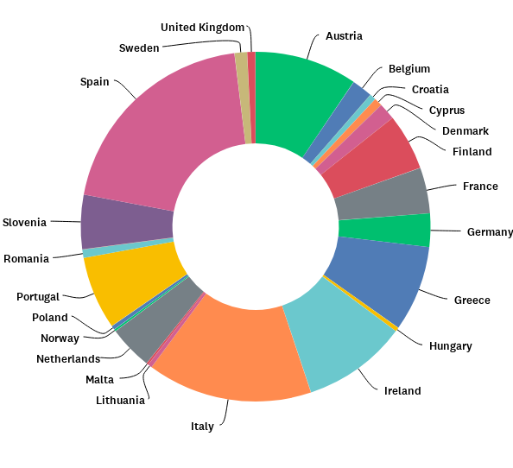
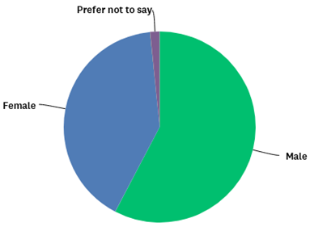
T1.4 Bottom-up Surveys
Demographic Profiles
The survey had 517 respondents from across 23 countries within the European Union, as well as countries outside of the European Union, and within the European Economic Area (EEA).
Gender Profile
Country Profile

Slide 7
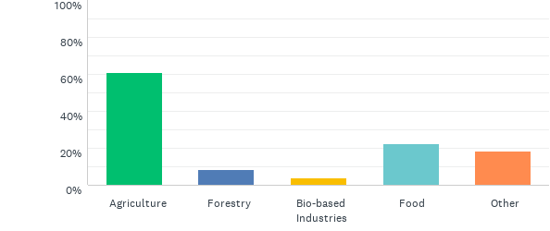
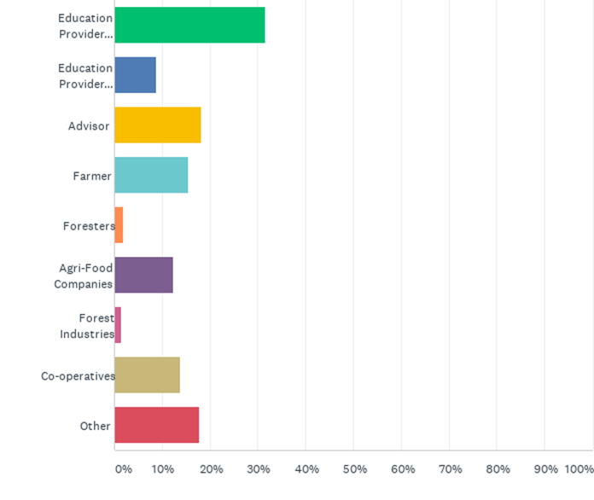
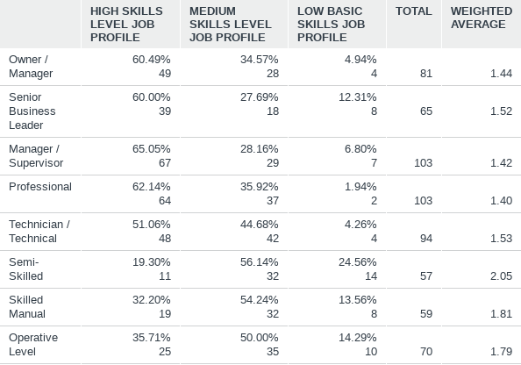
T1.4 Bottom-up Surveys
Organisational Insights
This includes Sectoral Profile, Areas of Operation, Organisation Size and Job Profiles
Sectoral Profile
Areas of Operation
Job Profiles

Slide 8
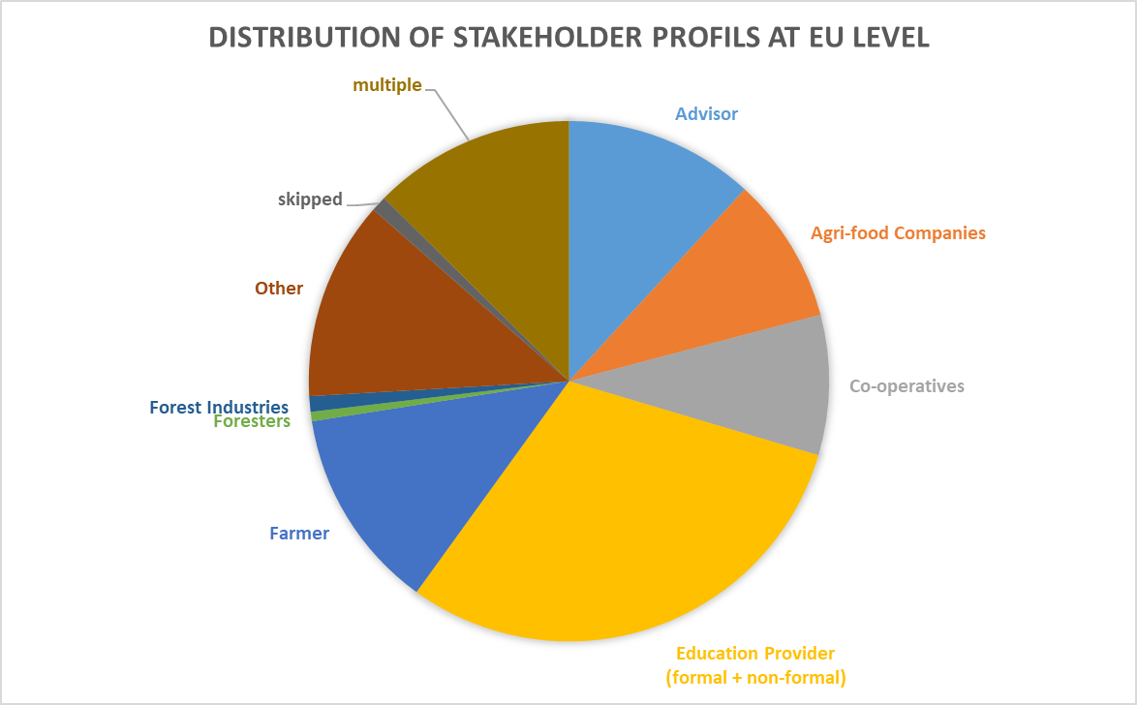
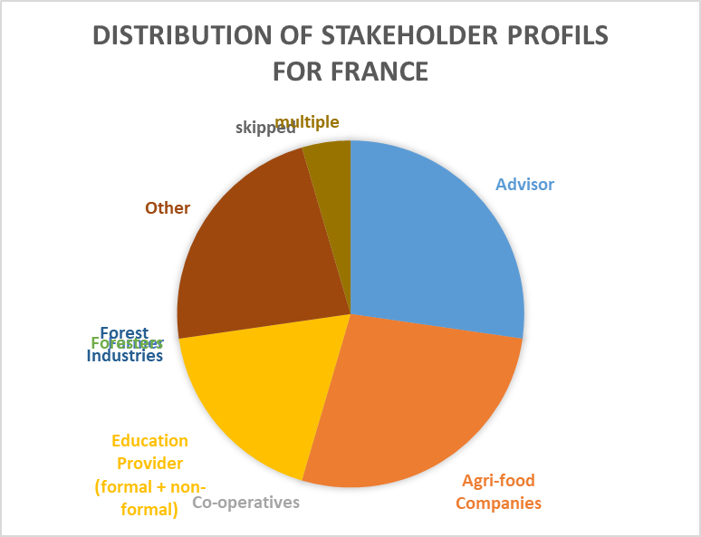
T1.4 Bottom-up Surveys
Stakeholder Engagement
Analysis of stakeholder profiles is done on the basis of European, & Country Levels
EU Level
Country Level

Slide 9
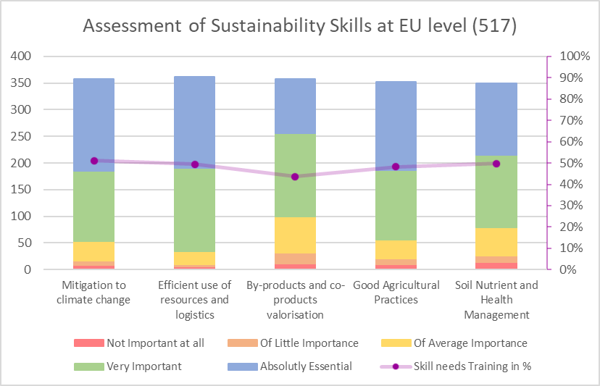
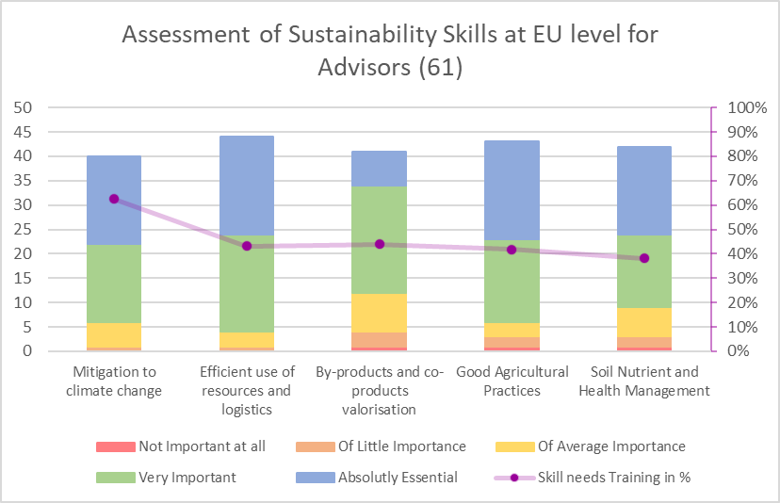
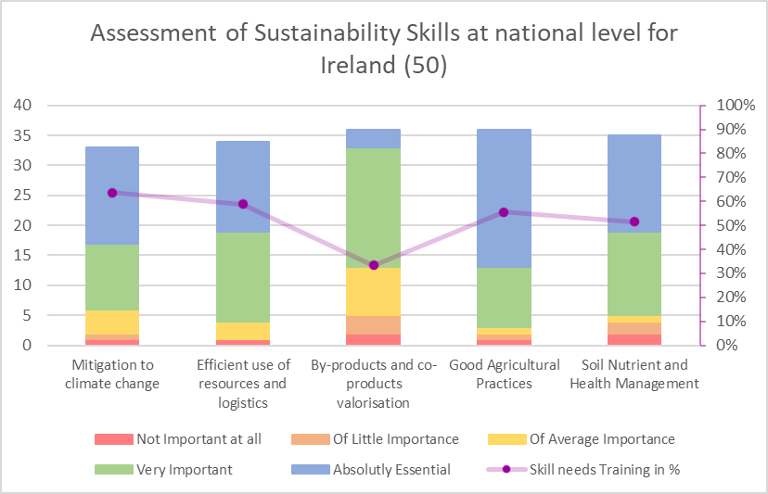
T1.4 Bottom-up Surveys
Identified Skills
Analysis done on the basis of European, Sectoral & Country Levels
Identified Future Skills Needs
EU Level
Sectoral Level
Country Level

Slide 10
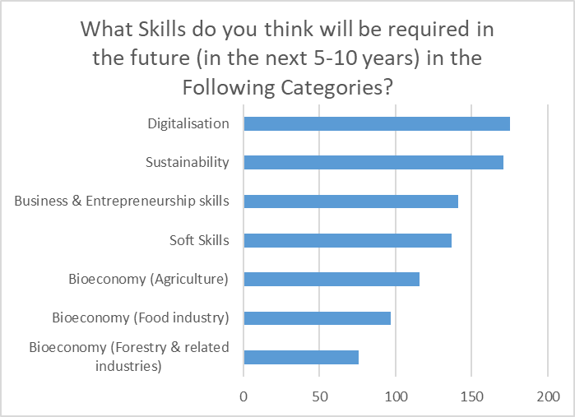
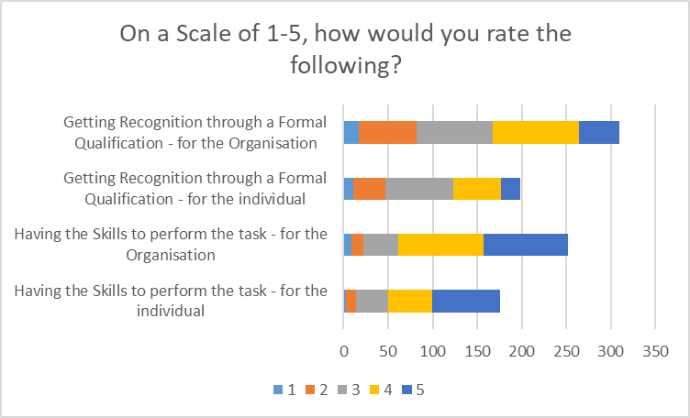
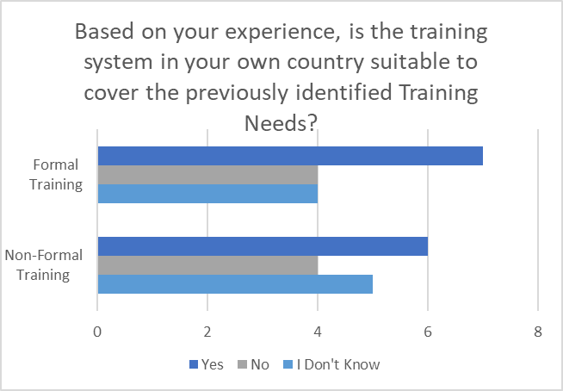
T1.4 Bottom-up Surveys
Training Needs & Recognition
Analysis done on the basis of European & Country Levels
Country Level
EU Level
EU Level
Netherlands

Slide 11
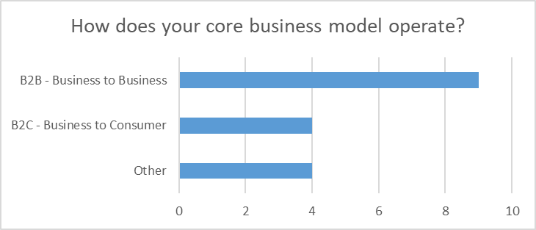
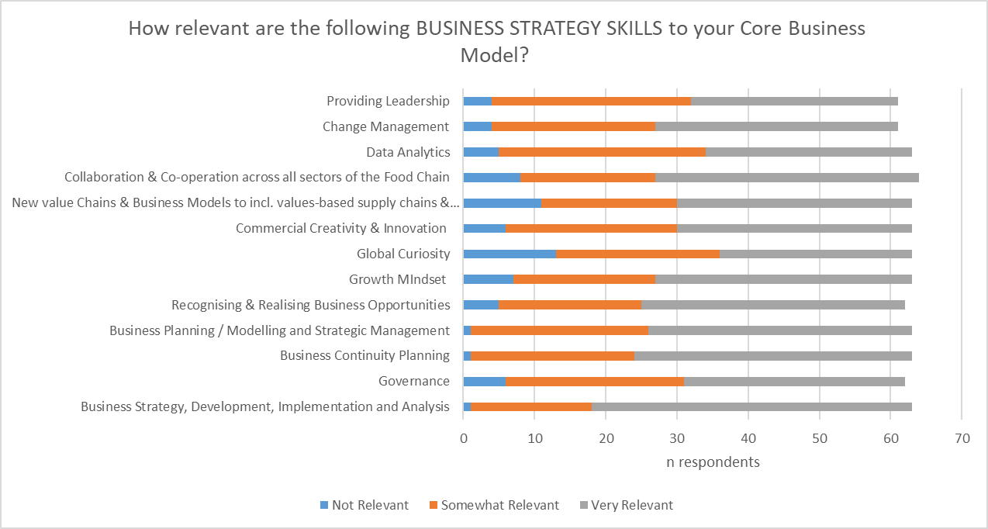
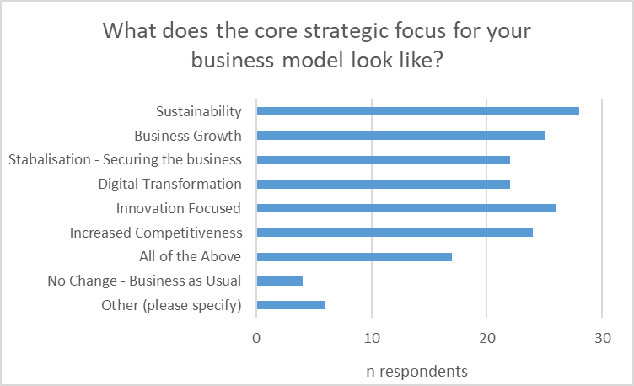
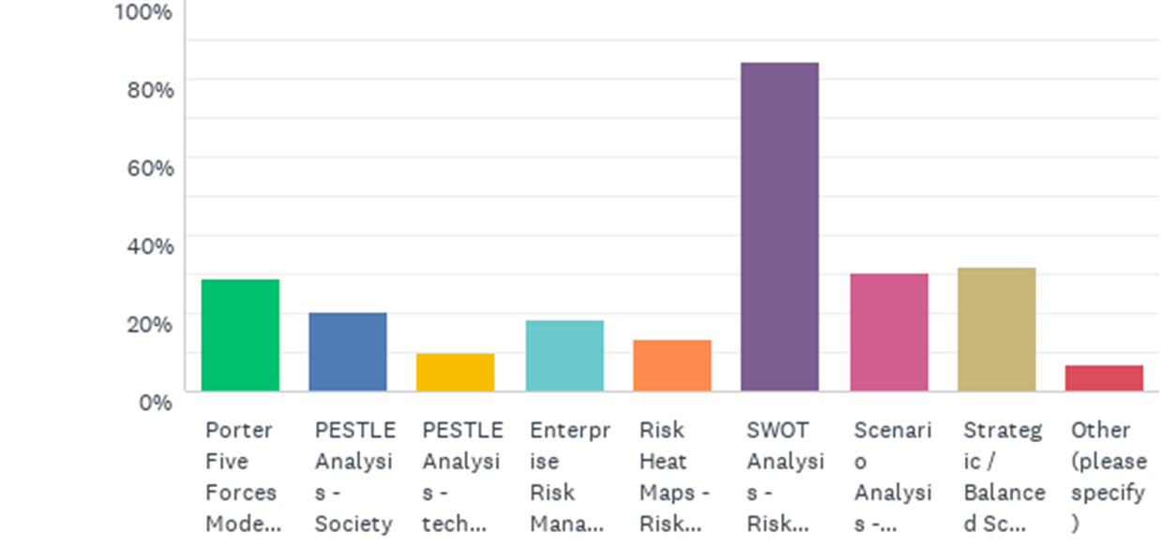
T1.4 Bottom-up Surveys
Business Trends
Business Operating Models
Strategic Business Model Focus Areas
Business Strategy Skills
Analytical Tools
Spain
Country Level
EU Level
EU Level
EU Level

Slide 12
T1.4 Bottom-up Surveys
Challenges / Key Learnings
Time (of Year) & (Analysis)
Cross Pollination across multiple areas.
Stakeholders Profiles
Sector Alignment
Areas of Operation
Skills vs Training
Language Barriers – Analysing the Results
Lack of Sufficient / Balanced Data across all areas in some countries.
Skewed Data – too many entries of data sources by participants

Slide 13
Questions?

Slide 14
Thank you for your attention!
Billy Goodburn, ICOS
Email: billy.goodburn@icos.ie

