Slide 1
WP2.2 – Profile prioritisation
CONFAGRI PT
Domingos Godinho domingos.godinho@confagri.pt
FIELDS 5th project meeting
30-31/05/2022
CONFAGRI PT

Slide 2
WP 2.2 – Profile prioritisation
Start/end date: M14-M18 (Feb until Jun /2020)
was delievered late
The objective of this task was to choose 10 profiles from those created in task 2.1
Only 10 profiles were created, it became obvious which profiles to choose
Prioritize for the all European Union vs Prioritize for a particular territory

Slide 3
WP 2.2 – Profile prioritisation
Methodology
Multi-criteria approach – each skill classified based on:
● Criticality. How the skill/knowledge is important to learn other skills and complete the occupational profile. Based on opinion of several consortium partners and experts on the industry
● Impact. How achieving a particular skill will positively impact the growth of the sector. Based on results of the D 1.8 and consortium partners contributes.
● Time. How much time it will take to achieve a skill through training activities. Based on the experience of consortium partners and on the
training time of comparable skills/knowledge in other available training courses.
● Volume. How many learners are potentially interested in the skill/knowledge. Based on both the experience of contributing partners
and the results of task 1.3 (focus groups)

Slide 4
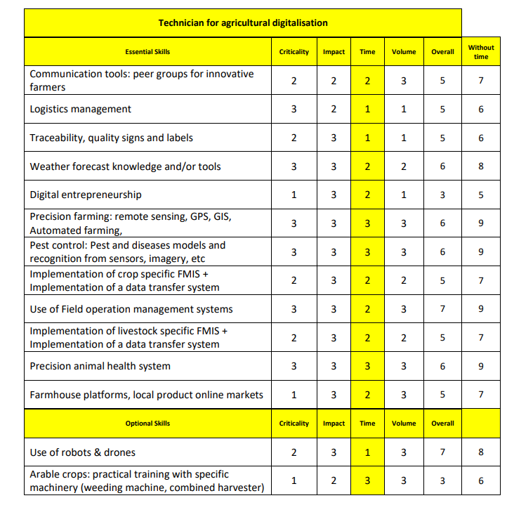
WP 2.2 – Profile prioritisation
Notes:
Intuitive - important a concise description / summary of the regulatory frameworks.

Slide 5
Thank you for your attention!

