Slide 1


FIELDS project meeting
WP3 - New tools and training design
Francesca Sanna, Remigio Berruto
5th Partnering Meeting – Paris, France
30-31 May 2022

Slide 2
WP3 – New tools and training design (UNITO) M4-M45
Task 3.1: Methodology definition (UNITO), M4-M9
D3.1: Training methodologies - Francesca Sanna (UNITO)
Task 3.2: Curricula design (ICOS), M17-M21
D3.2: Curricula (M21) – Billy Goodburn (ICOS)
Task 3.3: Apprenticeship scheme (AERES), M17-M45
D3.3: Apprenticeship scheme report (M42) – Marg Leijdens (AERES)
Task 3.4: Training content creation and new tools (UCLM), M20-M32
D3.4: Online training materials (M30) – Manuel Rodrigo (UCLM)
Task 3.5: Train the trainers' materials and tools (AP), M20-M32
D3.5: User guide for trainers and train the trainers’ session material (M30)

Slide 3
WP3 – New tools and training design (UNITO) M4-M45
Task 3.1: Methodology definition (UNITO), M4-M9
New deadline M27
Involved partners:
ISEKI, ICOS, AERES, AP, UHOH, LVA, UCLM, INFOR
D3.1: Training methodologies
Francesca Sanna (UNITO)

Slide 4

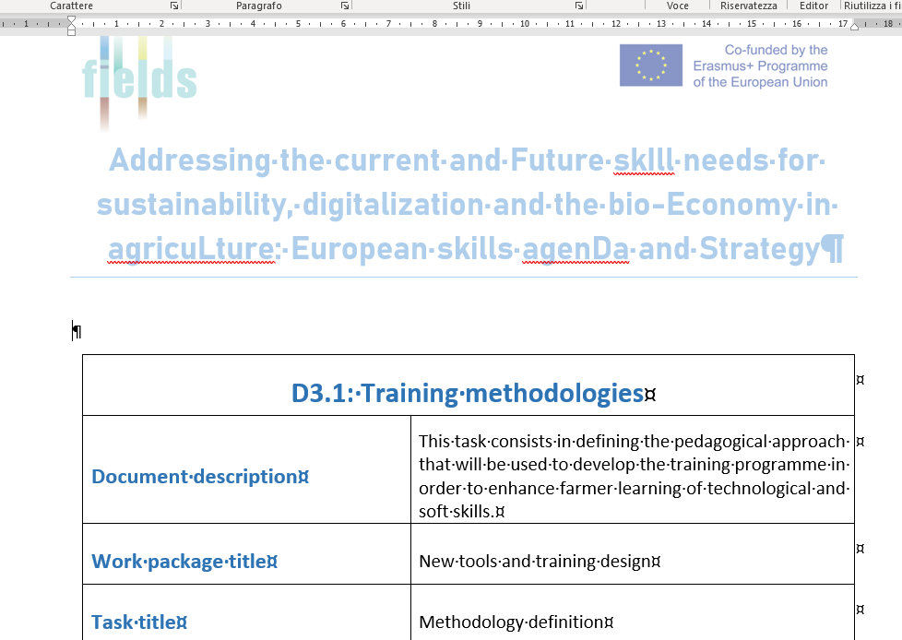


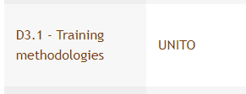


T3.1 Methodology definition
28/02/2022

Slide 5
D3.1: Training methodologies - report
With the objective to support innovation and sustainable development in the agricultural, food-industry and forestry sector, a variety of methods for teaching content and processes that enhance farmer learning of technological and soft skills may be applied.
Report:
Introduction
    1.1 Erasmus+ Open Access and Open License Requirement
Pedagogical approaches
Learning objectives classification - bloom's taxonomy
Training Methodologies
E-learning platform Access Modality
Conclusions

Slide 6


D3.1: Training methodologies - report
1. Introduction
1.1 Erasmus+ Open Access and Open License
Erasmus+ promotes the open access of project outputs to support learning, teaching, training. This serves both to ensure that publicly funded materials provide value to the general public, and to ensure long-term access to the results, even if a beneficiary consortium ceases to exist.
The Erasmus+ programme commits its beneficiaries to make any educational resources produced as part of projects freely available for the public under an open license.
2. Pedagogical approaches
2.1 Active and Passive Learning
Active learning is anything course-related that all students in a class session are called upon to do other than simply watching, listening and taking notes.
Passive learning occurs when students are engaged solely in taking in information.

Slide 7
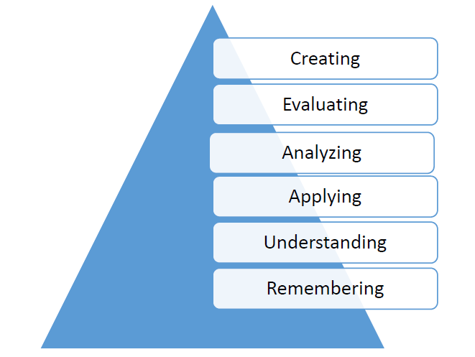
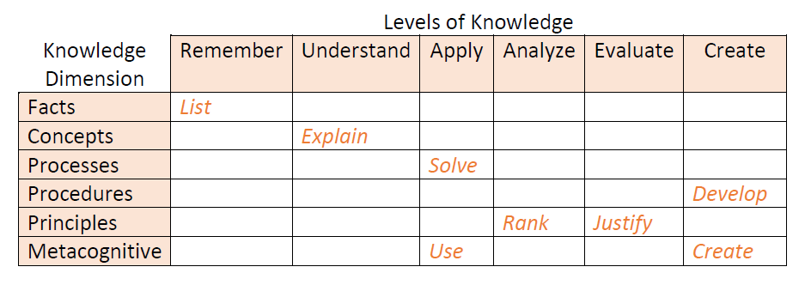
D3.1: Training methodologies - report
3. Learning objectives classification - bloom's taxonomy
To promote higher forms of thinking in education a taxonomy was created in three domains of educational activity (Bloom, et al., 1956).
Behaviourism, cognitivism, and constructionism are the three most popular learning theories.
Bloom’s Taxonomy also added the concept of a knowledge matrix to add a cognitive dimension
Levels of the revised Bloom’s Taxonomy in the Cognitive domain

Slide 8
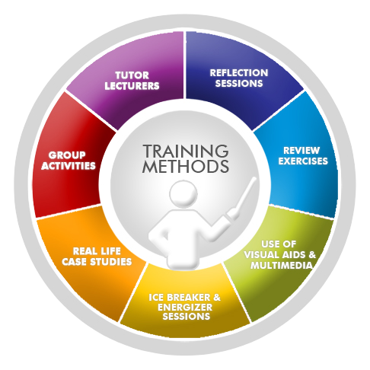
D3.1: Training methodologies - report
4. Training Methodologies
4.1 In person class
4.2 Online learning
4.3 Microlearning
4.4 Gamification
4.5 Flipped classroom
4.6 Blended learning
4.7 Peer learning
4.8 On-farm demonstration activities
4.9 Action-based and participatory learning
  4.9.1 Participatory Learning and Action
  4.9.2 Participatory training approaches

Slide 9





D3.1: Training methodologies - report
E-learning platform Access Modality
E-learning platform sections and user navigation, E-learning platform languages, Available IT platforms and tools, Main categories of LMSs, Comparison among the tools available, Basic parameters for comparison,
Advanced parameters for comparison:
Moodle
Sakai
Canvas
Open edX
Blackboard

Slide 10
T3.1 Methodology definition - Conclusions
This task consists in defining the pedagogical approach that will be used to develop the training programme in order to enhance farmer learning of technological and soft skills.
Several methodologies were considered: In person class, online learning, microlearning, gamification, flipped classroom, blended learning, peer learning, on-farm demonstration activities, Action-based and participatory learning
Considering the target groups and their different needs (farmers, students and farmers advisors), the types of learning and the topics, units and learning outcomes that will be developed in the curricula design, a single methodology was not selected but a combination of those will be used, considering case by case the one that suits the needs of the moment.
UNITO compared different opensource Learning management systems, and choose Moodle to be used to implement the training material and to manage the training
ICOS and AERES provided practical hints to make efficient learning scheme for both farmer and foresters and students.

Slide 11





























Thank you for your attention!
Francesca Sanna, FIELDS project manager
francesca.sanna@unito.it

Slide 12
D3.1: Training methodologies - report
Behaviourism is a world-view that operates on a principle of “stimulus-response”. It assumes that a learner is essentially passive and responds to external stimuli. The learner starts as a “tabula rasa” and behaviour is shaped through positive or negative reinforcement. Learning is defined as a change of behaviour in the learner.
Cognitivism is a paradigm where the learner is viewed as an information processor. Knowledge is seen as a schema, or symbolic mental construction. Learning is a change in a learner’s schemata. Cognitivism responds to behaviourism by recognizing that people require active participation in order to learn and changes in behaviour are an indication of what occurs within the learner’s brain.
Constructivism postulates that learning is an active and constructive process in which the learner is the information constructor. (An individual constructs his/her own subjective reality linked to prior knowledge). It views learning as an active and contextualised process in which knowledge is constructed (as opposed to acquired). This construction is based on the learner’s personal experience and hypothesis about the environment, bringing past experiences and cultural factors into a learning situation.

