Slide 1
WP3 – New Tools & Training Design
Billy Goodburn
Head of Learning & Development
TPM Paris
30-31/05/2022

Slide 2
WP3 – T3.2 Curricular Design
Duration: M17-M21
Leader: ICOS
Partners Involved:
UNITO, CONFAGRI, ISEKI, ICOS, AERES, UHOH, CERTH, ACTIA, GAIA, GZS, LVA, AC3A, FIAB, FENACORE, INFOR, SEVT, EFB, EfVET, CEPI

Slide 3
T3.2 Curricular Design
Develop the outline of 7/10 occupational profiles, which corresponds to the job profiles identified in T2.1 and T2.4
at least one per topic (sustainability, digitalisation, bioeconomy).
Two levels: EQF level 4 (farmers, foresters and SMEs) and one for EQF level 5 (students) in line with the sector changing needs in the short to longer term.
Each occupational profile outline will correspond approximately to 680 h,
  120 online,
  180 in-class
  360 as a work based
  20 hours for the assessment
  allow for the EQAVET certification.
The number of hours dedicated to sustainability, bioeconomy, forestry and digitalisation, soft skills will vary among countries, following the country roadmaps developed in TX2.4

Slide 4
T3.2 Curricular Design
Deliverables:
Curricula Report
Description
This deliverable will present in detail 10 curricula outlines,
referred to the prioritised ones.
Due date September 2021 (M21)
Language(s)
English, German, French, Greek, Italian, Dutch, Spanish,
Slovenian, Finnish
Media(s) Electronic (+ platform layer)

Slide 5
T3.2 Curricular Design
Design Process:
Establish L/O’s
(based on the ESCO Skills - European Skills, Competences,
Qualifications and Occupations - part of the Europe 2020 strategy.)
Mapped to Occupational Profiles
Identify the Learning Assessment
Outline the training material that has to be developed
(Focus will be on What’s missing)

Slide 6
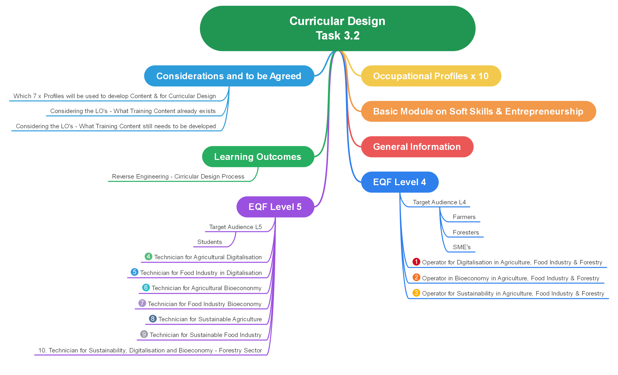
T3.2

Slide 7
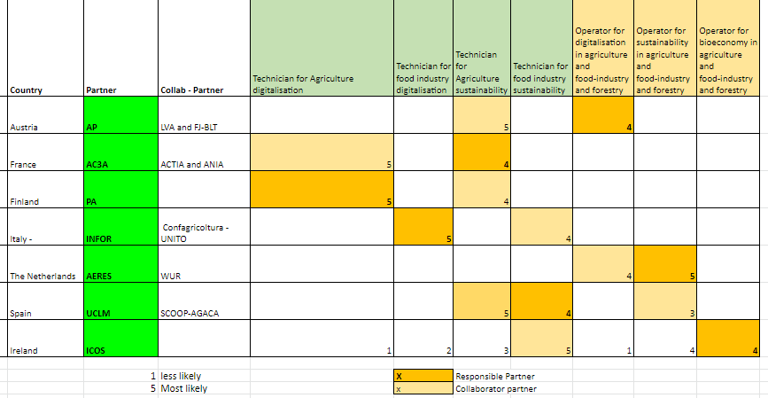
T3.2 Curricular Design

Slide 8
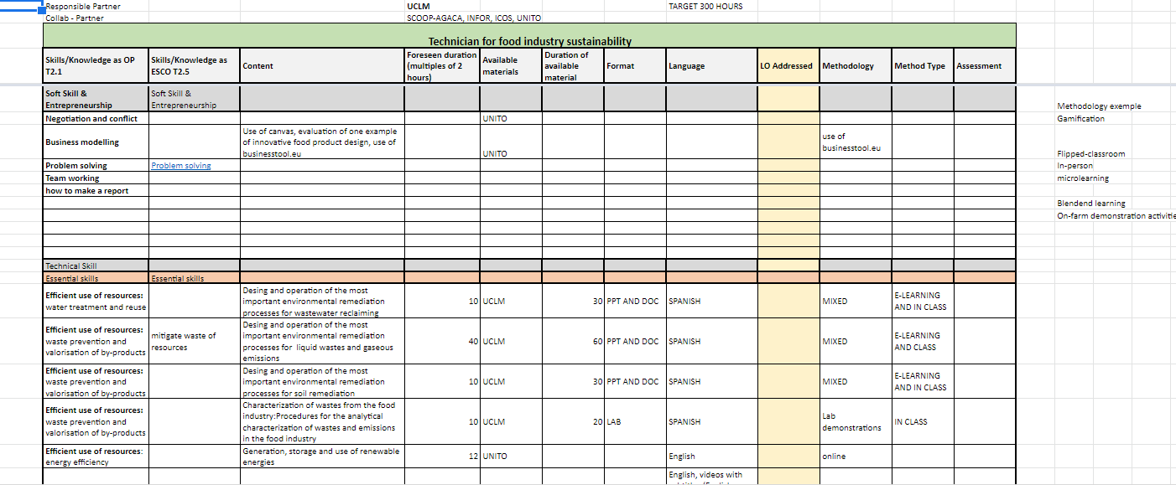
T3.2 Curricular Design

Slide 9
T3.2 Curricular Design
Next Steps
Identify Existing materials
Map LO’s to Skills & Competencies – Double Check Occ Profiles
Focus on What’s missing

