Slide 1
FIELDS WP4 – Task 4.3 Map creation updated and use
Francesca Sanna, Project Manager
Francesca.sanna@unito.it
4th Virtual Project Monitoring Meeting
17 March 2021

Slide 2
WP4 – Implementation (AERES)
Task 4.3: Map creation, update and use (UNITO), M4-M48
Francesca Sanna (UNITO)
D4.3: Online public platform and map (M12)

Slide 3
Task 4.3: Map creation, update and use
Project outputs visible: a database with a geographical map
All information created in the project, in particular:
Organisation (WP1)
VET providers/stakeholders (WP1)
Previous best practices, projects and their outputs (WP1)
Curricula available within the project and outside (WP1)
Stakeholders interested in the training and offering apprenticeship (WP3)
National and EU frameworks and funding opportunities (WP5)
Management portal
http://www.erasmus-fields.eu/management/?q=node/871
Notes:
The databases will be further used in Task 4.3 and integrated with a geographical map as an additional layer on the website.

Slide 4
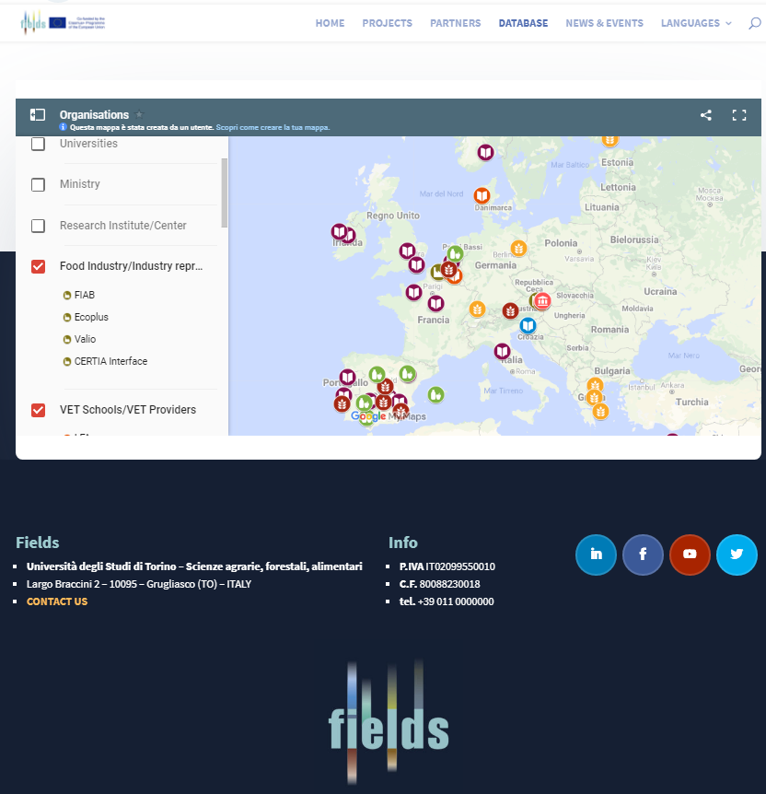
https://www.erasmus-fields.eu/database/
Public website
- Home page
- Database

Slide 5
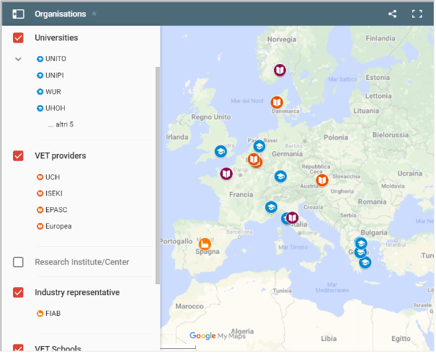
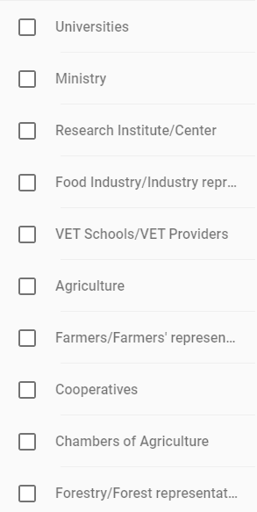
Task 4.3: Map creation, update and use
About 100 records inserted so far!
http://www.erasmus-fields.eu/management/?q=node/871
It will be kept updated during the project lifetime and maintained afterwards.
Notes:
The databases will be further used in Task 4.3 and integrated with a geographical map as an additional layer on the website.

Slide 6
Questions and comments?

Slide 7
Thank you for your attention!
Francesca Sanna, FIELDS project manager
francesca.sanna@unito.it

