Slide 1



WP4
T4.4 Translation
FIELDS – Blueprint 612664 – 1/1/20-31/12/23
Daniel Rossi, Camilla Tomao
CONFAGRICOLTURA
Task leader
17th of March 2021
FIELDS 4th Project Meeting

Slide 2


Task 4.4 Info
Start/end date: M4-M8
Partners involved: UNITO, WUR, COS, AP, UHOH, CERTH, ACTIA, CONFAGRI PT, SCOOP, GZS, LVA, UCLM, AC3A, FIAB, FENACORE, INFOR, ANIA, EFB, PA, FJ-BLT
Days: 25/1; 50/2; 40/3
Main Objectives:
Ensure transferability of Strategies and Content for Strategy and Training

Slide 3

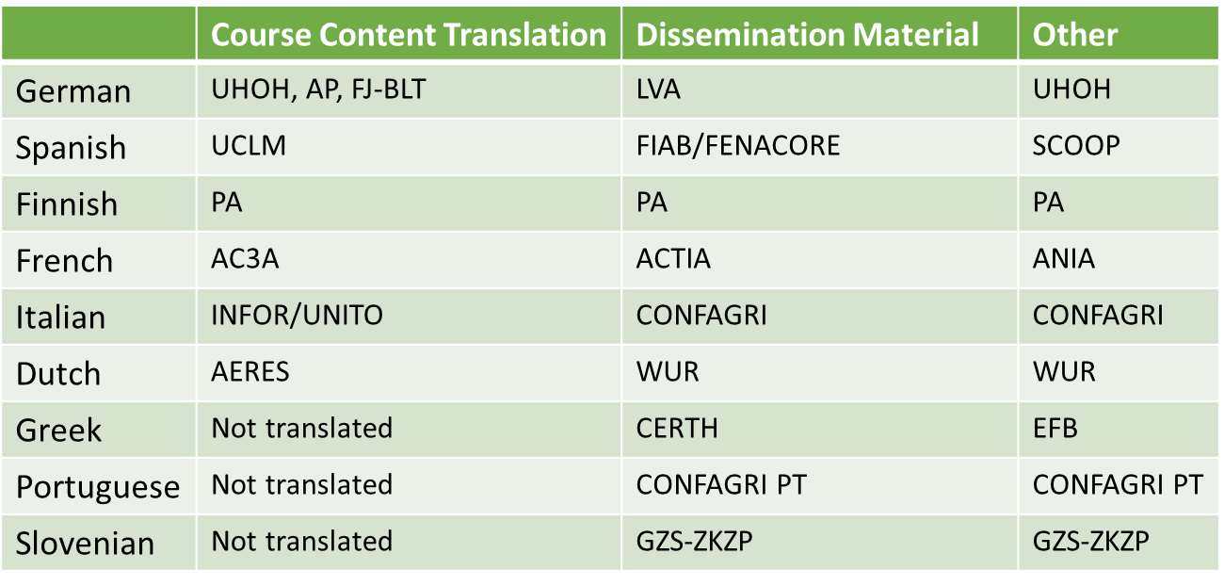

Slide 4
Dissemination Material
Leaflet and Poster M8
Leaflet_FRE_web.pdf
Poster FIELDS_FIN.pdf
Newsletter M11
https://drive.google.com/drive/folders/1-BSWZt9lVGTquXsYytFSlQkmLJFilkRb
Website Content M12
FIELDS\Translations 4.4\Dissemination-Website\27_Finnish_FIELDS_website_main sectors_ProAgria.docx

Slide 5

Other
Task 1.4. Surveys - M10
European Strategy – M45
National Roadmaps –M45
Curricula –M21

Slide 6

Course Content
Course Content will have to be translated into the 7 launguages (German, Spanish, Finnish, French, Italian, Dutch + English) where the Pilot Training wil be developed.

Slide 7
M1-M15 Deliverables

Slide 8
M15-M48 Deliverables
WP2 | M45 | European strategy | Electronic format | English, German, French, Greek, Italian, Dutch, Spanish, Slovenian, Finnish
WP2 | M45 | National Roadmaps (Austria, Italy, France, Finland, Netherlands, Spain, Ireland) | Electronic format | English, German, French, Italian, Dutch, Spanish, Finnish
WP2 | M27 | Open transferability framework | Electronic format | English, German, French, Italian, Dutch, Spanish, Finnish
WP3 | M21 | Curricula (10) | Electronic format | English, German, French, Greek, Italian, Dutch, Spanish, Slovenian, Finnish
WP3 | M30 | Online training materials – country specific | Electronic format | English, German, French, Italian, Dutch, Spanish, Finnish
WP3 | M30 | User guide for trainers and train the trainers’ session material | Electronic format | English, German, French, Italian, Dutch, Spanish, Finnish
WP4 | M48 | Online public platform and map | Online | English, German, French, Greek, Italian, Dutch, Spanish, Portuguese, Slovenian, Finnish

Slide 9






























Thank you for your attention!
Daniel Rossi, CONFAGRI: d.rossi@confagricoltura.it
Camilla Tomao, CONFAGRI: tomao@enapra.it

