Slide 1
WP5.1 – National & EU Regulatory Frameworks
CONFAGRI PT
Cátia Rosas catia.rosas@confagri-pt
FIELDS 4th Virtual Meeting
17th march 2021
CONFAGRI PT

Slide 2


WP 5.1 - National and EU Regulatory Framework
Start/end date: M7-M24 (July/2020 until December/2021)
Lead by CONFAGRI.PT; all partners from the next slides involved
Aim: preparing the roll-out of project deliverables at national and regional levels with the relevant governmental and sectoral authorities
UNTIL M20 (August 2021), partners will provide the information on the regulatory frameworks

Slide 3
WP 5.1 - National and EU Regulatory Framework
Regulatory framework – specific input
FDE will contribute to provide EU regulatory frameworks
CEPI, EFVET and LLL-P will provide EU regulatory frameworks
FENACORE contribute with EU and Spanish regulatory framework for water, sustainability and reuse

Slide 4
WP 5.1 - National and EU Regulatory Framework
Regulatory framework – national input
LVA, AP, FJ-BLT in Austria
ANIA, AC3A in France
UHOH in Germany
GAIA in Greece
ICOS in Ireland
CONFAGRI, INFOR in Italy
AERES, WUR in Netherlands
CONFAGRI PT in Portugal
GZS in Slovenia
SCOOP, FIAB in Spain
FOCUS ON REGULATORY FRAMEWORK FOR TRAINING

Slide 5
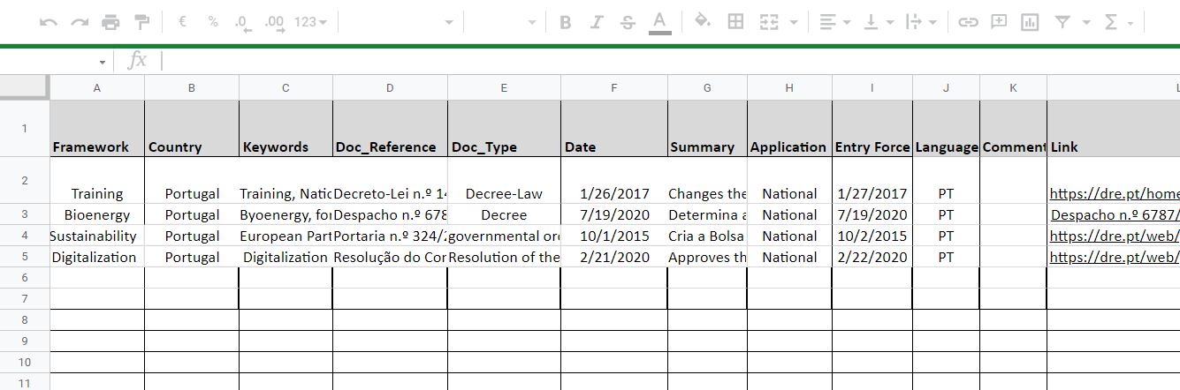
WP 5.1 - National and EU Regulatory Framework
Regulatory Framework List
Notes:
Intuitive - important a concise description / summary of the regulatory frameworks.

Slide 6
WP 5.1 - National and EU Regulatory Framework
The regulatory framework list compiled by CONFAGRI PT:
- in M21 (Setember/2021) will give some information to include in D2.4-National Roadmap (CONFAGRI)
- will be uploaded into the platform described in T 4.3- Map creation, update and use (UNITO)
D5.1: Regulatory framework list (M24)

Slide 7
WP 5.1 - National and EU Regulatory Framework
Next steps
Framework List and the guidelines sent to all partners (March, 2021)
Partners’ contributes (August, 2021)
Deliverable D. 5.1 – Regulatory Framework List (December, 2021)
Notes:
Para análise da informação compilada e agregada.
Temos reuniões marcadas pelo estabelecimento do quadro regulativo nacional

Slide 8































Thank you for your attention!
catia.rosas@confagri.pt

