Slide 1
WP5.1 – National & EU Regulatory Frameworks
CONFAGRI PT
Domingos Godinho domingos.godinho@confagri.pt
FIELDS 5th project meeting
30-31/05/2022
CONFAGRI PT

Slide 2
WP 5.1 - National and EU Regulatory Framework
Start/end date: M7-M24 (July/2020 until December/2021)
was delievered on time
Aim: preparing the roll-out of project deliverables at national and regional levels with the relevant governmental and sectoral authorities
Regulatory framework – specific input/ European level
FDE, CEPI, EFVET and LLL-P provided EU regulatory frameworks
FENACORE provided EU and Spanish regulatory framework for water, sustainability and reuse

Slide 3
WP 5.1 - National and EU Regulatory Framework
Regulatory framework – national level
LVA, AP, FJ-BLT in Austria
ANIA, AC3A in France
UHOH in Germany
GAIA in Greece
ICOS in Ireland
CONFAGRI, INFOR in Italy
AERES, WUR in Netherlands
CONFAGRI PT in Portugal
GZS in Slovenia
SCOOP, FIAB in Spain

Slide 4
WP 5.1 - National and EU Regulatory Framework
Territory | Number
Austria | 12
EU | 34
France | 8
Germany | 6
Greece | 15
Ireland | 13
Italy | 23
Netherlands | 2
Portugal | 25
Slovenia | 6
Spain | 8
Total | 152
Number of regulatory frameworks
indentified in each
country and in EU
Notes:
Intuitive - important a concise description / summary of the regulatory frameworks.

Slide 5
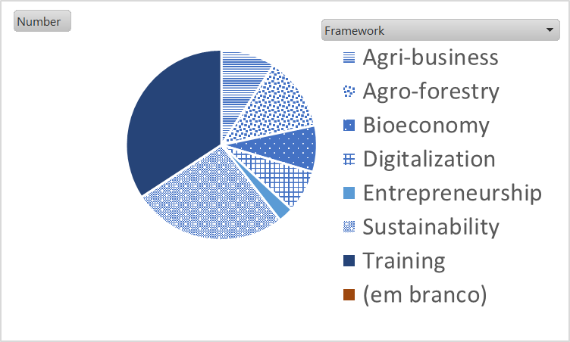
WP 5.1 - National and EU Regulatory Framework
Regulatory Framework per theme
Training 52
Sustainability 40
Agro-forestry 19
Agri-business 14
Bioeconomy 12
Digitalization 11
Entrepreneurship 4

Slide 6
WP 5.1 - National and EU Regulatory Framework
The list of regulatory frameworks identified is a working in progress!
Partners are incentivised to update the list.
The regulatory framework may help to identify gaps on training areas that can be proposed for future projects.

Slide 7
Thank you for your attention!

