Slide 1
WP5 – Long term action plan
Lifelong Learning Platform
Pauline Boivin, pauline.boivin@lllplatform.eu
4th project meeting
17/03/2021

Slide 2
WP5 – T5.2 Funding opportunities
WP Start/end date: M7-M24
Partners involved (PMs): CONFAGRI, WUR, ICOS, AERES, AP, UHOH, CERTH, ACTIA, GAIA, AC3A, CONFAGRI PT, GZS, LVA, FIAB, FDE, INFOR, SEVT, EFVET, CEPI
Main Objectives:
List the funding to put into practice the strategy (implementation of training based on the developed curricula, policy making, etc)
List funding to maintain and ensure the future use of the project outputs (platform maintenance and update).
If possible, the consortium will prepare applications to one EU and several national schemes by the end of the project to further implement the training.

Slide 3
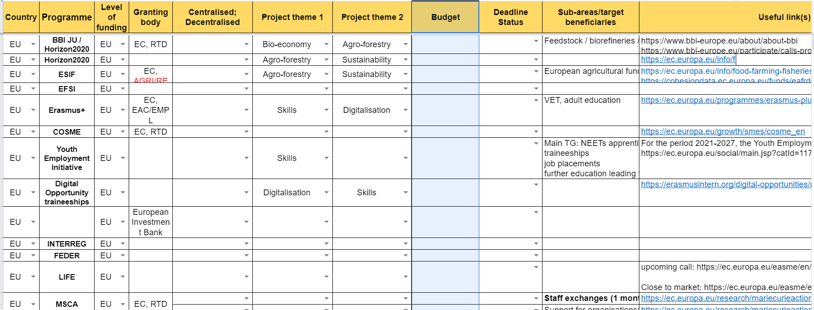
WP1 – T1.2 Stakeholders strategic mapping
Partners upload EU and national funding on FIELDS Management Portal (from April/May 2021 until September) Survey to partners to use of funding opportunities (Oct-Nov 2021)

