Slide 1
T 7.2 Communication and Dissemination Campaign
5^{rh} Consortium meeting
May 2022

Slide 2
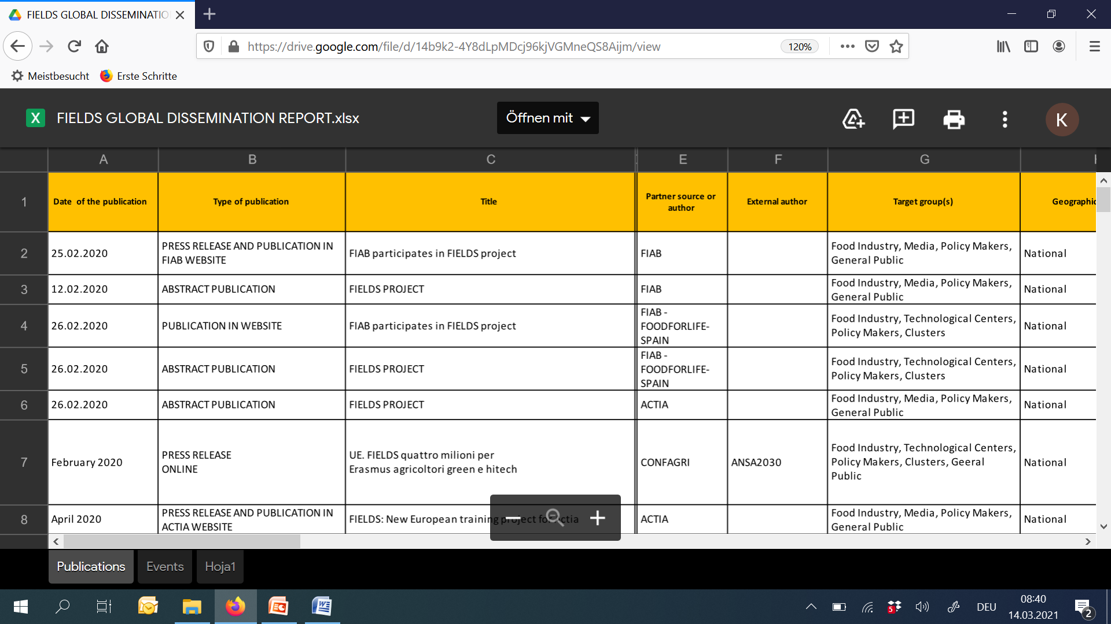
WP7 – Global dissemination report
To be filled by each partner
Global dissemination report https://drive.google.com/file/d/14b9k2-4Y8dLpMDcj96kjVGMneQS8Aijm/view?usp=sharing

Slide 3
WP7 – task 7.2
Task Leader: FIAB
Partners involved: all
From month 1 to 48
The aim of communication and dissemination campaign is to ensure that the program will be spread effectively to the stakeholders
Main Objectives are to developed and implement this campaign to ensure broad awareness rising of the project outcomes to the target groups by creating dissemination material as website, leaflet, poster, newsletters, social media channels, by organizing workshops and conferences, by presenting the project in external conferences/meetings at national and international level and by the publication of FIELDS goals and outputs in specialized magazines.

Slide 4
COMMUNICATION MATERIAL
LOGO
Leaflet available in English and all consortium languages
http://www.erasmus-fields.eu/management/sites/default/files/documents/others/final/Leaflet_Front_ENG.pdf

Slide 5
COMMUNICATION MATERIAL
Poster available in English and all consortium languages
http://www.erasmus-fields.eu/management/sites/default/files/documents/others/final/Poster%20FIELDS_ENG.pdf

Slide 6
COMMUNICATION MATERIAL
Hosting plan for 8 years (to ensure sustainability of the platform 4 years after Project’s end).
https://www.erasmus-fields.eu/

Slide 7
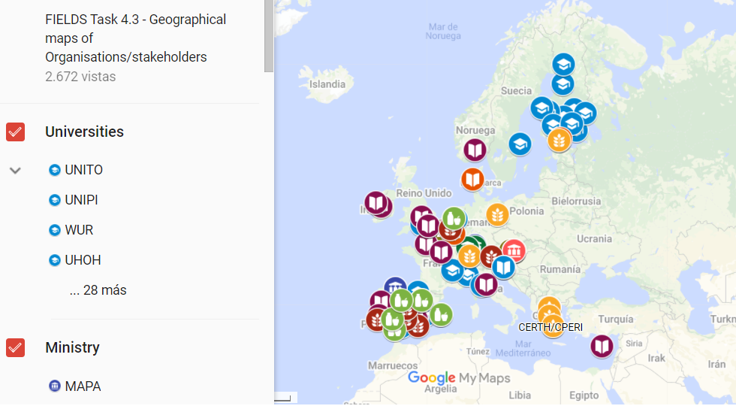
COMMUNICATION MATERIAL

Slide 8
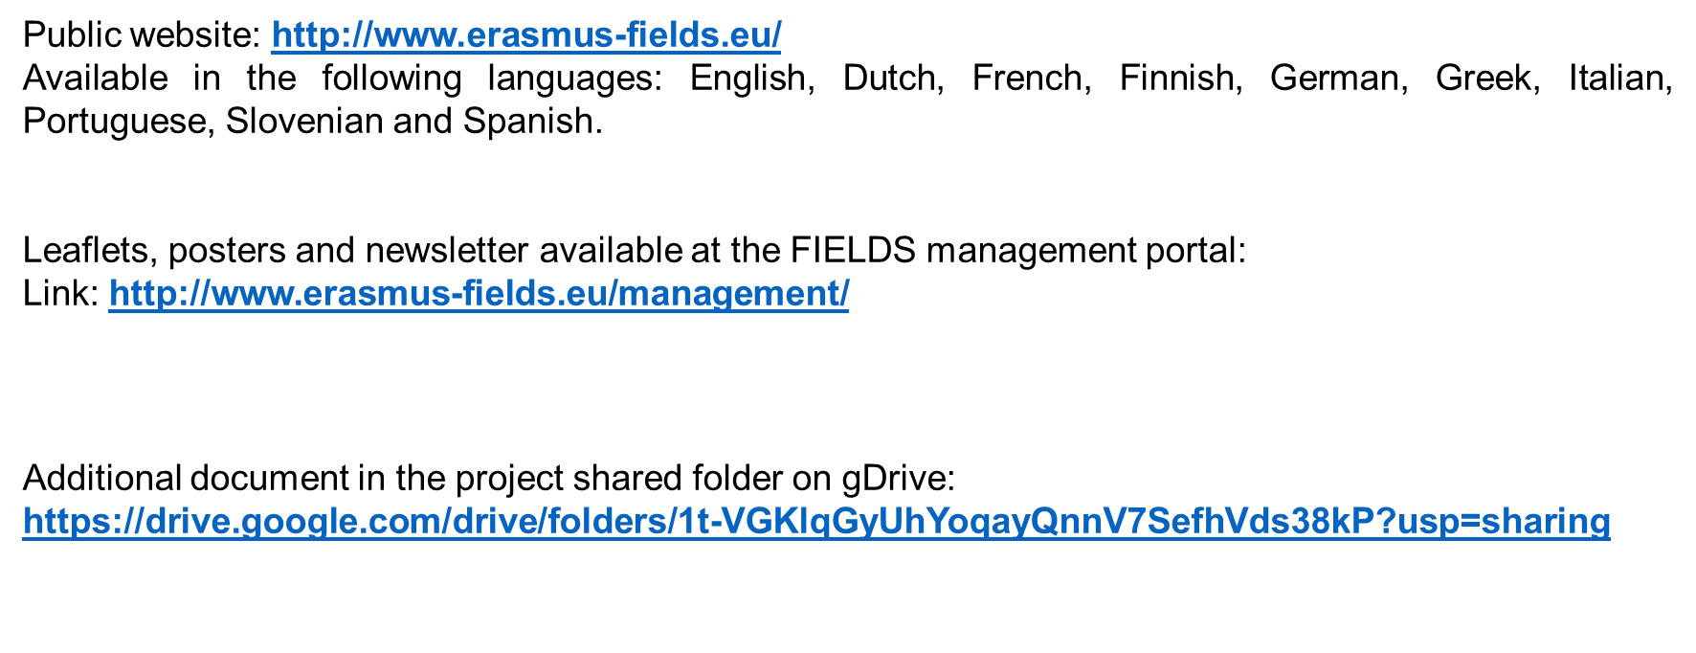
COMMUNICATION MATERIAL

Slide 9
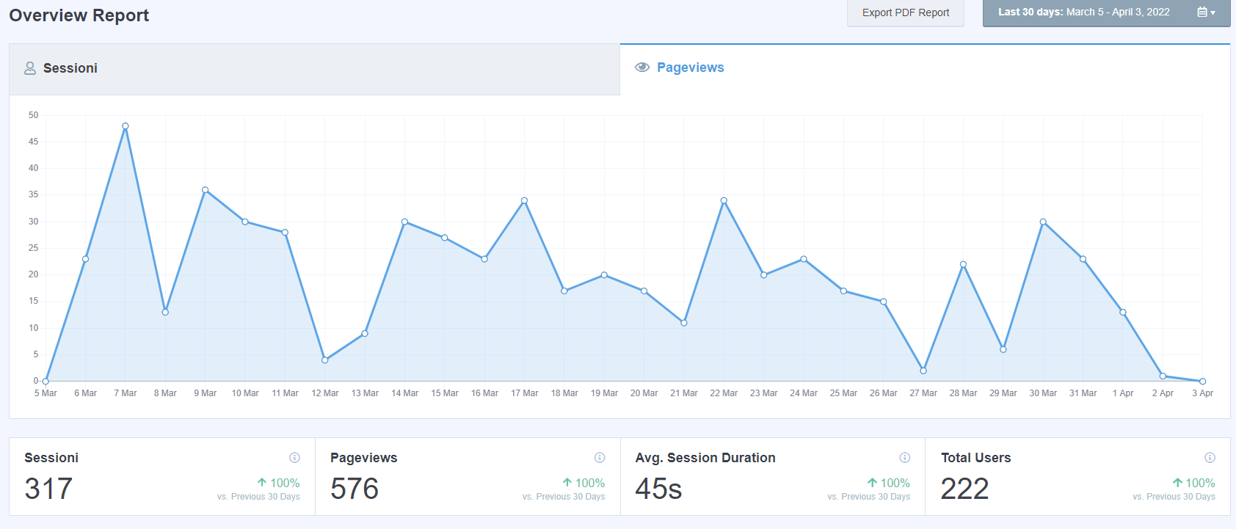
COMMUNICATION MATERIAL
UPDATED
Public website – Analytics Average 30 days

Slide 10
COMMUNICATION MATERIAL
#1 In English and translated in all partners’ languages.
https://drive.google.com/file/d/1C7EuFCRBlURtfPpazVyqXDHnWJUY18fb/view

Slide 11
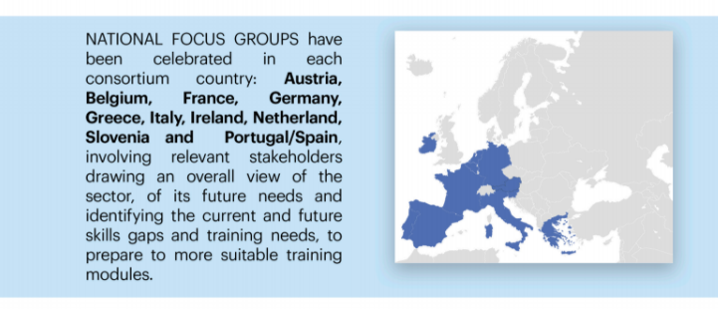
COMMUNICATION MATERIAL

Slide 12
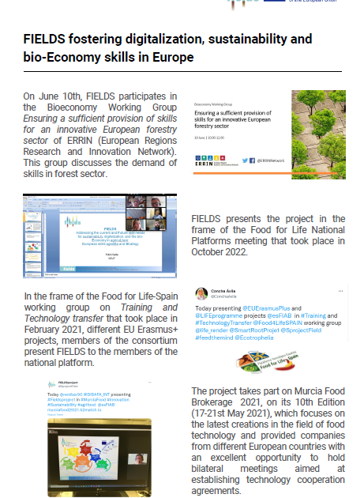
COMMUNICATION MATERIAL
NEW
#2 In English and translated in all partners’ languages.
http://www.erasmus-fields.eu/management/sites/default/files/documents/others/final/Newsletter_FIELDS_2.pdf

Slide 13
ARTICLES AND PRESS RELEASES
UPDATED
Abstract of the project in each partners website with a link to FIELDS
https://www.actia-asso.eu/en/projets/fields/
https://fiab.es/project/fields/
https://www.lva.at/lebensmittelversuchsanstalt/technet/europaeische-forschung-european-food-research/aktuelleprojekte/298-fields.html
http://www.agro-alimentarias.coop/noticias/ver/OTA1MQ==
https://www.iseki-food.net/projects/project-overview
https://www.confagri.pt/imprensa/fields-identificacao-das-necessidades-atuais-competencias-sustentabilidade-digitalizacao-bioeconomia-na-agricultura/
https://www.uclm.es/es/noticias/noticias2020/febrero/ciudad-real/proyecto_fields
https://www.sevt.gr/en/european-programs/GMON/fields
https://www.disafa.unito.it/do/progetti.pl/Show?_id=m865
https://miurltemporal.com/main/fenacore.org/

Slide 14
ARTICLES AND PRESS RELEASES
Publications in partners websites related to project goals, national focus groups, trends survey, newsletter
http://mkt.confagri.pt/vl/dbbf1219edf2a6-a62d22773b53ab4c1165ffca24eipe1k6jge19Ose4-459-f051
https://www.sevt.gr/en/european-programs-details/HMmMvg/fields-european-project
https://fiab.es/fiab-participa-en-el-proyecto-fields-para-formar-en-sostenibilidad-bioeconomia-y-digitalizacion-a-los-trabajadores-del-sector-agroindustrial/
https://www.iseki-food.net/have-your-say-future-skills-needed-agri-food-and-forestry-sectors

Slide 15
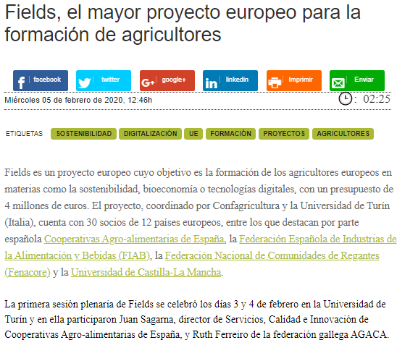
ARTICLES AND PRESS RELEASES
Articles published in relevant journals and specialized magazines
https://issuu.com/mondo_agricolo/docs/mondo_agricolo_3_2020_issuu
https://www.mercacei.com/noticia/52092/actualidad/fields-el-mayor-proyecto-europeo-para-la-formacion-de-agricultores.html
https://www.agricolae.eu/parte-fields-il-piu-grande-progetto-formativo-europeo-per-l-agroalimentare-italia-capofila-con-confagricoltura-e-universita-torino/

Slide 16
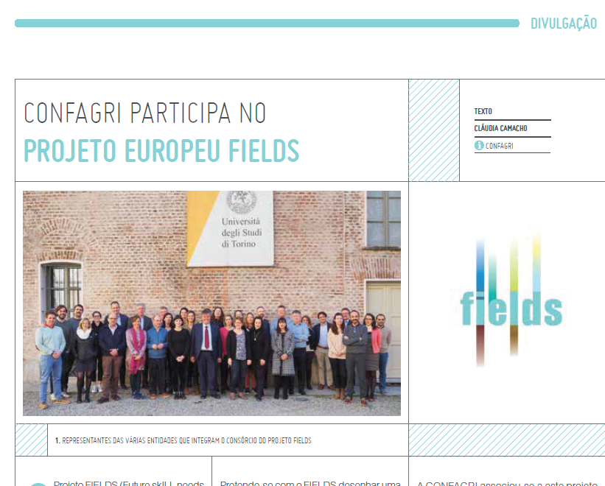
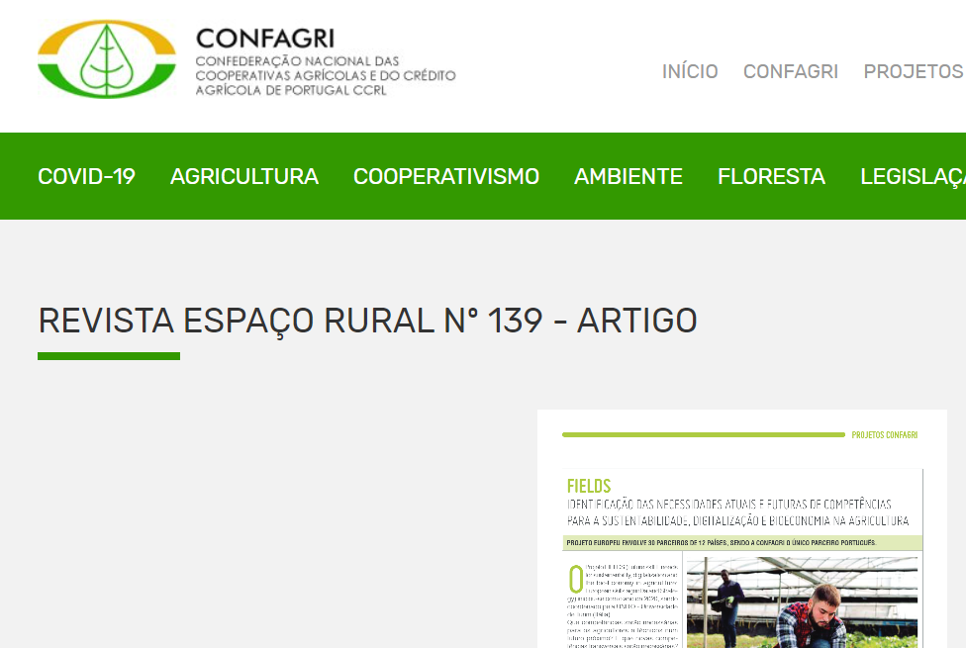
ARTICLES AND PRESS RELEASES
Articles published in relevant journals and specialized magazines
“CONFAGRI participa no projeto Europeu Fields”, Espaço Rural n.º 136, July 2020
https://www.confagri.pt/imprensa/fields-identificacao-das-necessidades-atuais-competencias-sustentabilidade-digitalizacao-bioeconomia-na-agricultura/

Slide 17
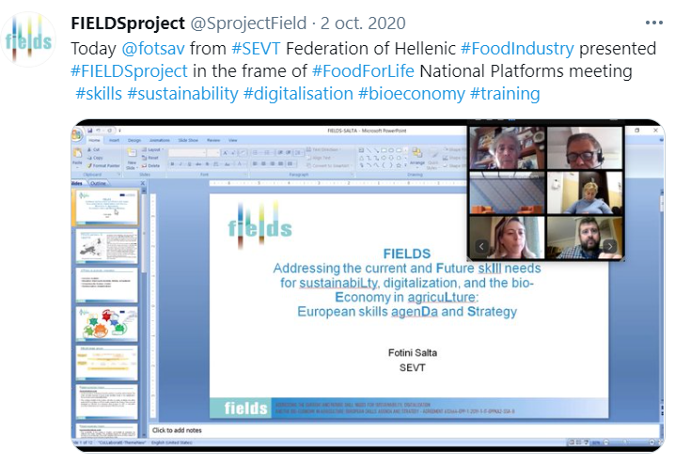
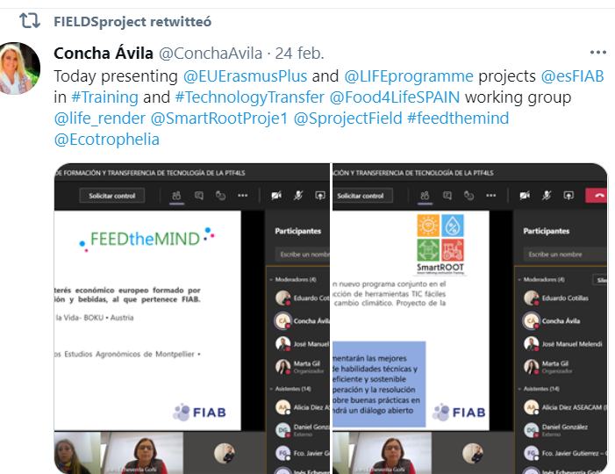
PROJECT PRESENTATIONS
Dissemination in National Food Technology Platforms at the different stages development of the project
Presentation of project goals and works in National Platforms FoodforLife meeting – SEVT (Oct.2020)
Presentation of project goals and works in FoodforLife-Spain working groups meeting – FIAB (Feb.2021)

Slide 18
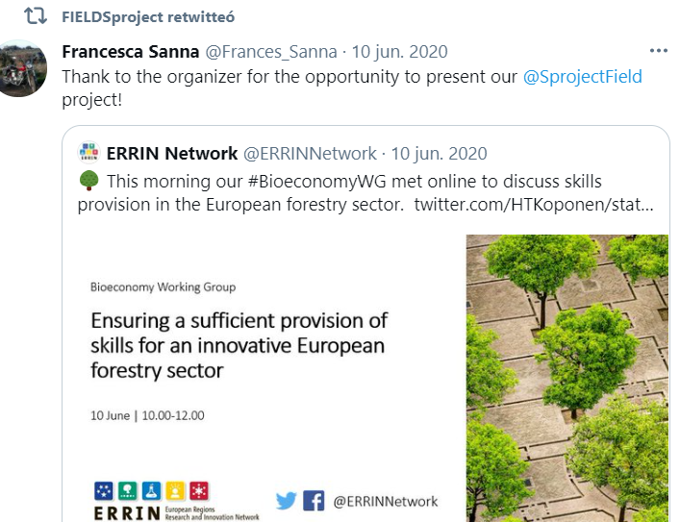
PROJECT PRESENTATIONS
Dissemination in external conferences
Presentation in ERRIN European Regions Research and Innovation Network – UNITO (June 2020)

Slide 19
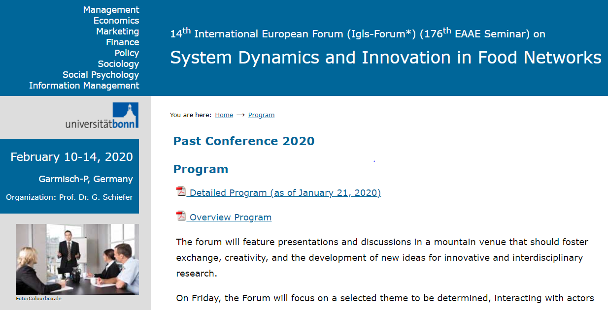
PROJECT PRESENTATIONS
Food Authority Conference - CoUk Novel Food – LVA, Austria
14th International European Forum (Igls-Forum) – UNITO, Germany http://www.fooddynamics.org/fooddynamics2020/program/program.html

Slide 20
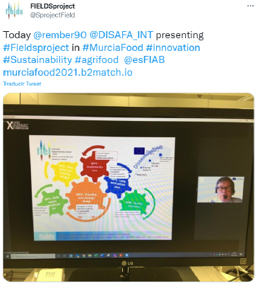
PROJECT PRESENTATIONS March 2021 – May 2022
NEW
UNITO presented the project in Murcia Food Brokerage 2021, on its 10th Edition (17-21st May 2021), which focuses on the latest creations in the field of food technology and provided companies from different European countries with an excellent opportunity to hold bilateral meetings aimed at establishing technology cooperation agreements.

Slide 21
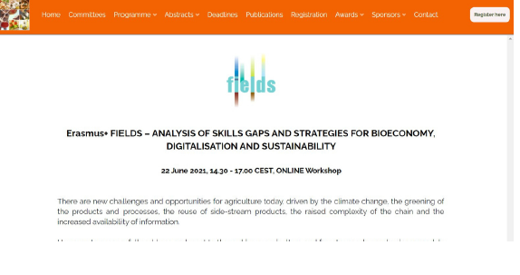
PROJECT PRESENTATIONS March 2021 – May 2022
FIELDS project celebrates an online Workshop during the 6th International ISEKI Food conference, focused on the analysis of skill gaps and strategies for bioeconomy, digitalisation and sustainability. This event took place on June 22nd 2021.

Slide 22
PROJECT PRESENTATIONS March 2021 – May 2022
On 14-16th October, during the celebration of the #ErasmusDays, ISEKI Food Association participates as a member of the Fields project.

Slide 23
PROJECT PRESENTATIONS March 2021 – May 2022
During the Pact of Skills meeting on October 18th, Fields project presents its ongoing works and outputs on the skills needed for the future of the EU agriculture

Slide 24
PROJECT PRESENTATIONS March 2021 – May 2022
FIELDS also took part in the EUBioNet Workshop "Promote education, training and skills across the bioeconomy” on October 26th.

Slide 25
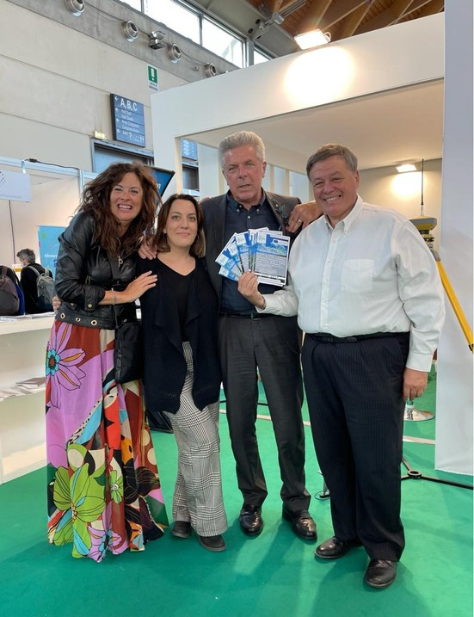
PROJECT PRESENTATIONS March 2021 – May 2022
Ecomondo is one of the biggest fairs on ecological transition and new models of circular and regenerative economies. FIELDS coordinators participate and present the project and its main outputs, 26-29th October

Slide 26
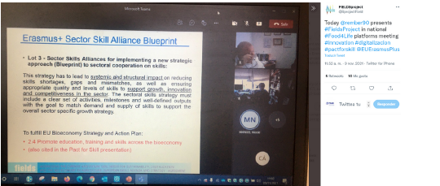
PROJECT PRESENTATIONS March 2021 – May 2022
The FIELDS project participates in the National Food 4 Life platforms
meeting.

Slide 27
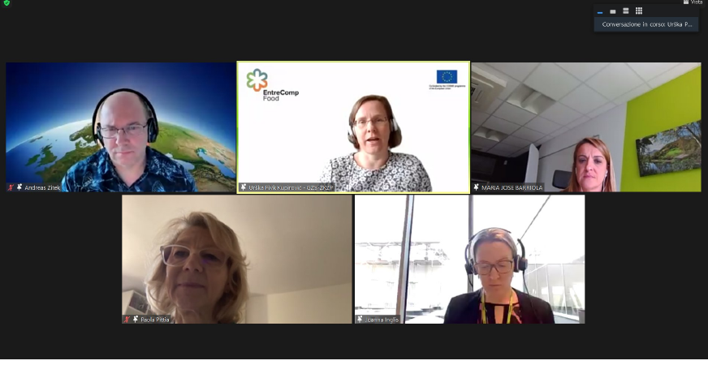
PROJECT PRESENTATIONS March 2021 – May 2022
FIELDS project also participated on the Education training and skills across the bioeconomy workshop by the EU Commission to gather a wide-range of stakeholders in the field of bioeconomy education training and skills

Slide 28
SOCIAL NETWORKS
https://twitter.com/SprojectField
https://www.linkedin.com/company/fields-project-erasmus/?viewAsMember=true
https://www.facebook.com/Fields-Project-Erasmus-115331017260054
https://www.youtube.com/channel/UCKFCxHAmRdRLF9_axPy-eNg

Slide 29
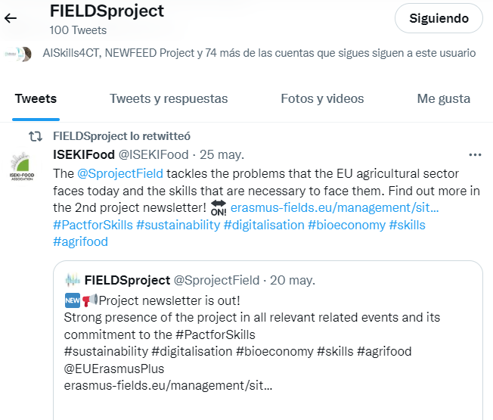
UPDATED
FIELDSproject - @SprojectFIELD
To be Followed by all partners - Promoted in partners accounts
News, pictures, events are published in English and/or partners languages
Up today 179 followers - 100 publications

Slide 30
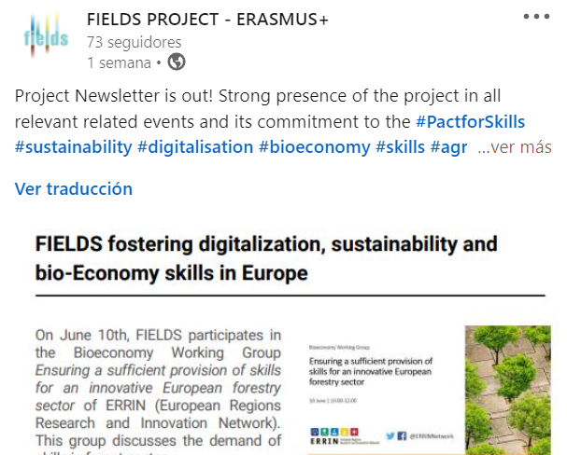
UPDATED
FIELDS PROJECT – ERASMUS+ https://www.linkedin.com/company/fields-project-erasmus/
To be Followed by all partners - Promoted in partners accounts
News, pictures, events are published in English and/or partners languages
Up today 73 followers – +20 publications

Slide 31
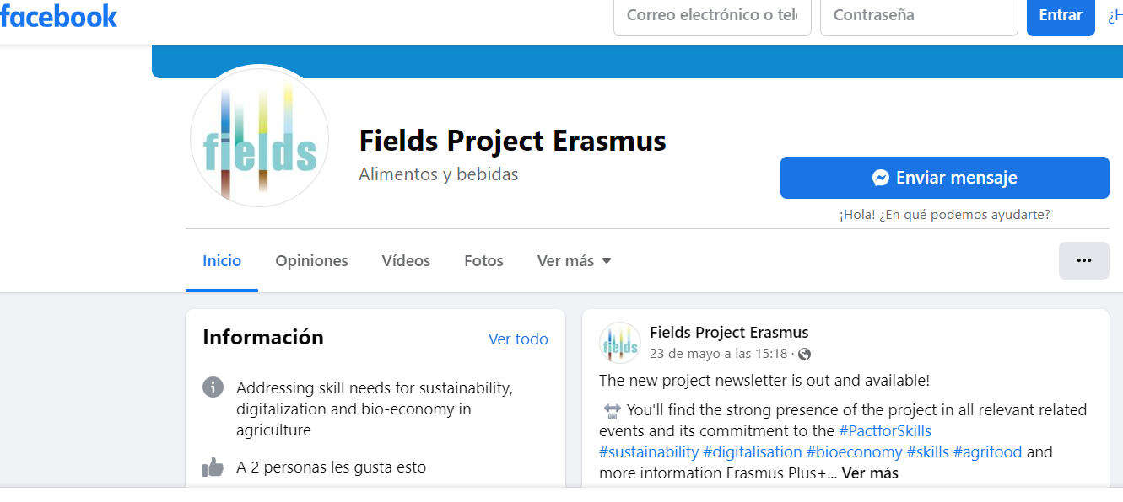
UPDATED
FIELDS PROJECT ERASMUS
https://www.facebook.com/fieldsproject.erasmus.1
To be Followed by all partners - Promoted in partners accounts
Up today 23 followers – +15publications

Slide 32
UPDATED
Fields Project Erasmus
https://www.youtube.com/channel/UCKFCxHAmRdRLF9_axPy-eNg
To be followed by all partners - Promoted in partners accounts
Up today 10 subscribers and 8 videos uploaded; it will be updated during the creation of training material and interviews with the trainers and trainees.

Slide 33
NEXT ACTIVITIES TO FOSTER DISSEMINATION
#3 NEWSLETTER
YouTube
Short videos from partners presenting the project and their institution involvement
Videos during training sessions
NEXT PARTICIATION IN CONFERENCES?
FIELDS SOCIAL MEDIA CHANNELS
All partners are requested to interact in FIELDS social media, to follow all of them, to name the Project in their publications, to increase their involment.
WE NEED TO ATTRACK MORE STAKEHOLDERS!!!
URGENT

Slide 34
Thank you for your attention!
Concha Ávila, Spanish Food and Drink Federation - FIAB
c.avila@fiab.es

