Slide 1
WP7 – Dissemination and Communication
virtual consortium meeting
17th of March, 2021
ACTIA - Christophe Cotillon - c.cotillon@actia-asso.eu
ACTIA – Gemma Cornuau – g.cornuau@actia-asso.eu
FIAB – Conchà Avila – c.avila@fiab.es
LVA - Katharina Stollewerk, katharina.stollewerk@lva.at
LVA - Julian Drausinger, julian.drausinger@lva.at

Slide 2
WP7 Info
WP Start/end date: M1-M48
Deliverables:
D7.1 - Dissemination Plan (LVA) - Submitted
D7.2 – Public website (UNITO) - Submitted
D7.3 – Public leaflet and poster (UNITO) – Submitted
D7.4 – Report on dissemination action (FIAB) – Due date: 31.12.2023
https://docs.google.com/spreadsheets/d/14b9k2-4Y8dLpMDcj96kjVGMneQS8Aijm/edit#gid=723198398

Slide 3
T7.1 Dissemination plan
Duration: M1-M9
Leader: LVA
Involved: ACTIA, FIAB, CONFAGRI, UNITO

Slide 4
T7.1 Dissemination Plan
The Dissemination Plan content
Dissemination objectives
The expected outcomes
for every Work pack: objectives and expected outcomes
Key Messages
Target Groups
Who are they and what is their benefit?
How can they be reached?
Communication tools
Guidelines for communicating project results
Surveillance actions
APPENDIX I. Communication guideline for indicative orientation of communication acitivities
APPENDIX II. List of deliverables, target groups and dissemination methods

Slide 5
T7.1 Dissemination Plan – Key messages

Slide 6
T7.1 Dissemination Plan – Communication tools and target groups
Figure 1 maps target groups against the communication tools described below.

Slide 7
T7.1 Dissemination Plan – Communication tools and partners

Slide 8
T7.1 Dissemination Plan – Guidelines for communicating project results
Notes:
We defined a „procedure“

Slide 9
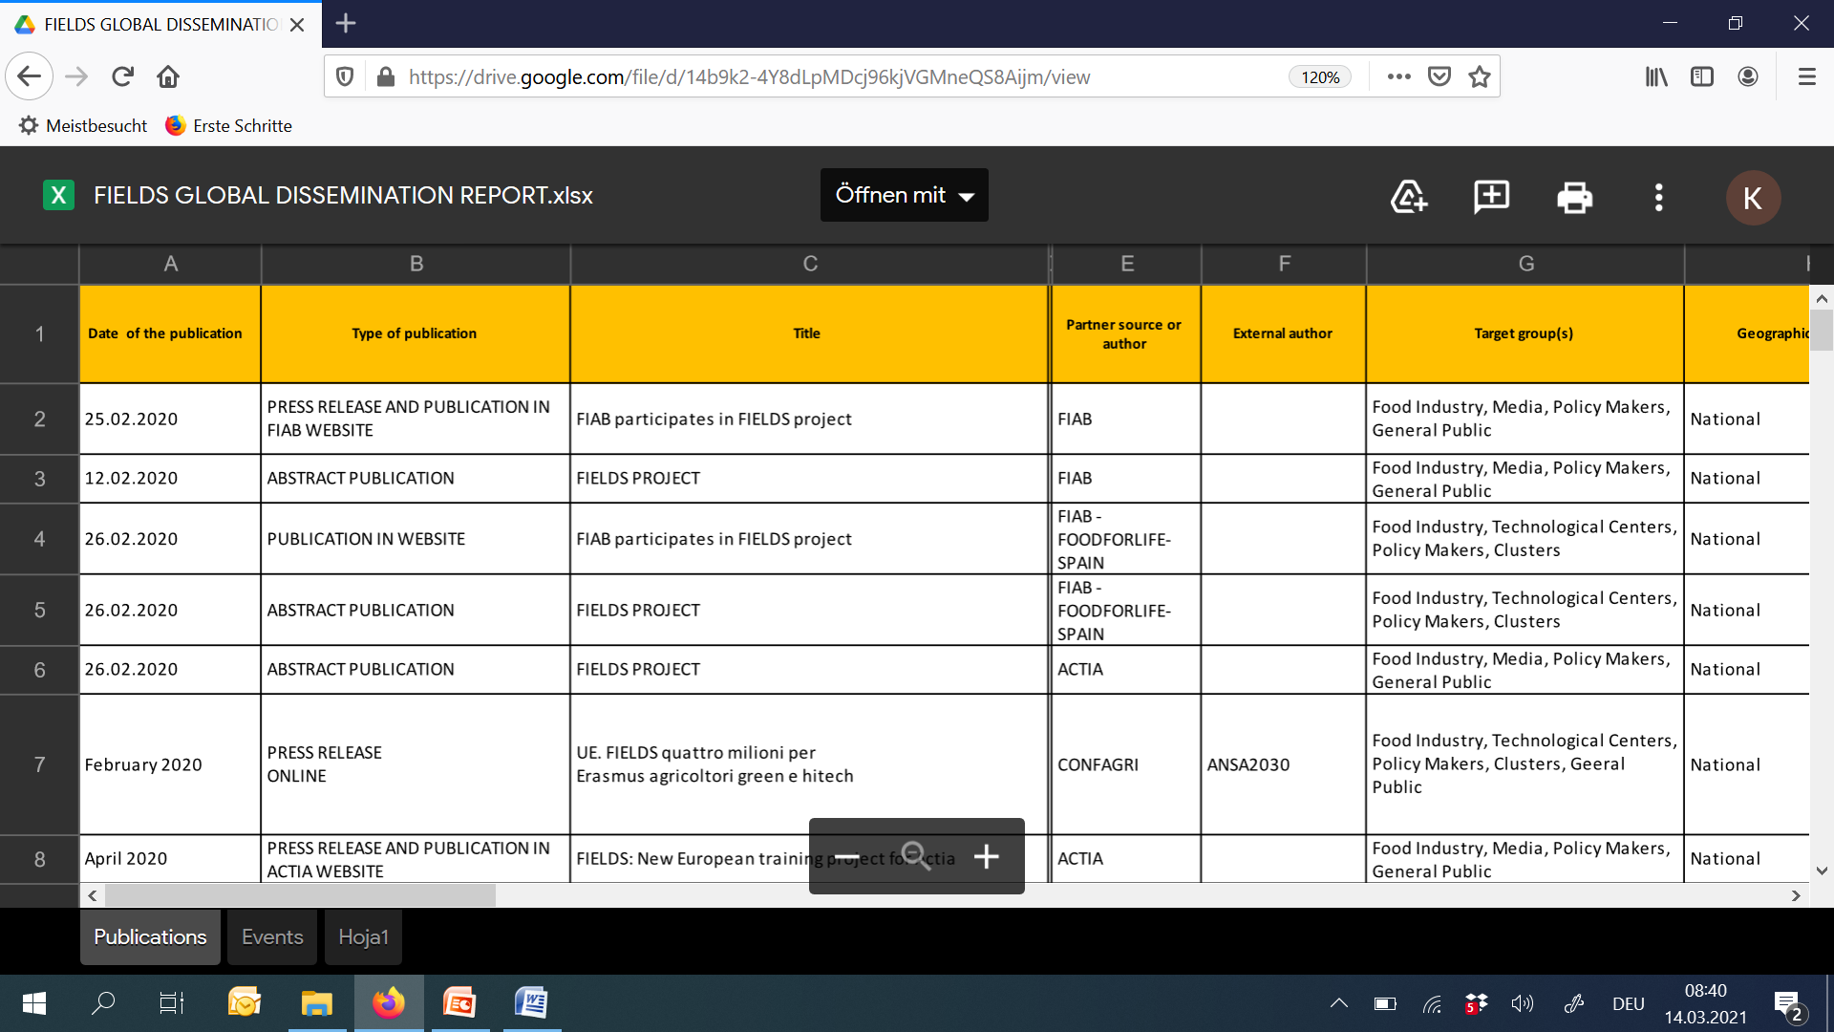
T7.1 Dissemination Plan – Surveillance actions (1)
Global dissemination report https://drive.google.com/file/d/14b9k2-4Y8dLpMDcj96kjVGMneQS8Aijm/view?usp=sharing

Slide 10
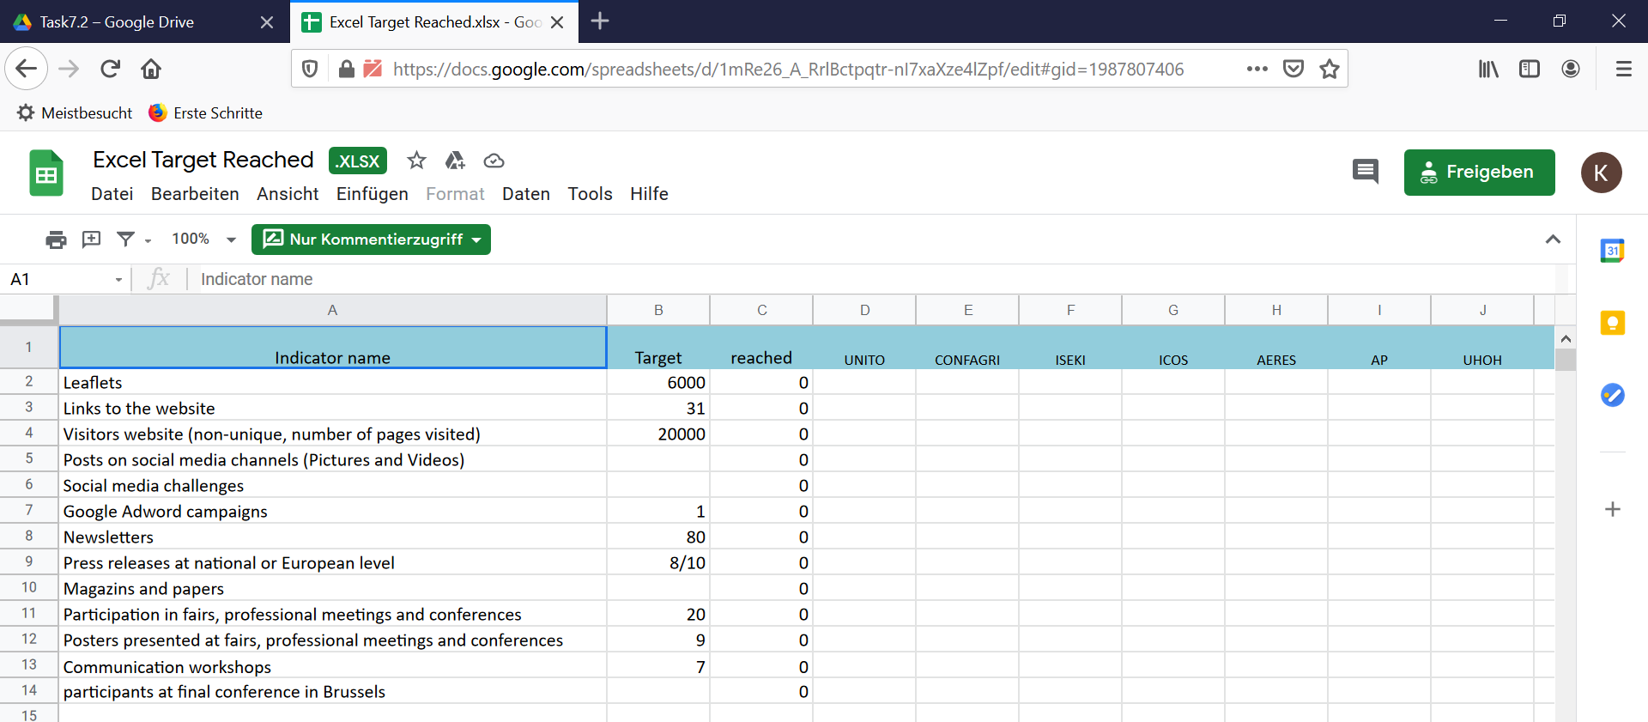
T7.1 Dissemination Plan – Surveillance actions (2 + 3)
Goal achievement excel file https://drive.google.com/drive/u/0/folders/1-ZRCyHZNro5XpHQ-swPgK7S4EVnr3uXz
Annual dissemination report per year (FIAB)

Slide 11
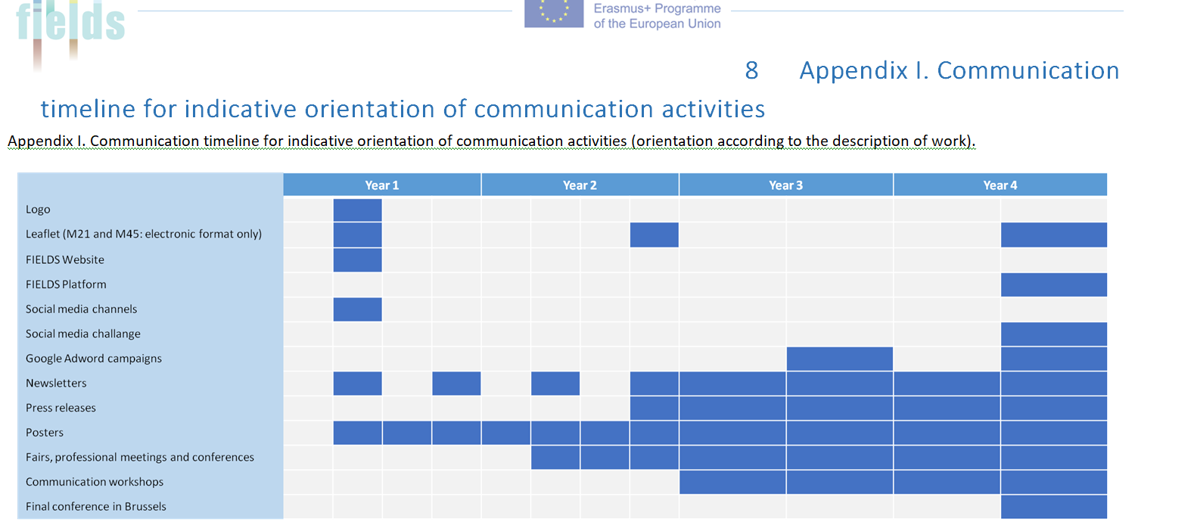
T7.1 Dissemination Plan – Appendix I

Slide 12
T7.1 Dissemination Plan – Appendix II
List includes all deliverables

Slide 13
T 7.2 Communication and Dissemination Campaign
Concha Ávila – c.avila@fiab.es
4th Consortium meeting
17th March 2021

Slide 14
WP7 – task 7.2
Task Leader: FIAB
Partners involved: all
From month 1 to 48
The aim of communication and dissemination campaign is to ensure that the program will be spread effectively to the stakeholders
Main Objectives are to developed and implement this campaign to ensure broad awareness rising of the project outcomes to the target groups by creating dissemination material as website, leaflet, poster, newsletters, social media channels, by organizing workshops and conferences, by presenting the project in external conferences/meetings at national and international level and by the publication of FIELDS goals and outputs in specialized magazines.

Slide 15
COMMUNICATION MATERIAL
LOGO
Leaflet available in English and all consortium languages
http://www.erasmus-fields.eu/management/sites/default/files/documents/others/final/Leaflet_Front_ENG.pdf

Slide 16
COMMUNICATION MATERIAL
Poster available in English and all consortium languages
http://www.erasmus-fields.eu/management/sites/default/files/documents/others/final/Poster%20FIELDS_ENG.pdf

Slide 17
COMMUNICATION MATERIAL
Hosting plan for 8 years (to ensure sustainability of the platform 4 years after Project’s end).
https://www.erasmus-fields.eu/

Slide 18
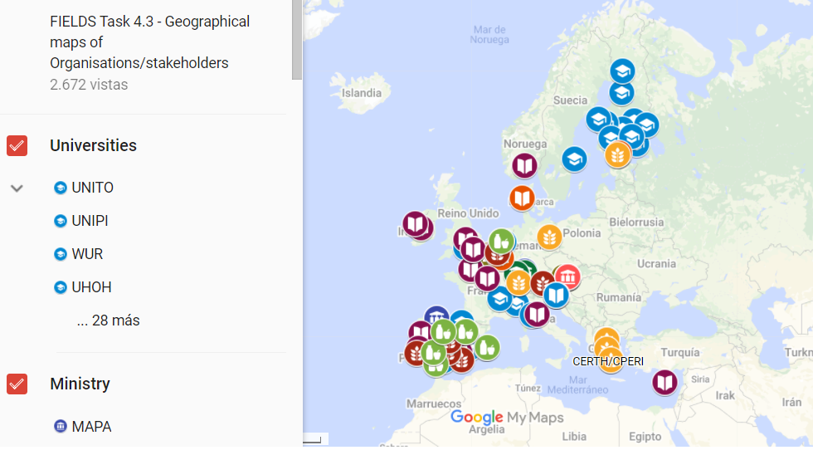
COMMUNICATION MATERIAL

Slide 19
COMMUNICATION MATERIAL
#1 In English and translated in all partners’ languages.
https://drive.google.com/file/d/1C7EuFCRBlURtfPpazVyqXDHnWJUY18fb/view

Slide 20
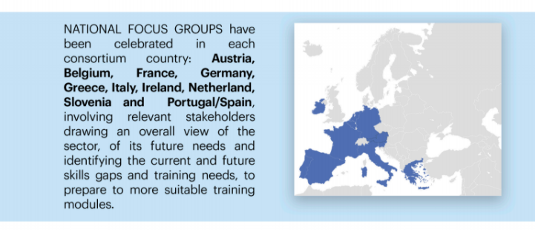
COMMUNICATION MATERIAL

Slide 21
ARTICLES AND PRESS RELEASES
Abstract of the project in each partners website with a link to FIELDS
https://www.actia-asso.eu/en/projets/fields/
https://fiab.es/project/fields/
https://www.lva.at/lebensmittelversuchsanstalt/technet/europaeische-forschung-european-food-research/aktuelleprojekte/298-fields.html
http://www.agro-alimentarias.coop/noticias/ver/OTA1MQ==
https://www.iseki-food.net/projects/project-overview
https://www.confagri.pt/imprensa/fields-identificacao-das-necessidades-atuais-competencias-sustentabilidade-digitalizacao-bioeconomia-na-agricultura/
https://www.uclm.es/es/noticias/noticias2020/febrero/ciudad-real/proyecto_fields
https://www.sevt.gr/en/european-programs/GMON/fields
https://www.disafa.unito.it/do/progetti.pl/Show?_id=m865

Slide 22
ARTICLES AND PRESS RELEASES
Publications in partners websites related to project goals, national focus groups, trends survey, newsletter
http://mkt.confagri.pt/vl/dbbf1219edf2a6-a62d22773b53ab4c1165ffca24eipe1k6jge19Ose4-459-f051
https://www.sevt.gr/en/european-programs-details/HMmMvg/fields-european-project
https://fiab.es/fiab-participa-en-el-proyecto-fields-para-formar-en-sostenibilidad-bioeconomia-y-digitalizacion-a-los-trabajadores-del-sector-agroindustrial/
https://www.iseki-food.net/have-your-say-future-skills-needed-agri-food-and-forestry-sectors

Slide 23
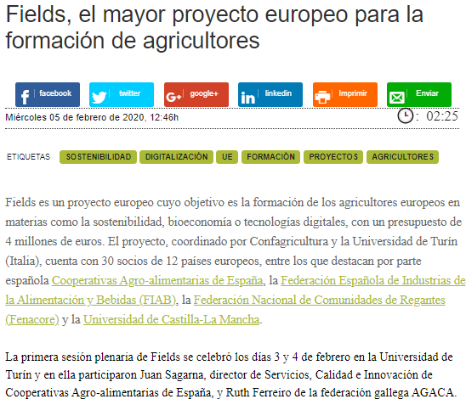
ARTICLES AND PRESS RELEASES
Articles published in relevant journals and specialized magazines
https://issuu.com/mondo_agricolo/docs/mondo_agricolo_3_2020_issuu
https://www.mercacei.com/noticia/52092/actualidad/fields-el-mayor-proyecto-europeo-para-la-formacion-de-agricultores.html
https://www.agricolae.eu/parte-fields-il-piu-grande-progetto-formativo-europeo-per-l-agroalimentare-italia-capofila-con-confagricoltura-e-universita-torino/

Slide 24
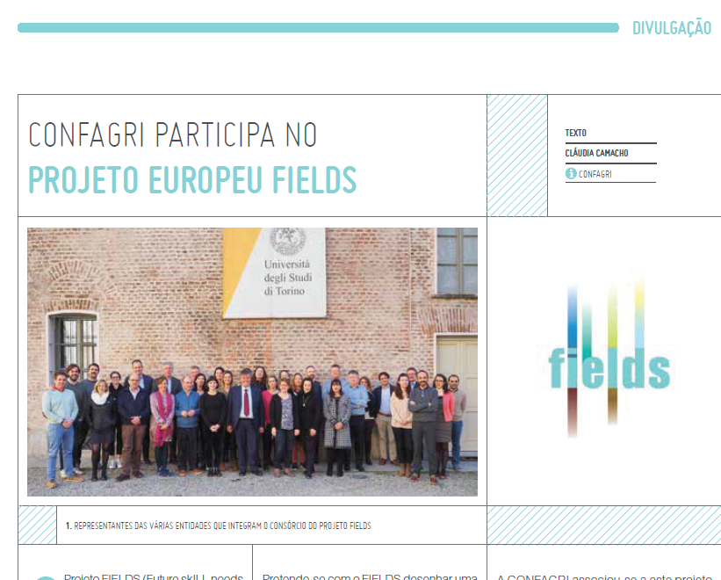
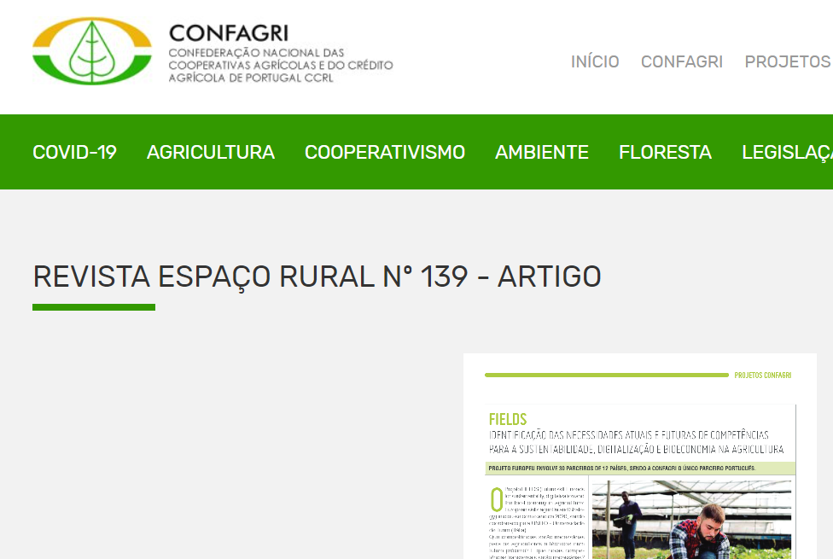
ARTICLES AND PRESS RELEASES
Articles published in relevant journals and specialized magazines
“CONFAGRI participa no projeto Europeu Fields”, Espaço Rural n.º 136, July 2020
https://www.confagri.pt/imprensa/fields-identificacao-das-necessidades-atuais-competencias-sustentabilidade-digitalizacao-bioeconomia-na-agricultura/

Slide 25
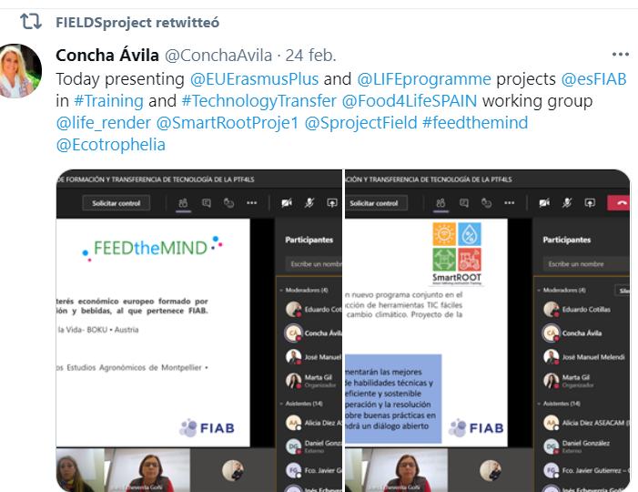
PROJECT PRESENTATIONS
Dissemination in National Food Technology Platforms at the different stages development of the project
Presentation of project goals and works in National Platforms FoodforLife meeting – SEVT (Oct.2020)
Presentation of project goals and works in FoodforLife-Spain working groups meeting – FIAB (Feb.2021)

Slide 26
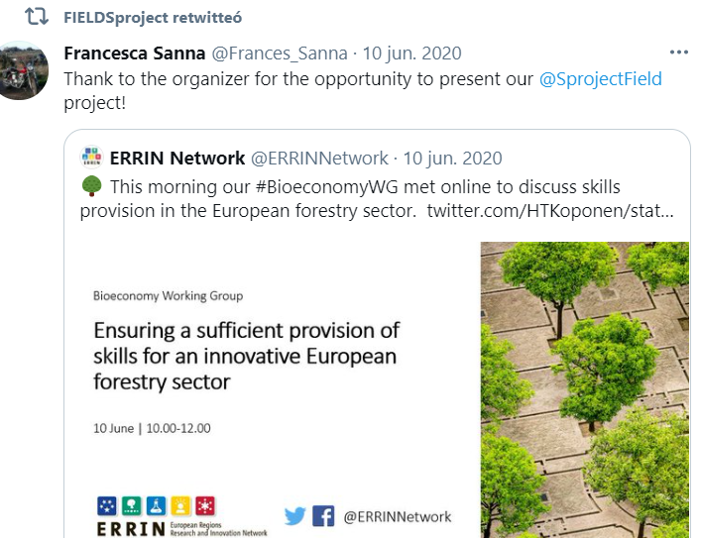
PROJECT PRESENTATIONS
Dissemination in external conferences
Presentation in ERRIN European Regions Research and Innovation Network – UNITO (June 2020)

Slide 27
PROJECT PRESENTATIONS
Food Authority Conference - CoUk Novel Food – LVA, Austria
14th International European Forum (Igls-Forum) – UNITO, Germany http://www.fooddynamics.org/fooddynamics2020/program/program.html

Slide 28
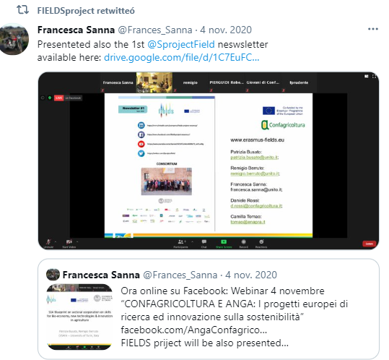
PROJECT PRESENTATIONS
Dissemination of the project through webinar
(Confagricoltura/UNITO, Nov.2020)

Slide 29
SOCIAL NETWORKS
https://twitter.com/SprojectField
https://www.linkedin.com/company/fields-project-erasmus/?viewAsMember=true
https://www.facebook.com/Fields-Project-Erasmus-115331017260054
https://www.youtube.com/channel/UCKFCxHAmRdRLF9_axPy-eNg

Slide 30
FIELDSproject - @SprojectFIELD
Followed by all partners
Promoted in partners accounts
News, pictures, events are published in English and/or partners languages

Slide 31
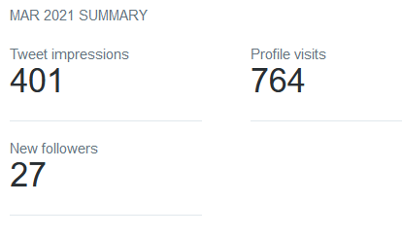
FIELDS figures in Twitter

Slide 32
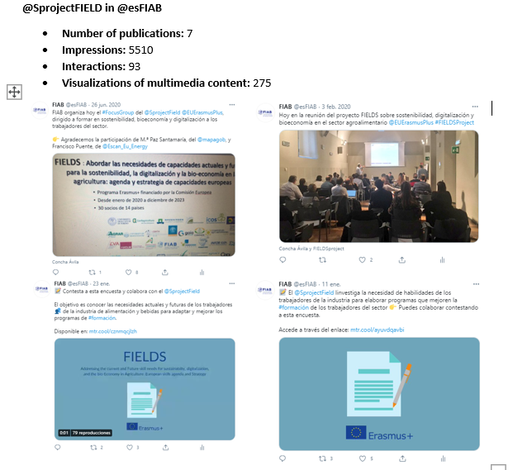
Promotion of FIELDS account from main partners accounts

Slide 33
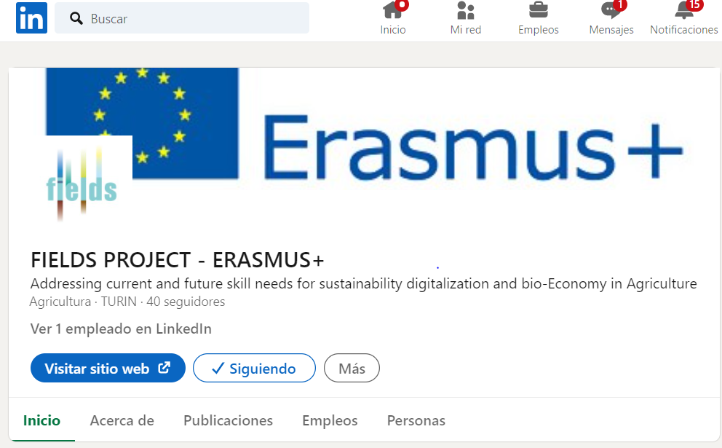

Slide 34
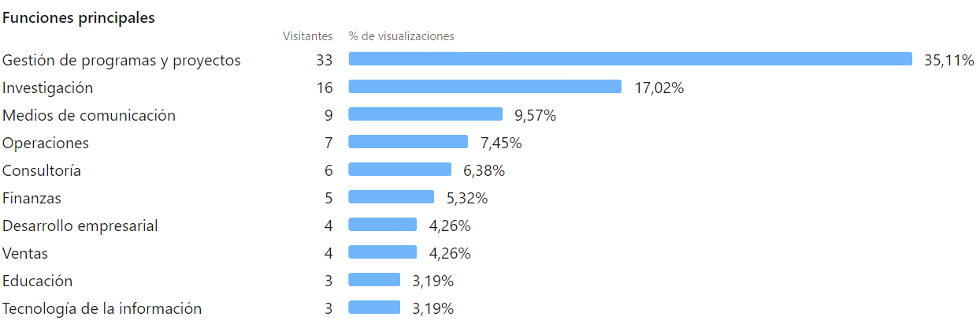
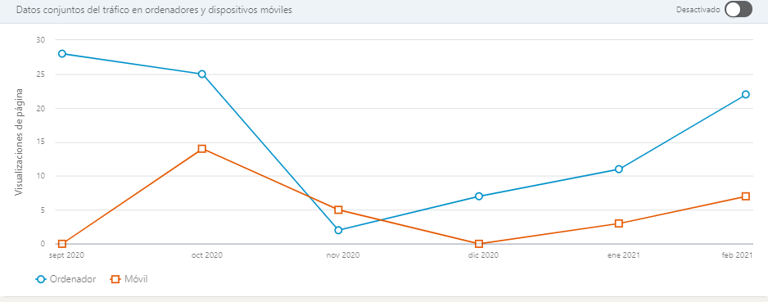

Slide 35
Promotion of FIELDS account from main partners accounts
Example FIAB LinkedIn

Slide 37
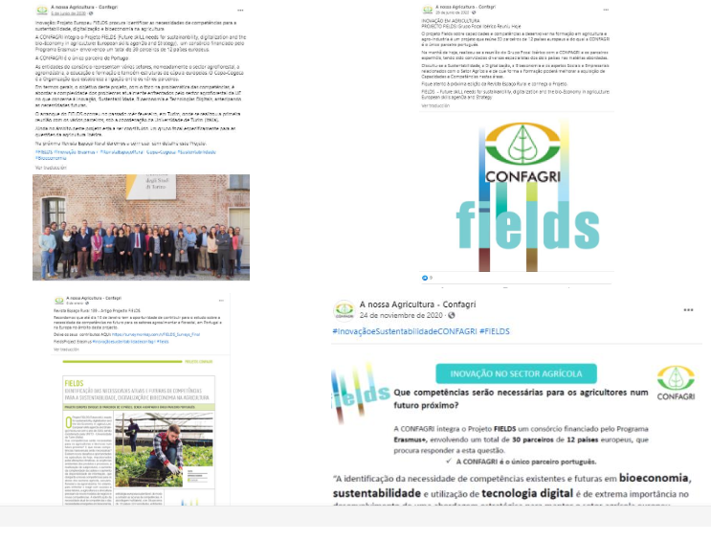
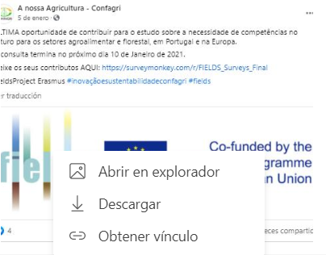

Slide 38
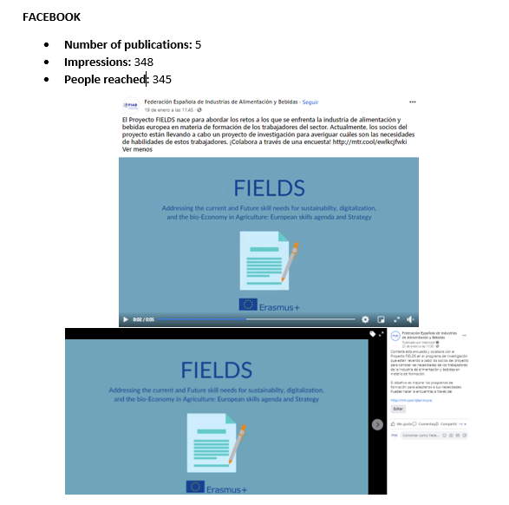
Promotion of FIELDS account from main partners accounts
Example FIAB FACEBOOK

Slide 40
NEXT ACTIVITIES
#2 NEWSLETTER –
Subjects proposed and to be discussed by FIELDS consortium
Project presentation in conferences/meetings with pictures
Results of WP1
YouTube
Videos proposed and to be discussed by FIELDS consortium
Short videos from partners presenting the project
PARTICIATION IN CONFERENCES
15th International European Forum (Igls-Forum) - System Dynamics and Innovation in Food Networks (March 2021, Germany)
Food Murcia Congress (May 2021, Spain)

Slide 41
Thank you for your attention!

