Slide 1
T 7.2 Communication and Dissemination Campaign
Concha Ávila – c.avila@fiab.es
4th Consortium meeting
17th March 2021

Slide 2
WP7 – task 7.2
Task Leader: FIAB
Partners involved: all
From month 1 to 48
The aim of communication and dissemination campaign is to ensure that the program will be spread effectively to the stakeholders
Main Objectives are to developed and implement this campaign to ensure broad awareness rising of the project outcomes to the target groups by creating dissemination material as website, leaflet, poster, newsletters, social media channels, by organizing workshops and conferences, by presenting the project in external conferences/meetings at national and international level and by the publication of FIELDS goals and outputs in specialized magazines.

Slide 3
COMMUNICATION MATERIAL
LOGO
Leaflet available in English and all consortium languages
http://www.erasmus-fields.eu/management/sites/default/files/documents/others/final/Leaflet_Front_ENG.pdf

Slide 4
COMMUNICATION MATERIAL
Poster available in English and all consortium languages
http://www.erasmus-fields.eu/management/sites/default/files/documents/others/final/Poster%20FIELDS_ENG.pdf

Slide 5
COMMUNICATION MATERIAL
Hosting plan for 8 years (to ensure sustainability of the platform 4 years after Project’s end).
https://www.erasmus-fields.eu/

Slide 6
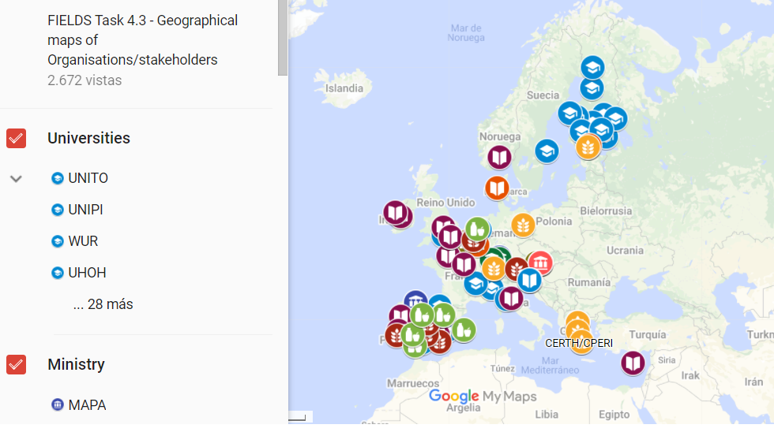
COMMUNICATION MATERIAL

Slide 7
COMMUNICATION MATERIAL
#1 In English and translated in all partners’ languages.
https://drive.google.com/file/d/1C7EuFCRBlURtfPpazVyqXDHnWJUY18fb/view

Slide 8
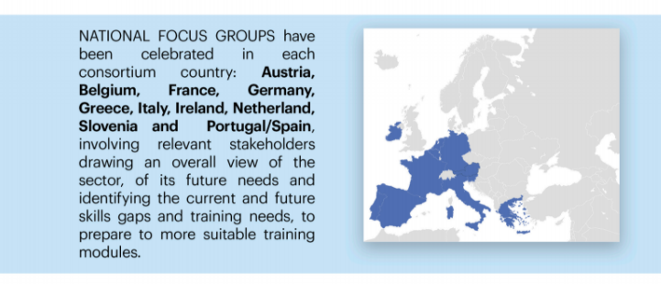
COMMUNICATION MATERIAL

Slide 9
ARTICLES AND PRESS RELEASES
Abstract of the project in each partners website with a link to FIELDS
https://www.actia-asso.eu/en/projets/fields/
https://fiab.es/project/fields/
https://www.lva.at/lebensmittelversuchsanstalt/technet/europaeische-forschung-european-food-research/aktuelleprojekte/298-fields.html
http://www.agro-alimentarias.coop/noticias/ver/OTA1MQ==
https://www.iseki-food.net/projects/project-overview
https://www.confagri.pt/imprensa/fields-identificacao-das-necessidades-atuais-competencias-sustentabilidade-digitalizacao-bioeconomia-na-agricultura/
https://www.uclm.es/es/noticias/noticias2020/febrero/ciudad-real/proyecto_fields
https://www.sevt.gr/en/european-programs/GMON/fields
https://www.disafa.unito.it/do/progetti.pl/Show?_id=m865

Slide 10
ARTICLES AND PRESS RELEASES
Publications in partners websites related to project goals, national focus groups, trends survey, newsletter
http://mkt.confagri.pt/vl/dbbf1219edf2a6-a62d22773b53ab4c1165ffca24eipe1k6jge19Ose4-459-f051
https://www.sevt.gr/en/european-programs-details/HMmMvg/fields-european-project
https://fiab.es/fiab-participa-en-el-proyecto-fields-para-formar-en-sostenibilidad-bioeconomia-y-digitalizacion-a-los-trabajadores-del-sector-agroindustrial/
https://www.iseki-food.net/have-your-say-future-skills-needed-agri-food-and-forestry-sectors

Slide 11
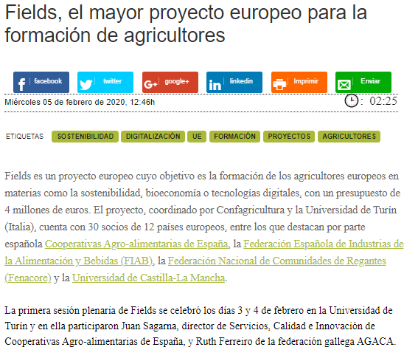
ARTICLES AND PRESS RELEASES
Articles published in relevant journals and specialized magazines
https://issuu.com/mondo_agricolo/docs/mondo_agricolo_3_2020_issuu
https://www.mercacei.com/noticia/52092/actualidad/fields-el-mayor-proyecto-europeo-para-la-formacion-de-agricultores.html
https://www.agricolae.eu/parte-fields-il-piu-grande-progetto-formativo-europeo-per-l-agroalimentare-italia-capofila-con-confagricoltura-e-universita-torino/

Slide 12
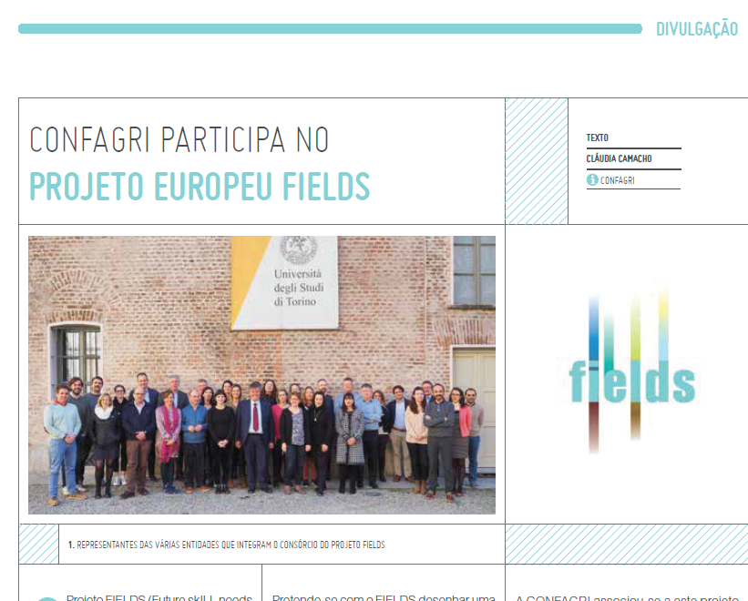
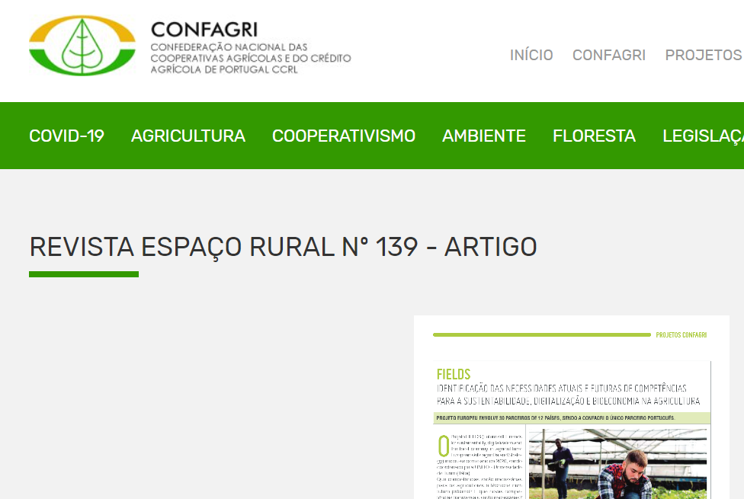
ARTICLES AND PRESS RELEASES
Articles published in relevant journals and specialized magazines
“CONFAGRI participa no projeto Europeu Fields”, Espaço Rural n.º 136, July 2020
https://www.confagri.pt/imprensa/fields-identificacao-das-necessidades-atuais-competencias-sustentabilidade-digitalizacao-bioeconomia-na-agricultura/

Slide 13
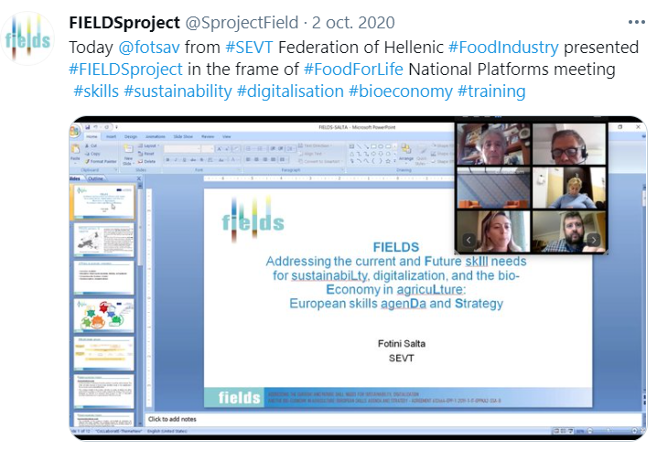
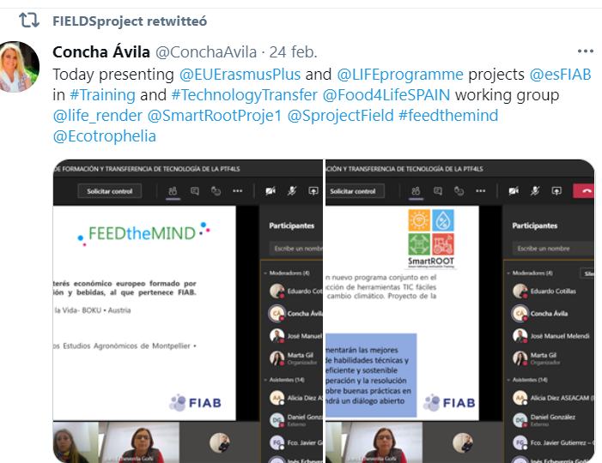
PROJECT PRESENTATIONS
Dissemination in National Food Technology Platforms at the different stages development of the project
Presentation of project goals and works in National Platforms FoodforLife meeting – SEVT (Oct.2020)
Presentation of project goals and works in FoodforLife-Spain working groups meeting – FIAB (Feb.2021)

Slide 14
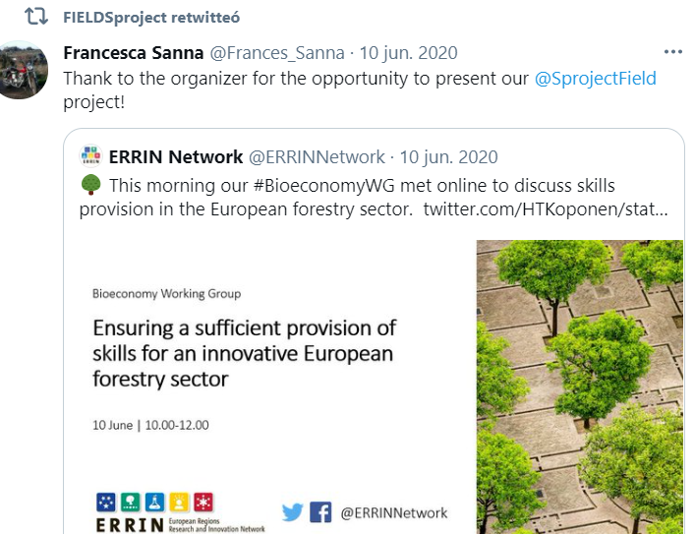
PROJECT PRESENTATIONS
Dissemination in external conferences
Presentation in ERRIN European Regions Research and Innovation Network – UNITO (June 2020)

Slide 15
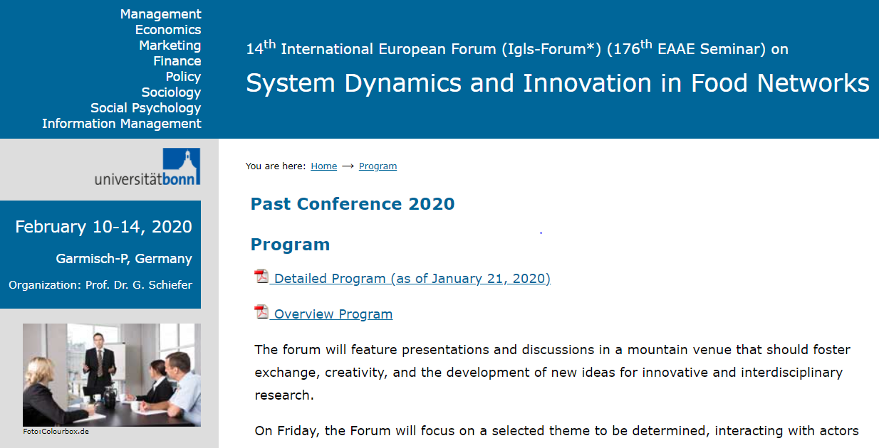
PROJECT PRESENTATIONS
Food Authority Conference - CoUk Novel Food – LVA, Austria
14th International European Forum (Igls-Forum) – UNITO, Germany http://www.fooddynamics.org/fooddynamics2020/program/program.html

Slide 16
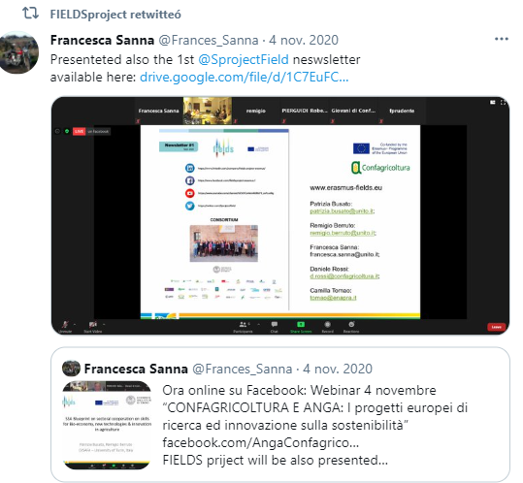
PROJECT PRESENTATIONS
Dissemination of the project through webinar
(Confagricoltura/UNITO, Nov.2020)

Slide 17
SOCIAL NETWORKS
https://twitter.com/SprojectField
https://www.linkedin.com/company/fields-project-erasmus/?viewAsMember=true
https://www.facebook.com/Fields-Project-Erasmus-115331017260054
https://www.youtube.com/channel/UCKFCxHAmRdRLF9_axPy-eNg

Slide 18
FIELDSproject - @SprojectFIELD
Followed by all partners
Promoted in partners accounts
News, pictures, events are published in English and/or partners languages

Slide 19
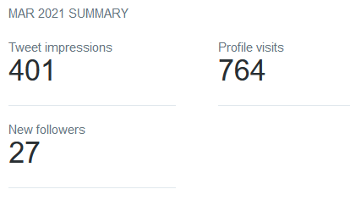
FIELDS figures in Twitter

Slide 20
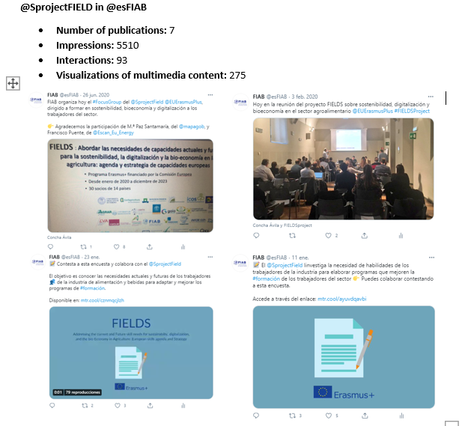
Promotion of FIELDS account from main partners accounts

Slide 21
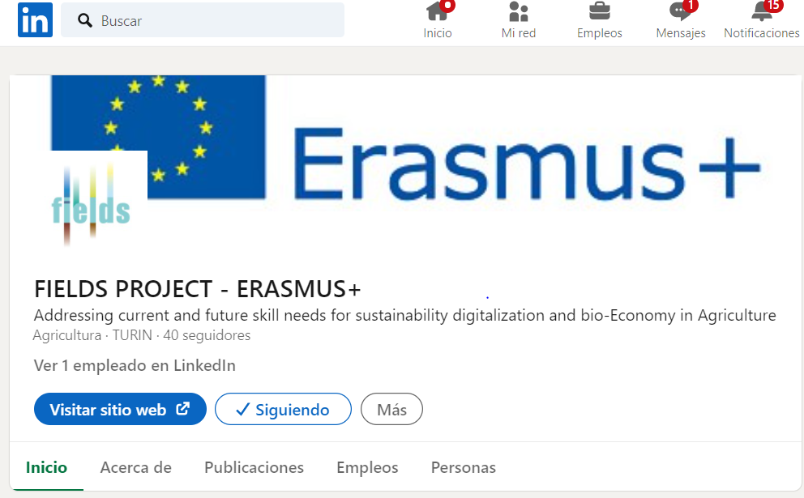

Slide 22
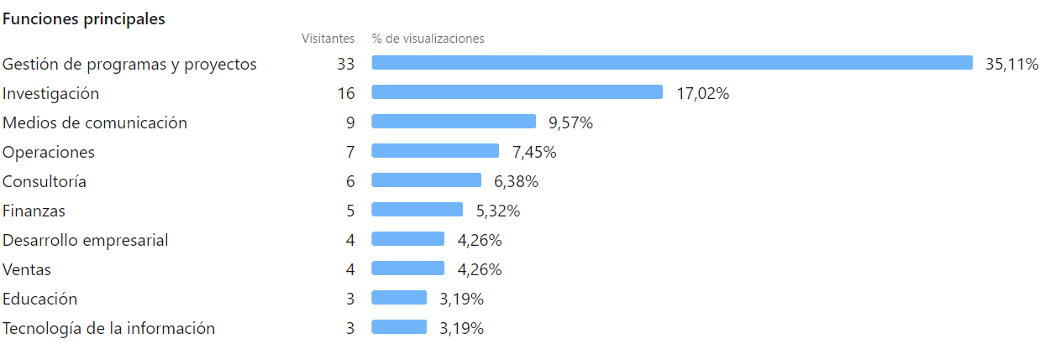
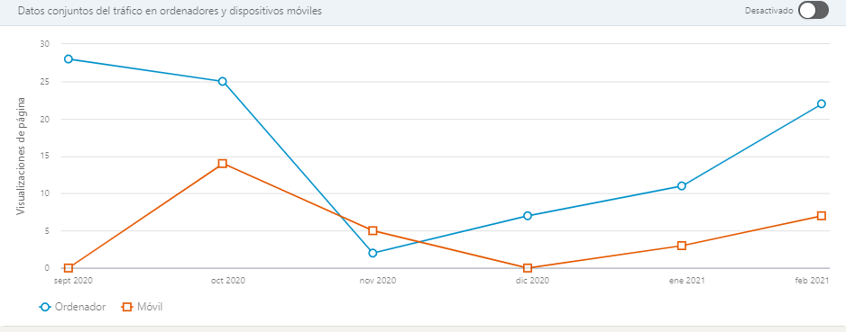

Slide 23
Promotion of FIELDS account from main partners accounts
Example FIAB LinkedIn

Slide 25
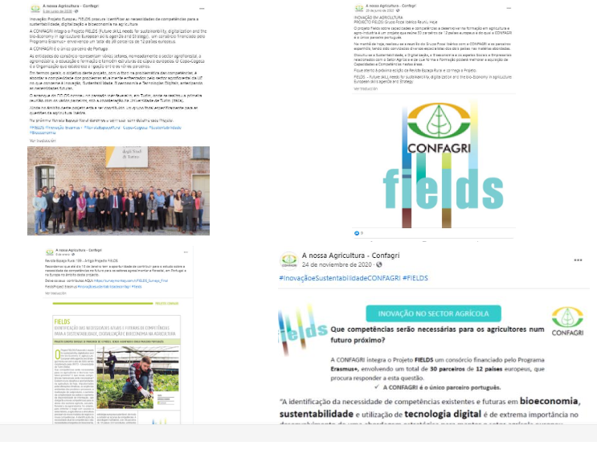
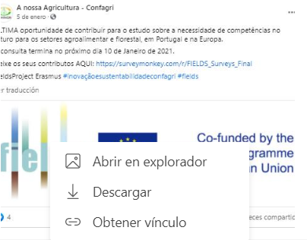

Slide 26
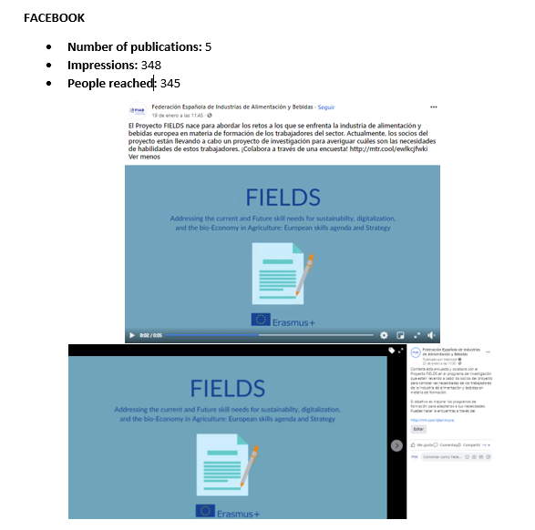
Promotion of FIELDS account from main partners accounts
Example FIAB FACEBOOK

Slide 28
NEXT ACTIVITIES
#2 NEWSLETTER –
Subjects proposed and to be discussed by FIELDS consortium
Project presentation in conferences/meetings with pictures
Results of WP1
YouTube
Videos proposed and to be discussed by FIELDS consortium
Short videos from partners presenting the project
PARTICIATION IN CONFERENCES
15th International European Forum (Igls-Forum) - System Dynamics and Innovation in Food Networks (March 2021, Germany)
Food Murcia Congress (May 2021, Spain)

Slide 29
Thank you for your attention!
Concha Ávila, Spanish Food and Drink Federation - FIAB
c.avila@fiab.es

