Slide 1


FIELDS WP8 - Project Management
Francesca Sanna, Project Manager
Remigio Berruto, Coordinator
5th Project Partnering Meeting – Paris, France
30-31 May 2022

Slide 2
WP8 - Project Management (UNITO) M1-M48
Task 8.1: Decision making and internal communication, M1-M48
D8.1: Consortium agreement (M1)
Task 8.2: Administrative and financial management, M1-M48
D8.2: Intranet (M1)
Task 8.3: Progress monitoring and risk management, M1-M48
D8.3: Progress reports M1, M13, M25, M37, M48

Slide 3
WP8 - Project Management (UNITO)
Management portal / official website
Technical and Financial reporting
Rescheduled activities
Monitoring of the activities and communications among partners
Future activities and next meetings
Remigio Berruto /Francesca Sanna (UNITO)

Slide 4


WP8 - Project Management (UNITO)
Task 8.1: Decision making and internal communication, M1-M48
Change of the Coordinator:
Remigio Berruto instead of Patrizia Busato
Amendment: New affiliated entity: Asociación Galega de Cooperativas Agroalimentarias – AGACA
Linked to Cooperativas Agro-alimentarias
de España- SCOOP
Entered into force the 1st July 2021

Slide 5

Activities and deliverable progress
25 Deliverables submitted, 9 in progress

Slide 6
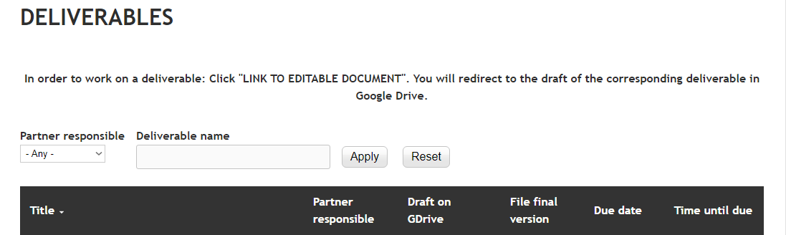
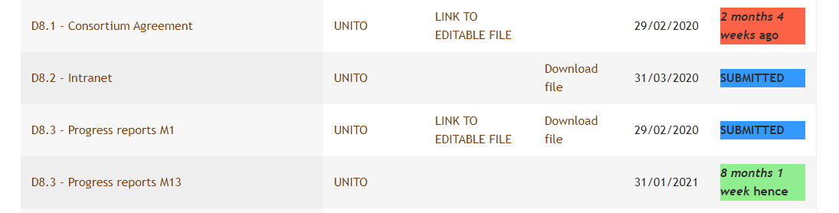
WP8 - Project Management (UNITO)
Task 8.3: Progress report, M1-M48
Progress report M1 submitted the 14/02/2020 (after Kick-off meeting)
Technical-progress report M13 submitted the 05/02/21
Interim report in M25 with pre-financing payment, submitted the 05/03/2022

Slide 7

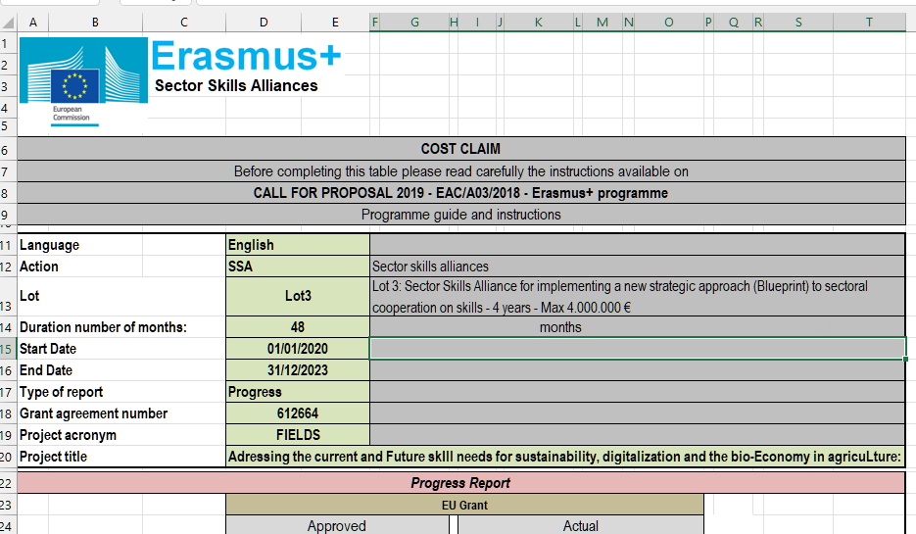

FIELDS progress report, EACEA
Task 8.2: Administrative and financial management, M1-M48
Midterm progress report with pre-financial
Submitted the 05/03/2022
Review meeting with EACEA and representative of DG GROW/DG EMPL
05/04/2022
Evaluation results

Slide 8


WP8 - Project Management (UNITO)
Task 8.2: Administrative and financial management, M1-M48
Webinar on financial issues, use of timesheet template, deadlines etc. – Q/A
Organised in Dicember, before the interim report in M25 with pre-financing payment
https://drive.google.com/file/d/1F2dJ_PAjx4dllZ-S0zhPBhH0w16TMlug/view?usp=sharing

Slide 9
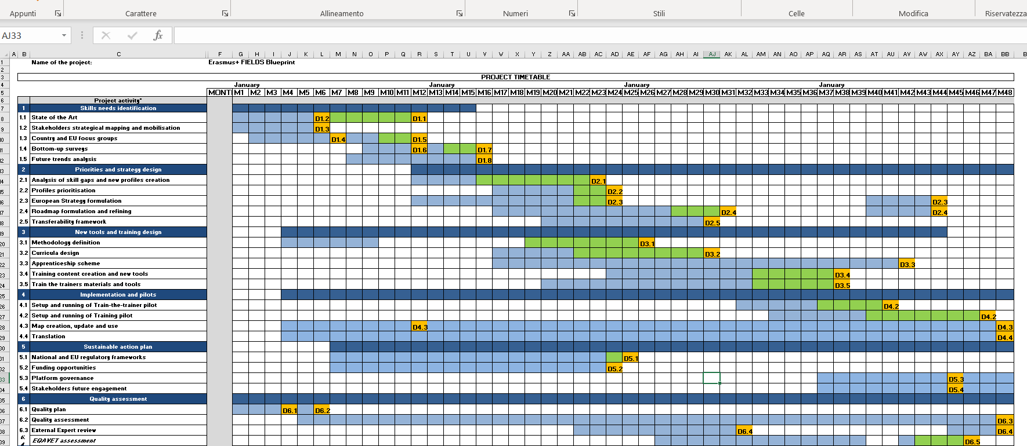
FIELDS rescheduling activities
New scheduled activities, including the reallocation of the days not spent in the first period, in order to complete some tasks as soon as possible considering the delays occurred during last year.
New Gantt chart

Slide 10
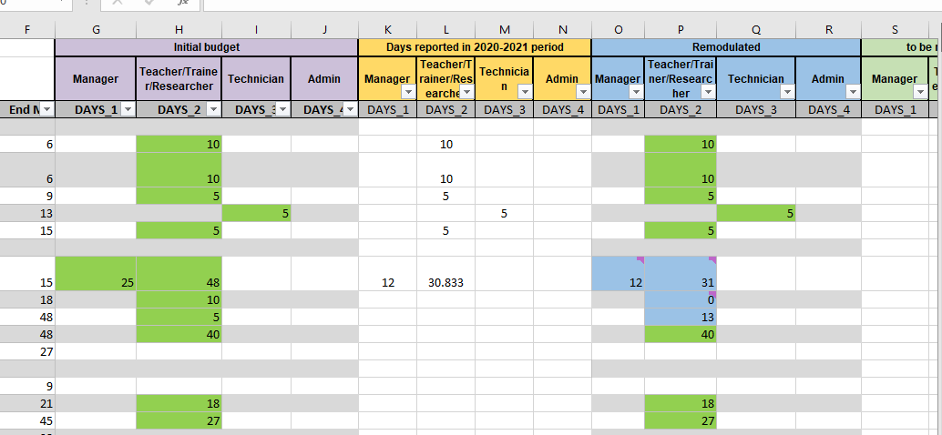
FIELDS rescheduling activities

Slide 11
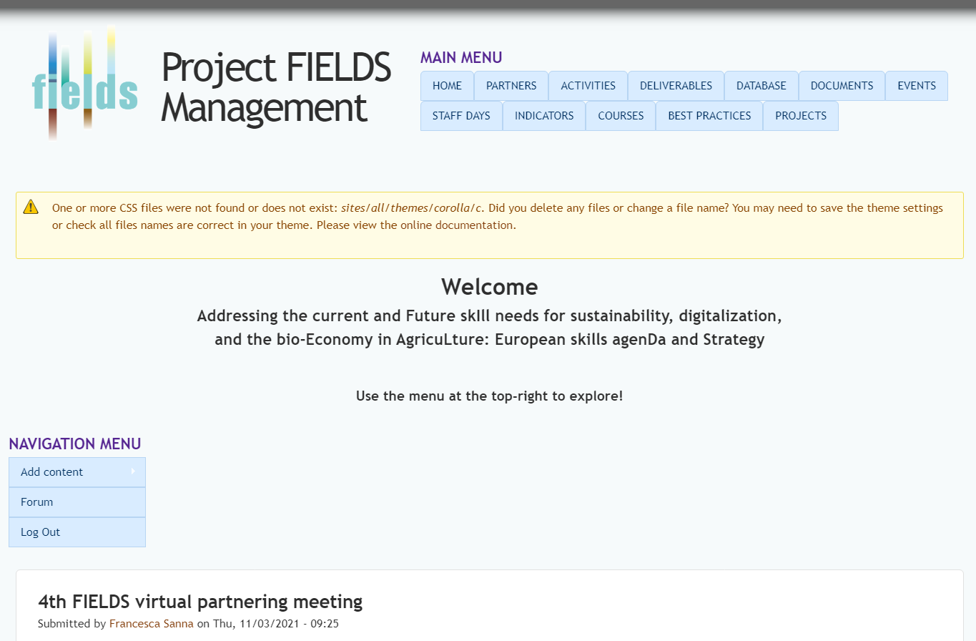
WP8 - Project Management (UNITO)
Task 8.2: Administrative and financial management, M1-M48
http://www.erasmus-fields.eu/management/
D8.2: Intranet (M1)

Slide 12
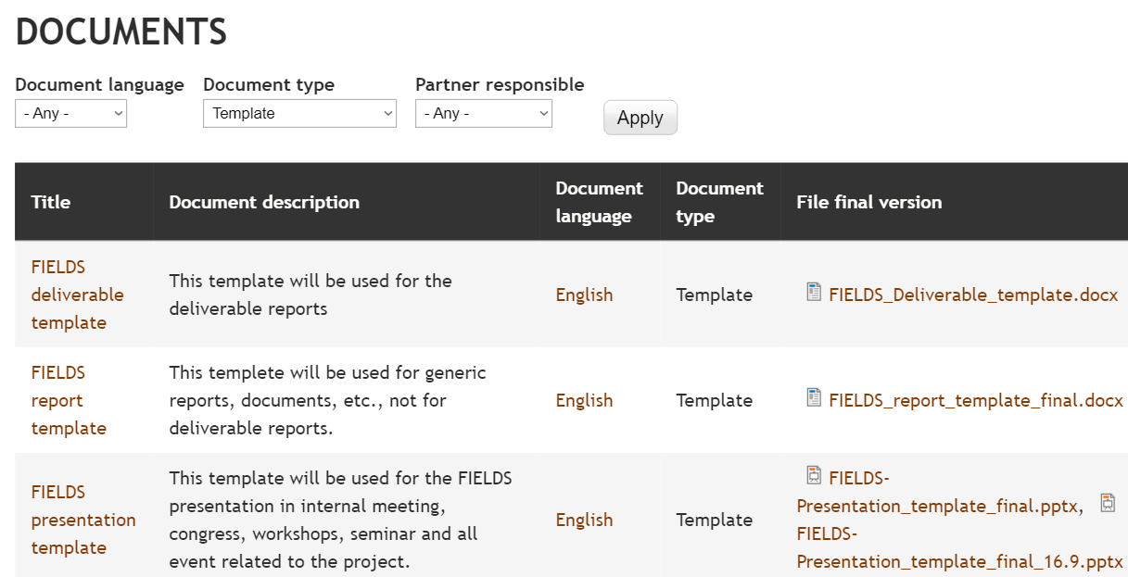
Templates
Task 8.2: Administrative and financial management, M1-M48

Slide 13
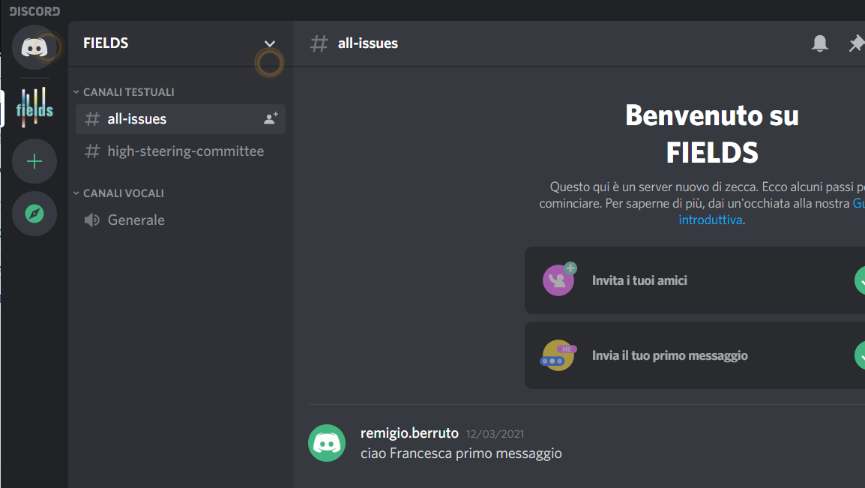






WP8 - Project Management (UNITO)
Official website / Social media

Slide 14

Dissemination
Dissemination on WP1 outcomes
Two articles in preparation (ISEKI), to be submitted in the special issue
"Sustainable Food System in the European Union"
Tentative titles:
1. Skill needs for sustainable agri-food and forestry sectors (I):
assessment through European and National Focus Groups
2. Skill needs for sustainable agri-food and forestry sectors (II):
insights of a European Survey

Slide 15
WP8 - Project Management (UNITO)
Task 8.3: Progress monitoring and risk management, M1-M48
Meeting | Date | Place | Host
Kick-off | M1 | Turin, Italy | UNITO
Management Meeting 1 (MM1) | M13 | Vienna, Austria | ISEKI/LVA
MM2 | M25 | Paris | ANIA
MM3 | M37 | Wageningen, Netherlands | WUR
MM4 | M45 | FIAB | Spain
Final conference in Brussels | M48 | FDE | Brussels
In addition, the HSC will meet also on M6, M18, M31 and M42, with only representatives of the WP leaders. Other partners are welcome to participate.
In addition, a virtual conference call will be organised every 2 months to closely monitor the evolution of tasks and deliverables of the project

Slide 16
Next meetings - calendar
FIELDS MEETINGS 2021
Day | hour start | hour End | Who | Zoom link | Notes
16/09/2021 | 14:30 | 15:30 | Working meeting
23/09/2021 | 14:30 | 15:30 | HSC meeting | https://us02web.zoom.us/j/82339687793
30/09/2021 | 14:30 | 15:30 | Working meeting
14/10/2021 | 14:30 | 15:30 | Working meeting
28/10/2021 | 14:30 | 15:30 | Working meeting
11/11/2021 | 14:30 | 15:30 | Working meeting
18/11/2021 | 14:30 | 15:30 | HSC meeting | https://us02web.zoom.us/j/82339687793
25/11/2021 | 14:30 | 15:30 | Working meeting
09/12/2021 | 14:30 | 15:30 | Working meeting
20/01/2022 | 14:30 | 15:30 | HSC meeting
17/03/2022 | 14:30 | 15:30 | HSC meeting | https://us02web.zoom.us/j/82339687793
TBD |  |  | Working meeting

Slide 17
Questions and comments?
Conclusion and greetings

Slide 18





























Thank you for your attention!
Francesca Sanna, FIELDS project manager
francesca.sanna@unito.it

