Slide 1


FIELDS WP8 - Project Management
Remigio Berruto, Coordinator
remigio.berruto@unito.it
Francesca Sanna, Project Manager
francesca.sanna@unito.it
4th Virtual Project Monitoring Meeting
17 March 2021

Slide 2
WP8 - Project Management (UNITO)
Task 8.1: Decision making and internal communication, M1-M48
D8.1: Consortium agreement (M1)
Task 8.2: Administrative and financial management, M1-M48
D8.2: Intranet (M1)
Task 8.3: Progress monitoring and risk management, M1-M48
D8.3: Progress reports M1, M13, M25, M37, M48
Remigio Berruto /Francesca Sanna (UNITO)

Slide 3
Activities and deliverable progress

Slide 4


WP8 - Project Management (UNITO)
Task 8.1: Decision making and internal communication, M1-M48
Change of the Coordinator:
Remigio Berruto instead of Patrizia Busato
Amendment: New affiliated entity: Asociación Galega de Cooperativas Agroalimentarias – AGACA
Linked to Cooperativas Agro-alimentarias
de España- SCOOP
Please note that an amendment only enters into force when the last party signs the letter confirming agreement with the request for amendment.

Slide 5

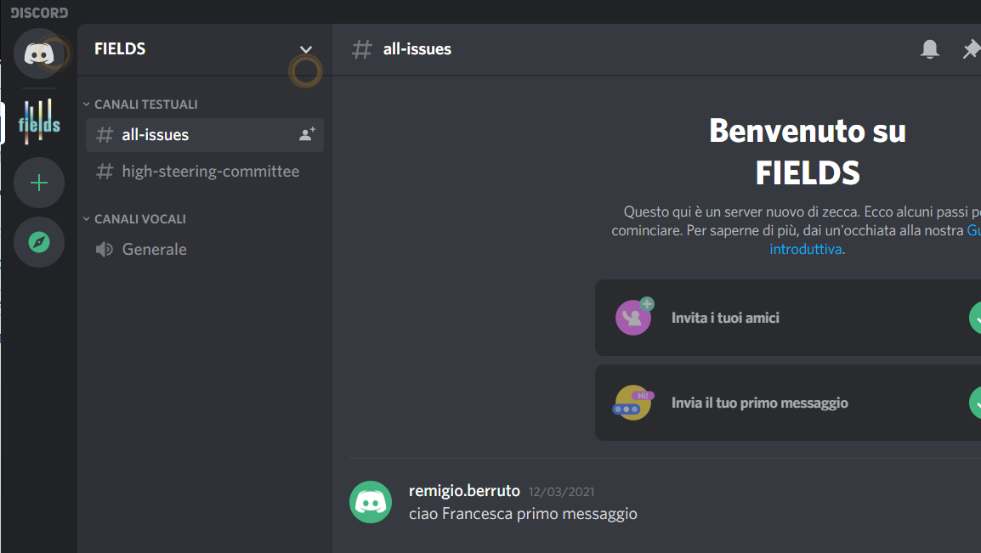


WP8 - Project Management (UNITO)
Task 8.1: Decision making and internal communication, M1-M48
Discord: email address (textual and vocal channels (i.e. for WPs, for HSC, etc.)
Whatsapp: mobile number (textual and vocal groups)

Slide 6

WP8 - Project Management (UNITO)
Task 8.1: Decision making and internal communication (UNITO), M1-M48
D8.1: Consortium agreement (M1)
All signed pages received and submitted

Slide 7

WP8 - Project Management (UNITO)
Task 8.2: Administrative and financial management, M1-M48
http://www.erasmus-fields.eu/management/
D8.2: Intranet (M1)

Slide 8
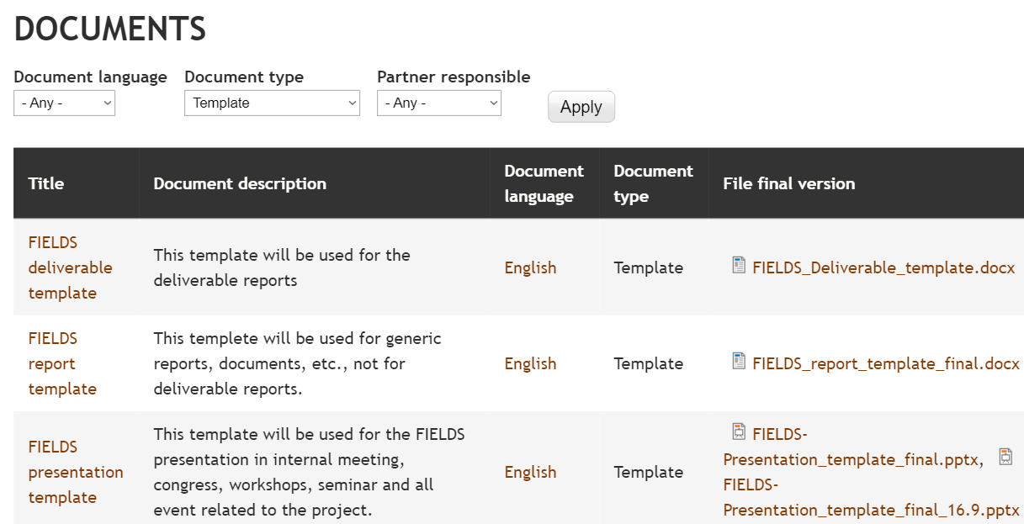
Templates
Task 8.2: Administrative and financial management, M1-M48

Slide 9
WP8 - Project Management (UNITO)
Task 8.2: Administrative and financial management, M1-M48
Financial statement (without pre-financing payment) submitted the 05/02/21

Slide 10
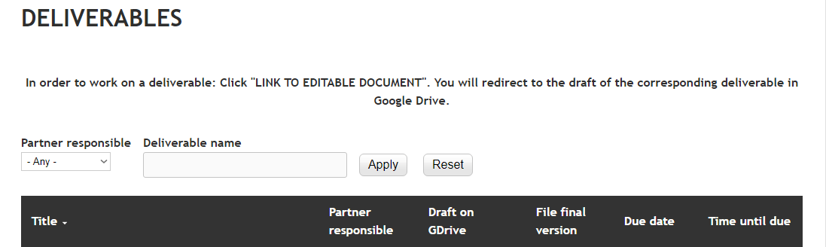

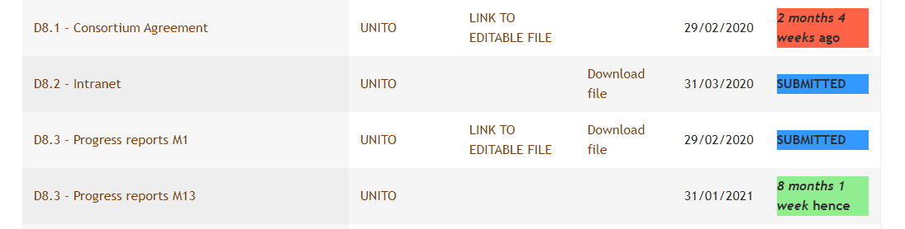
WP8 - Project Management (UNITO)
Task 8.3: Progress report, M1-M48
Progress report M1 submitted the 14/02/2020 (after Kick-off meeting)
Next: Interim report in M25 with pre-financing payment
Technical-progress report M13 submitted the 05/02/21

Slide 11


WP8 - Project Management (UNITO)
Task 8.2: Administrative and financial management, M1-M48
Propose: Webinar on financial issues, use of timesheet template, deadlines etc. – Q/A
To be organised in October/November, before the interim report in M25 with
pre-financing payment

Slide 12
WP8 - Project Management (UNITO)
Task 8.3: Progress monitoring and risk management, M1-M48
Meeting | Date | Place | Host
Kick-off | M1 | Turin, Italy | UNITO
Management Meeting 1 (MM1) | M13 | Vienna, Austria | ISEKI/LVA
MM2 | M25 | Paris | ANIA
MM3 | M37 | Wageningen, Netherlands | WUR
MM4 | M45 | FIAB | Spain
Final conference in Brussels | M48 | FDE | Brussels
In addition, the HSC will meet also on M6, M18, M31 and M42, with only representatives of the WP leaders. Other partners are welcome to participate.
In addition, a virtual conference call will be organised every 2 months to closely monitor the evolution of tasks and deliverables of the project

Slide 13

Next meetings - calendar
FIELDS MEETINGS 2021
Day | hour start | hour End | Who | Zoom link | Notes
25/03/2021 | 14:30 | 15:30 | HSC meeting | https://us02web.zoom.us/j/82339687793
31/03/2021 | 15:00 | 16:30 | WP1/WP2 meeting | https://us02web.zoom.us/j/88456336354
15/04/2021 | 14:30 | 15:30 | Working meeting
29/04/2021 | 14:30 | 15:30 | Working meeting
13/05/2021 | 14:30 | 15:30 | Working meeting
20/05/2021 | 14:30 | 15:30 | HSC meeting | https://us02web.zoom.us/j/82339687793
27/05/2021 | 14:30 | 15:30 | Working meeting
10/06/2021 | 14:30 | 15:30 | Working meeting
24/06/2021 | 14:30 | 15:30 | Working meeting
08/07/2021 | 14:30 | 15:30 | Working meeting
22/07/2021 | 14:30 | 15:30 | HSC meeting | https://us02web.zoom.us/j/82339687793
05/08/2021 | 14:30 | 15:30 | Working meeting
02/09/2021 | 14:30 | 15:30 | Working meeting
16/09/2021 | 14:30 | 15:30 | Working meeting
23/09/2021 | 14:30 | 15:30 | HSC meeting | https://us02web.zoom.us/j/82339687793
30/09/2021 | 14:30 | 15:30 | Working meeting
14/10/2021 | 14:30 | 15:30 | Working meeting
28/10/2021 | 14:30 | 15:30 | Working meeting
11/11/2021 | 14:30 | 15:30 | Working meeting
18/11/2021 | 14:30 | 15:30 | HSC meeting | https://us02web.zoom.us/j/82339687793
25/11/2021 | 14:30 | 15:30 | Working meeting
09/12/2021 | 14:30 | 15:30 | Working meeting
20/01/2022 | 14:30 | 15:30 | HSC meeting
17/03/2022 | 14:30 | 15:30 | HSC meeting | https://us02web.zoom.us/j/82339687793
TBD |  |  | Working meeting

Slide 14
Questions and comments?
Conclusion and greetings

Slide 15




























Thank you for your attention!
Francesca Sanna, FIELDS project manager
francesca.sanna@unito.it

