Slide 1


FIELDS project meeting
Francesca Sanna, Project Manager
Remigio Berruto, Coordinator
5th Partnering Meeting – Paris, France
30-31 May 2022

Slide 2
Agenda
Day 2 | Project results & Future activities | Contributors
9:15 | Welcome Coffee
9:30 | WP5 – Sustainable action plan (ICOS) Task 5.1: National and EU regulatory frameworks (ConfagriPT) Task 5.2: Funding opportunities (LLL-P), M7-M20 | Billy Goodburn D. Godinho (Confagri PT) E. Somlyay/P. Boivin (LLL-P)
10:20 | WP5 – Q/A
10:30 | WP6 – Quality Assessment (CERTH) Task 6.2 - Quality assessment (EFB) 5 min Task 6.3: HAB and External Expert review (EFB), 10 min Task 6.4: EQAVET assessment (INFOR), 10 min | D. Bochtis/E. Rodias Christos Koidis Dimitrios Aidonis (EFB) Giuseppe Vanella (INFOR)
10:55 | WP6 – Q/A
11:00 | Coffee break

Slide 3
Agenda
Day 2 | Project results & Future activities | Contributors
11:30 | WP7 - Dissemination and communication (ACTIA) Task 7.2: Communication and dissemination campaign (FIAB), | Christophe Cotillon Gemma Cornuau Concha Avila (FIAB) , all
11:45 | WP7 – Q/A
11:50 | WP8 - Project Management (UNITO) Management portal / official website Technical and Financial reporting Rescheduled activities Monitoring of the activities and communications among partners Future activities and next meetings | Remigio Berruto Francesca Sanna F. Sanna / R. Berruto (UNITO)
12:15 | Project Questions and Comments
13:00 | Conclusion and greetings

Slide 4

Questions and comments
At the end of the WP session

Slide 5
WP5 – Sustainable action plan (ICOS)
Task 5.1: National and EU regulatory frameworks (ConfagriPT), M7-M20
  D5.1: Regulatory framework list (M24)
Domingos Godinho (ConfagriPT)
Task 5.2: Funding opportunities (LLL-P), M7-M24
  D5.2: Funding opportunity (M24)
Erika María Rodríguez Somlyay (LLL-P)

Slide 6
WP6 – Quality Assessment (CERTH)
Task 6.1 – Quality Plan (CERTH)
  D6.1: Quality plan M1-M4
  D6.2: Evaluation Grids (INFOR), M5-M6
Efthymios Rodias (CERTH)
Task 6.2 – Quality assessment (EFB) M5-M48)
  D6.3. Internal quality assessment (M48)
Task 6.3: HAB and External Expert review (EFB)
  D6.4. EE quality assessment (M32&M48)
  Christos Koidis/Dimitrios Aidonis (EFB)
Task 6.4: EQAVET assessment (INFOR)
  D6.5: ECVET accreditation report (M42)
Giuseppe Vanella (INFOR)

Slide 7

5th Project Meeting - Paris
Coffee break
See you at 11:20

Slide 8
WP7 - Dissemination and communication (ACTIA)
Task 7.1: Dissemination plan (LVA), M1-M9
  D7.1 Dissemination plan (M9) - DONE
Task 7.2: Communication and dissemination campaign (FIAB), M1-M48
  D7.2: Public Website (M3) - DONE
  D7.3: Project leaflet and poster (M6) - DONE
  D7.4: Report on dissemination action (M48)
Concha Avila (FIAB)
Newsletter
Social media

Slide 9

Dissemination
Dissemination on WP1 outcomes
Two articles in preparation (ISEKI), to be submitted in the special issue
"Sustainable Food System in the European Union"
Tentative titles:
1. Skill needs for sustainable agri-food and forestry sectors (I):
assessment through European and National Focus Groups
2. Skill needs for sustainable agri-food and forestry sectors (II):
insights of a European Survey
Forthcoming events/workshops
Next Project/Partnering meeting ?

Slide 10
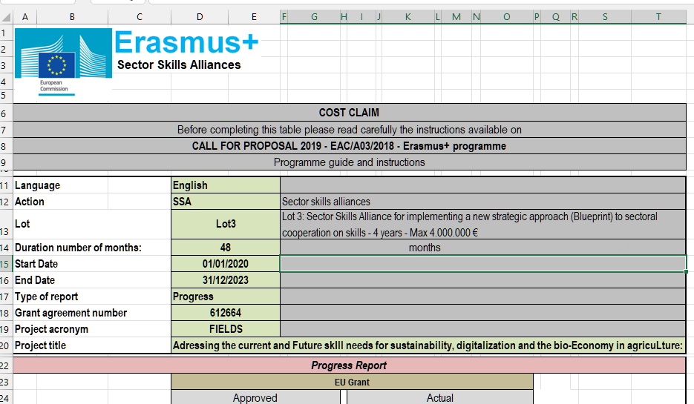

FIELDS progress report, EACEA
Midterm progress report with pre-financial
Submitted the 05/03/2022
Review meeting with EACEA and representative of DG GROW/DG EMPL
05/04/2022
Evaluation results by 60 days from the submission

Slide 11





























Thank you for your attention!
Francesca Sanna, FIELDS project manager
francesca.sanna@unito.it

